Slide 1
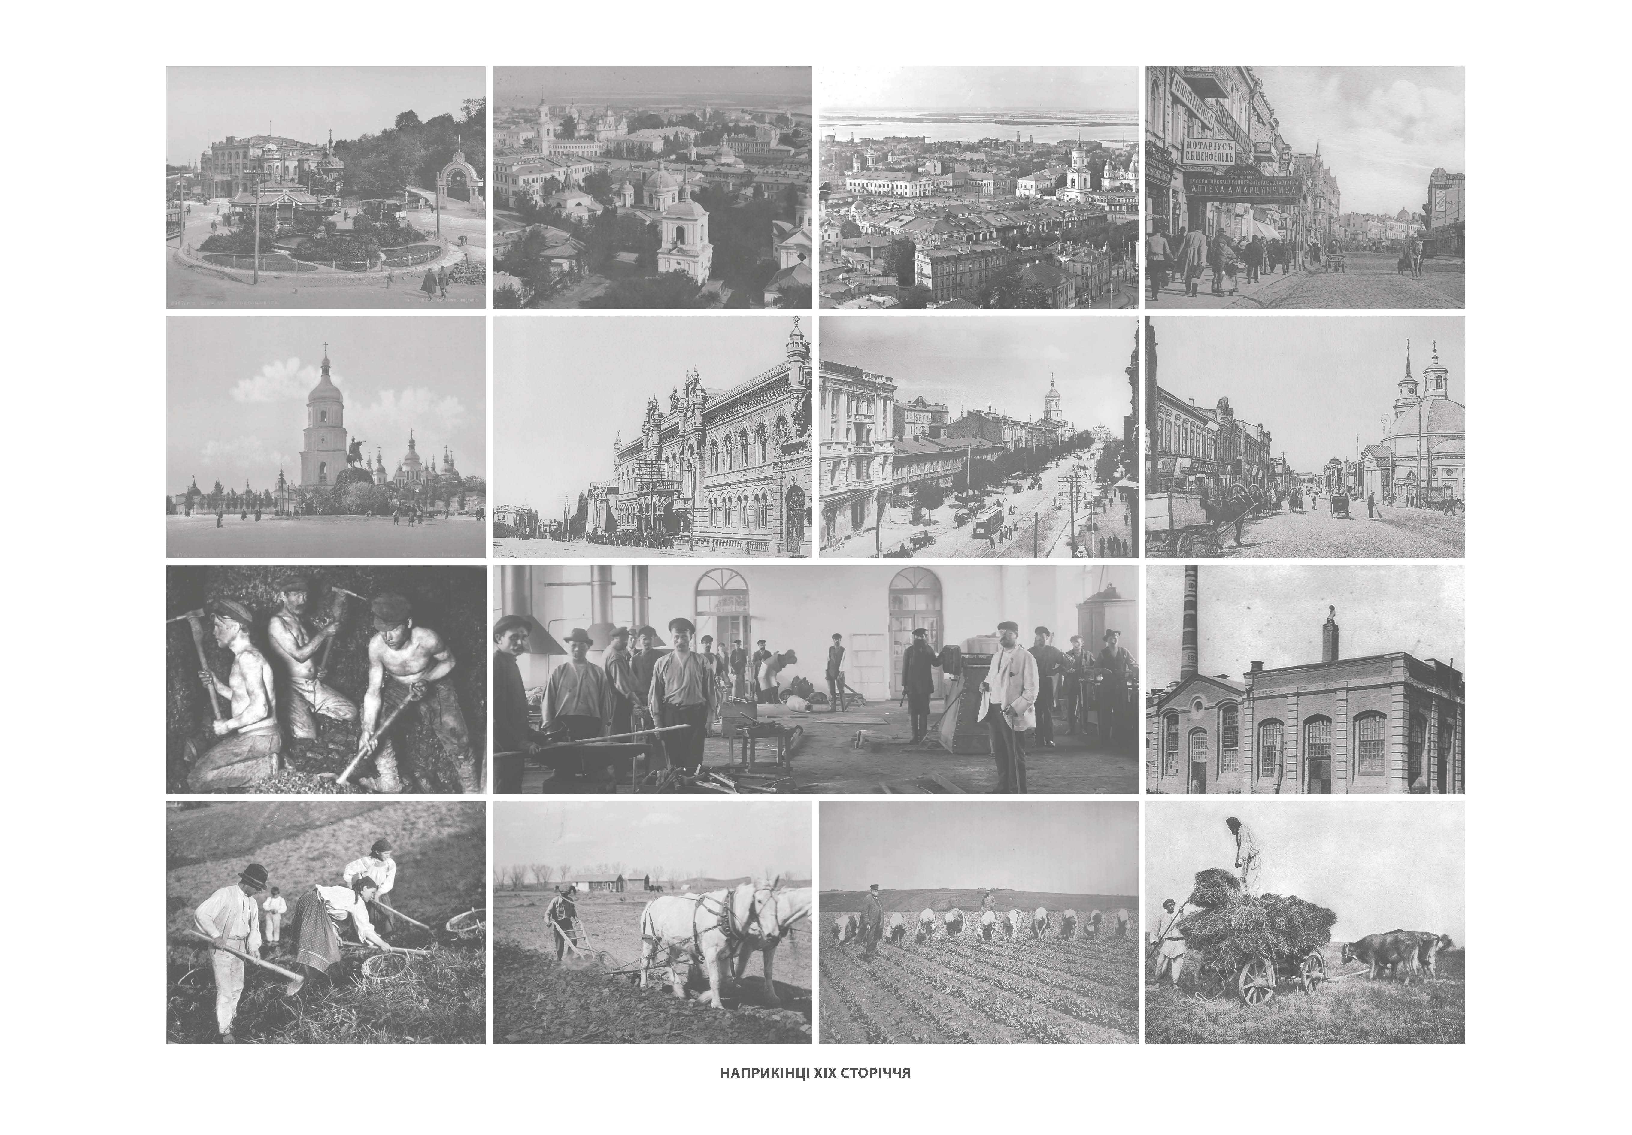

Thematic Atlas
“Settlement network of Ukraine
(Formation and Development)"
Institute of Geography
of the NAS of Ukraine
Leonid Rudenko, Alla Bochkovska, Marharyta Vyshnia,
Oleksandr Leiberiuk, Victoria Podvoiska, Kateryna Polyvach

Slide 2
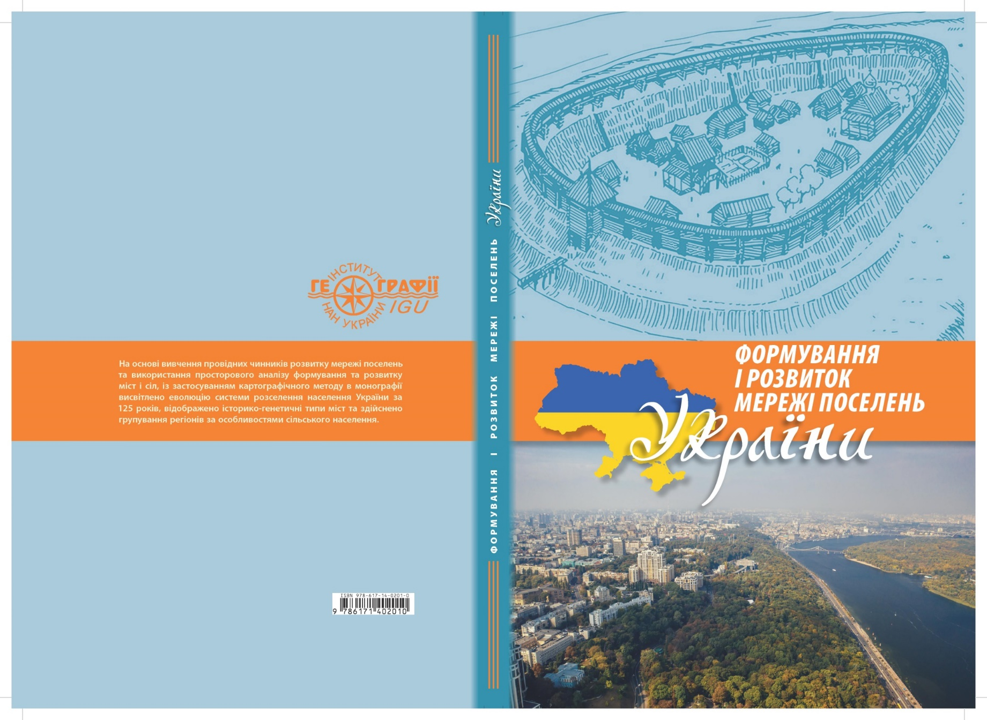
Monograph ‘Formation and development of the network of settlements in Ukraine (cartographic analysis)’, 2023
Based on the study of the leading factors in the development of the network of settlements and the use of spatial analysis of the formation and development of cities and villages, using the cartographic method, the monograph highlights the evolution of the settlement system of Ukraine over 125 years, reflects the historical and genetic types of cities and groups regions by the characteristics of the rural population

Slide 3
CONTENTS
Introduction
1. Geographical approach and main natural and geographical factors in the study of the settlement network
2. The main socio-geographical factors of the formation and development of settlements
2.1. Urbanisation
2.2. Demographic processes and social sphere
2.3. Migration processes
2.4. Natural and cultural heritage
2.5. Changes in organisational forms of management in Ukraine
2.6. Globalisation processes
3. Formation of a database for the cartographic study of the network of settlements in Ukraine
4. The urban settlement network: a cartographic cross-section of historical changes and main factors of development
4.1. Historical and genetic types of cities
4.2. Types of urban settlements by changes in their population
4.3. Functional typification of cities
5. Rural settlement network
5.1. Changes in the settlement of the rural population of Ukraine
5.2. Types of maps by indicators of transformational changes in the settlement of the rural population
5.3. Typification of regions by changes in the size of the rural population
5.4. Transformational changes in the settlement of the rural population within territorial communities of Ukraine (2001-2022)
6. Geographical cartography and cartographic monitoring of the study of space and destruction of settlements
7. Justification of the thematic content of the series of monitoring maps
8. Methodological approaches to the production of electronic monitoring maps
Conclusions

Slide 4
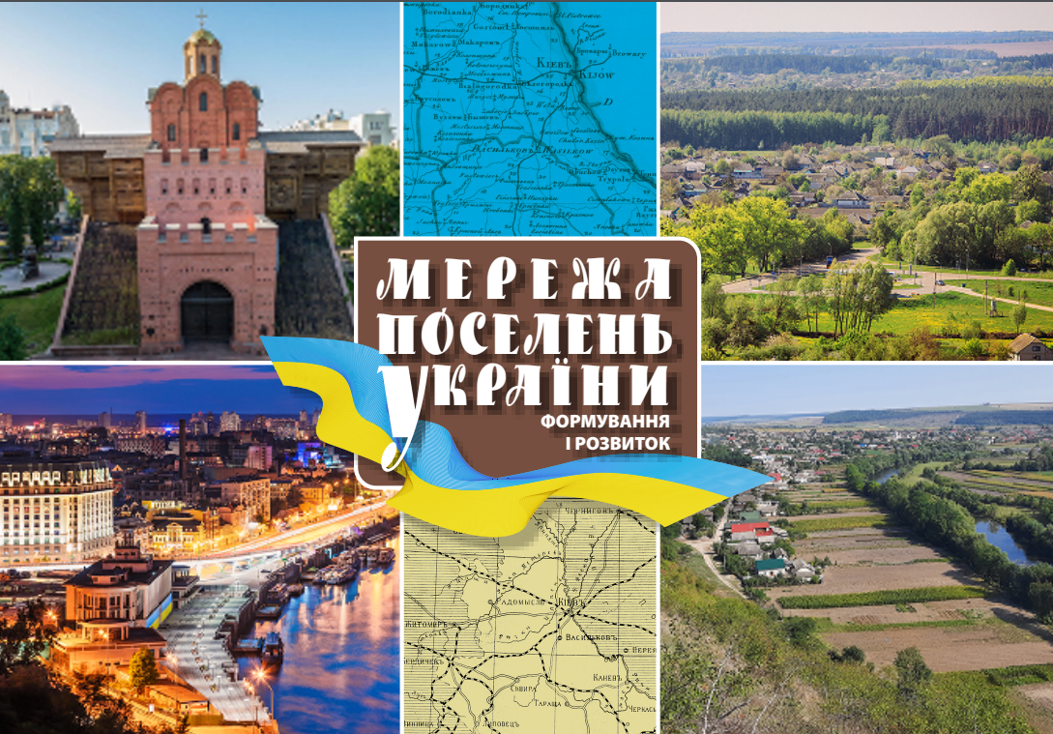

The Atlas
Settlement Network of Ukraine
(Formation and Development) was prepared by the Cartography Department of the Institute of Geography of the NAS of Ukraine under the editorship of Prof. L.Rudenko and published in 2024
The Atlas contains 32 maps that visualize information on regional and local population distribution, geography of settlements, their number, density, population, development dynamics and history

Slide 5
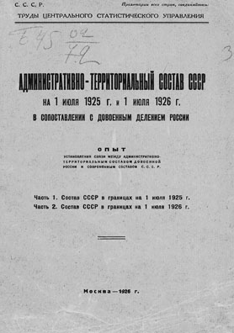


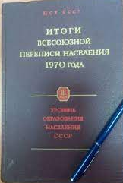
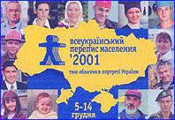
The maps are based on data from Сensuses on Ukrainian lands
from 1897 to 2001 and subsequent statistical observations
The structure of the Atlas and the maps content are based on the Institute's own researches as well as publications of the results of studies of specialized institutes of the NAS of Ukraine. These results are briefly included in the text descriptions of the Atlas maps. They reveal the main characteristics of the complex process of settlement network formation in Ukraine

Slide 6
STRUCTURE OF THE ATLAS
Urban population and urban settlement network
1. Ukraine. Population of regions (2022)
2. Changes in population density and size (1897-2022)
3. Urban population
4. Potential of regions in terms of urban population
5. The network of settlements (2001)
6. Formation of the urban network
7. Structure of the modern urban network (by historical and genetic types of cities)
8. Structure of urban settlements
9-17. Changes in the population of urban settlements (1897-1926; 1926-1939; 1939-1959; 1959-1970; 1970-1979;
1979-1989; 1989-2001; 2001-2021; 1897-2021)
18. Urban settlements within the Joint Forces Operation (JFO) until 24.02.2022.
Rural population and rural settlement network
19-21. Change in the number of rural population (1959-1970; 1070-1989; 1970-2022). Density of rural settlements (1970,
1989, 2022)
22-26. Regional potential in terms of rural population (1970, 1979, 1989, 2001, 2022)
27-28. Change in the number of rural population in the regions (2022 to 1959) (2001-2022)
29-30. Rural population density in communities (2001, 2022)
31. Rural settlements excluded from the state accounting
32. Prospective changes in the status of settlements in Ukraine in 2023

Slide 7
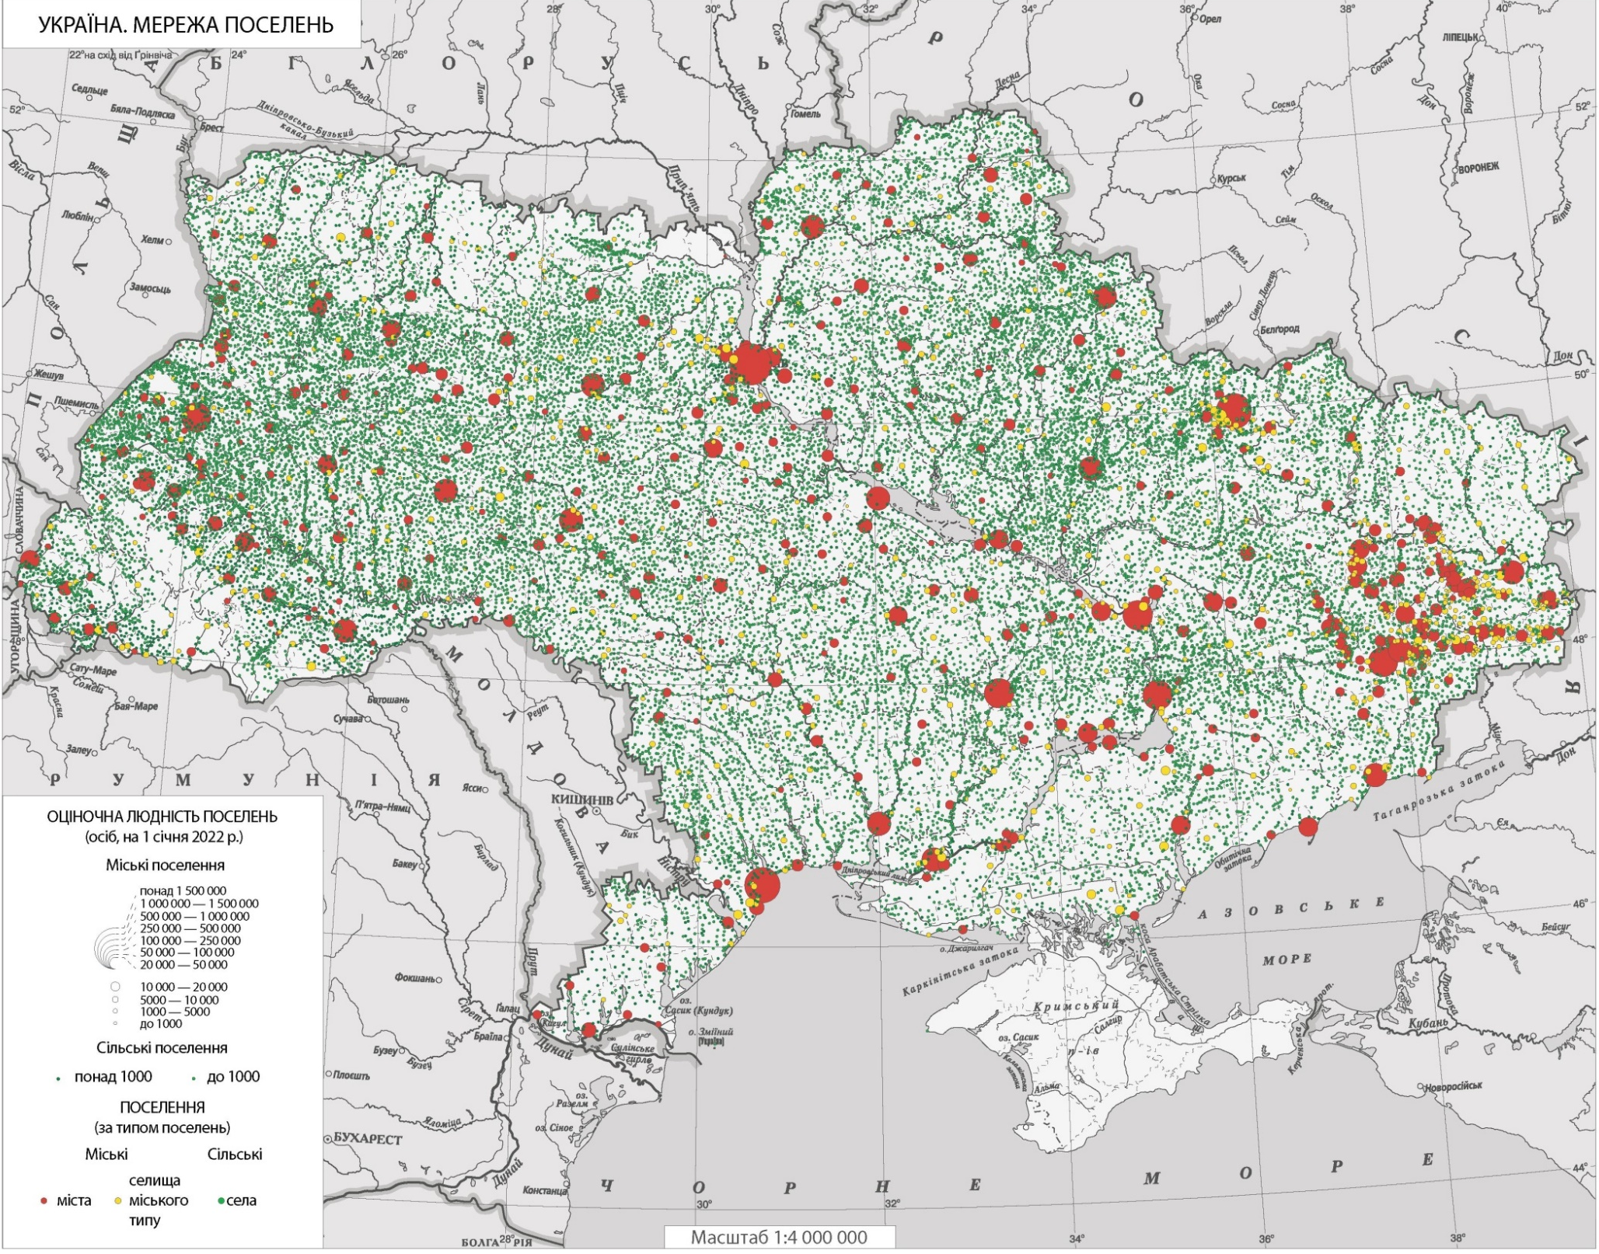
Settlement Network
At the beginning of 2001 (according to the latest census), there were 29795 settlements in Ukraine: 454 cities, 889 urban-type settlements, and 28452 rural settlements. Most of the urban population is - 35% - lives in cities with populations over 500,000.

Slide 8
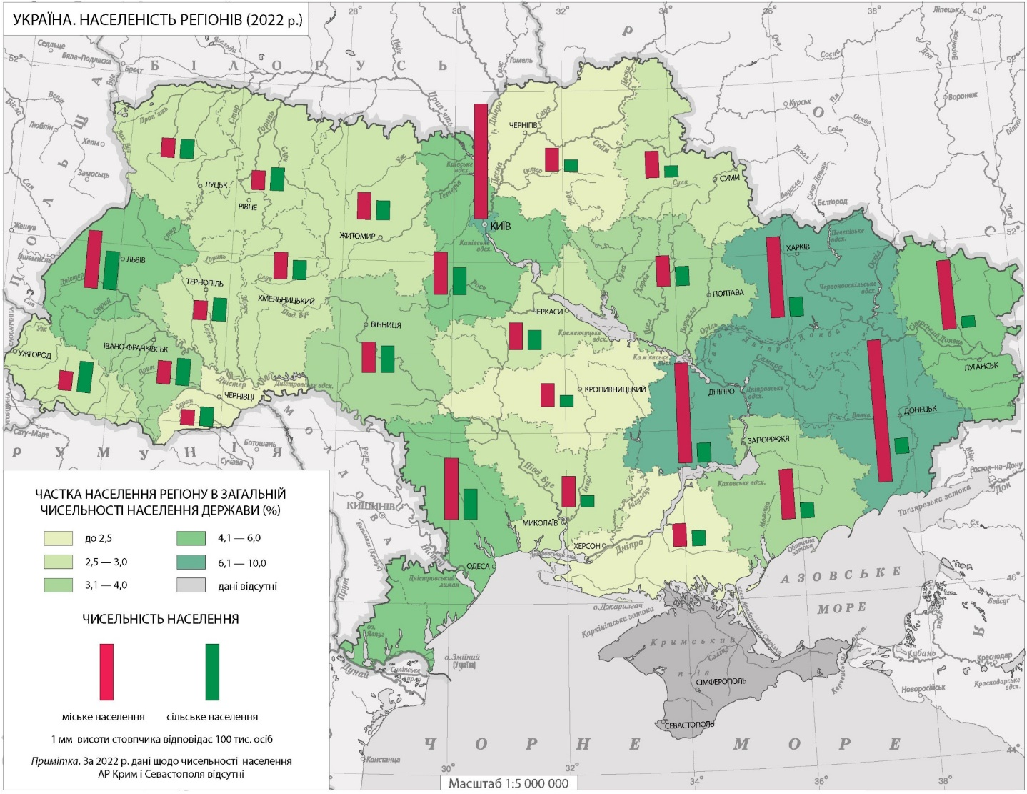
Population of Regions (2022)
The industrialized areas of eastern Ukraine are the most populated regions, with almost 10% of the national population living in Donetsk Oblast. The least of all is concentrated in the southern (Mykolaiv, Kherson Oblasts), the western and Polissya regions.

Slide 9

Changes in Population Density and Size
(1897-2022)
Over the past 100 years (1926-2020), the population on Ukrainian lands has fluctuated significantly, reaching its highest level of 51.7 million in the 1989 census. Currently, in 2021, the pre-war year, it amounted to 42.6 million people (including Crimea and Donbas). The population density and structure have undergone significant changes. In industrial areas, the change in population density reached up to 400%. The share of urban population has increased significantly - from 19% in 1926 to 70% in 2021.

Slide 10
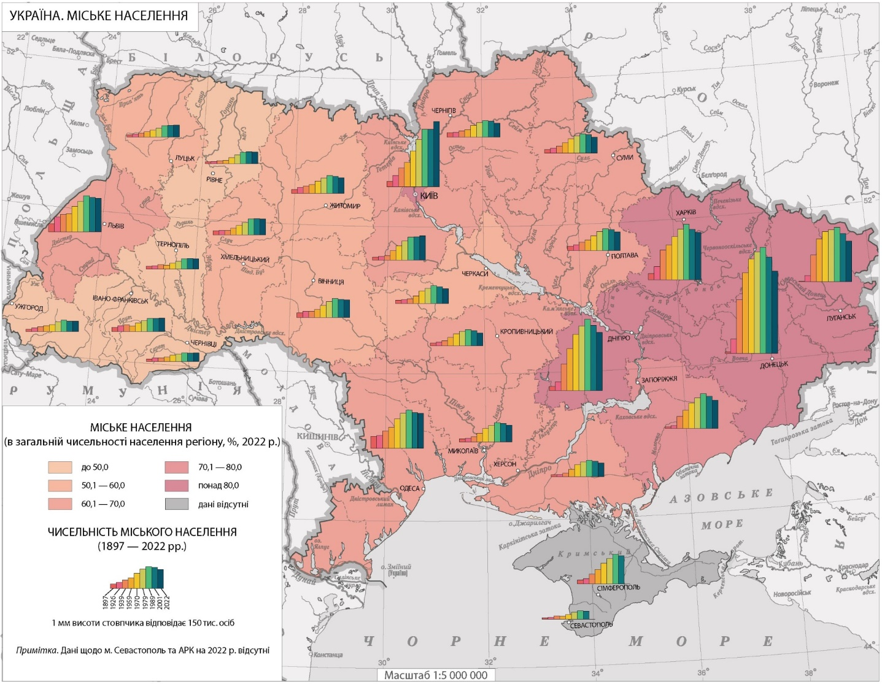
Urban Population
The industrial east (up to 80%) and the agrarian west (up to 50%) still stand out in terms of the number and share of the population of regions in Ukraine. However, the rural population does not prevail in any of the regions as of 2022. Its number in most regions has been declining since the early 1990-s or, as in some western regions, has stabilized.

Slide 11
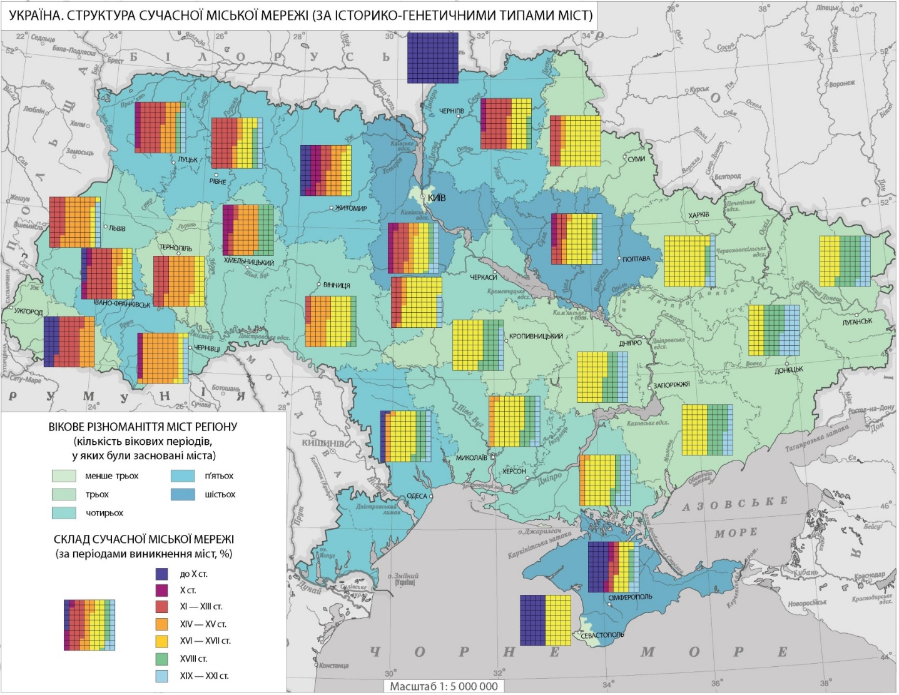
Structure of the Modern Urban Network by Historical and Genetic Types of Cities
Ukraine is a country with a long history of urban development. The first cities on the modern Ukrainian lands were founded in the northern Black Sea region and on the southern coast of Crimea by the ancient Greeks and Romans in the VI-IV centuries BC. In mainland Ukraine, more than 20 cities founded in the 9th-10th centuries have survived and are still functioning as administrative centers. Some of them predate the emergence of the first state on Ukrainian lands, Kyivan Rus. Among them are Kyiv, Zhytomyr, and Chernihiv.

Slide 12
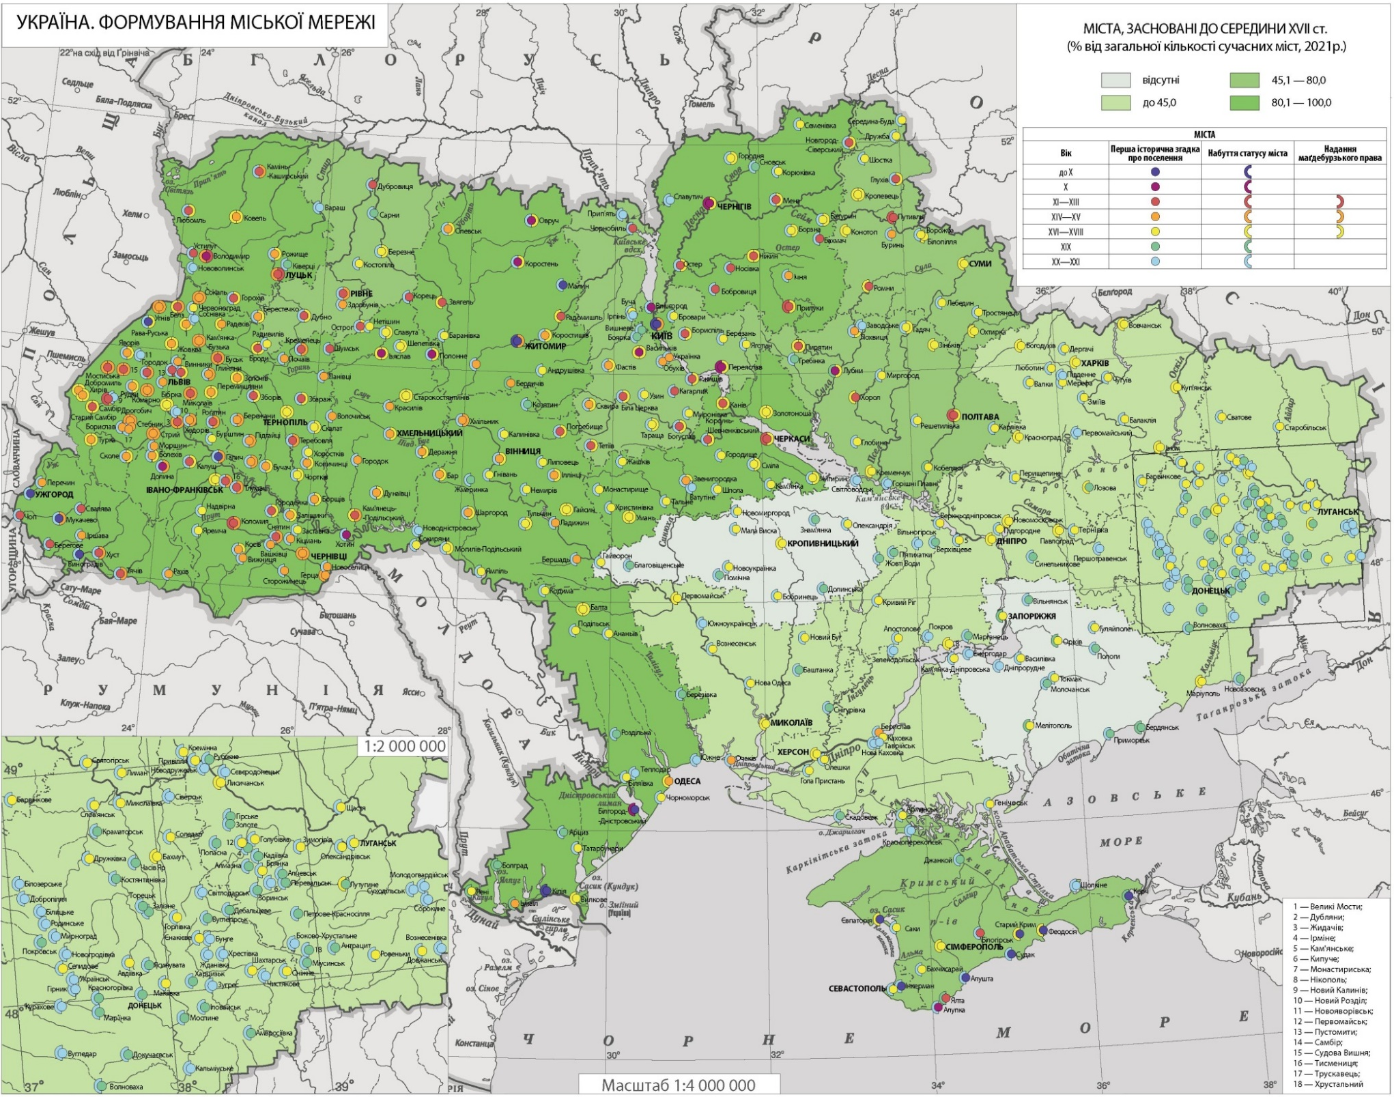
Formation of the urban network
The urban network of the Dnipro Right Bank is characterized by the most age diversity. The eastern regions (“Dyke Pole”) began to develop much later, with the beginning of active economic development in the XVIII century

Slide 13
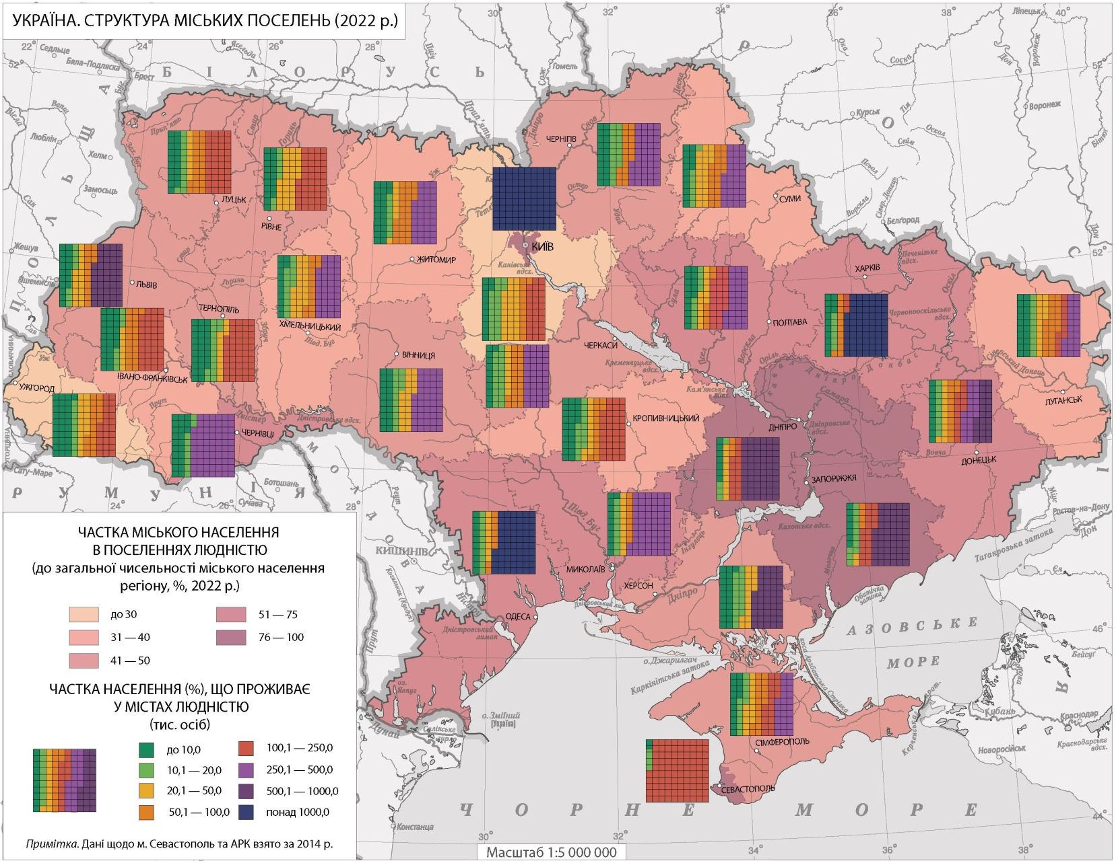
Structure of Urban Settlements
As of the 2001 census, there were 454 cities in Ukraine. Of these, the largest number of cities are those with less than 50 th inhabitants. They account for 22% of the total population of Ukrainian cities. 13% of the population lives in 56 cities with a population of 50.0-100.0 th people, 30% of the population lives in 36 cities with a population of 100.0-500.0 th people, and 35% of the total population of Ukrainian cities live in the largest cities with a population of over 500 th people (including 5 cities with a population of over 1 million people).

Slide 14
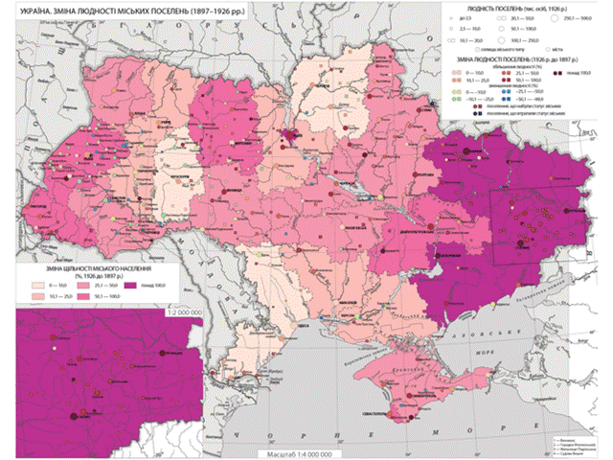
Changes in the Population of Urban Settlements
The Atlas presents a group of maps showing changes in urban population density and urban settlement population for the census years (1897 to 2001) and estimated maps for 2022. Urban population growth was most active in the period 1926-1939, during the period of intensive industrialization in the USSR. This is especially true for the eastern industrial regions. Since 1970, there has been a downward trend in urban population, especially in the eastern regions. These trends became most noticeable in the last intercensal period of 1989-2001, when the population of most cities in all regions of Ukraine decreased. In the period 2001-2022, a small increase in population is observed in a small number of cities on the Right Bank and even less on the Left Bank. The remaining cities in all regions, especially in Donbas, are experiencing a significant decrease in population.

Slide 15
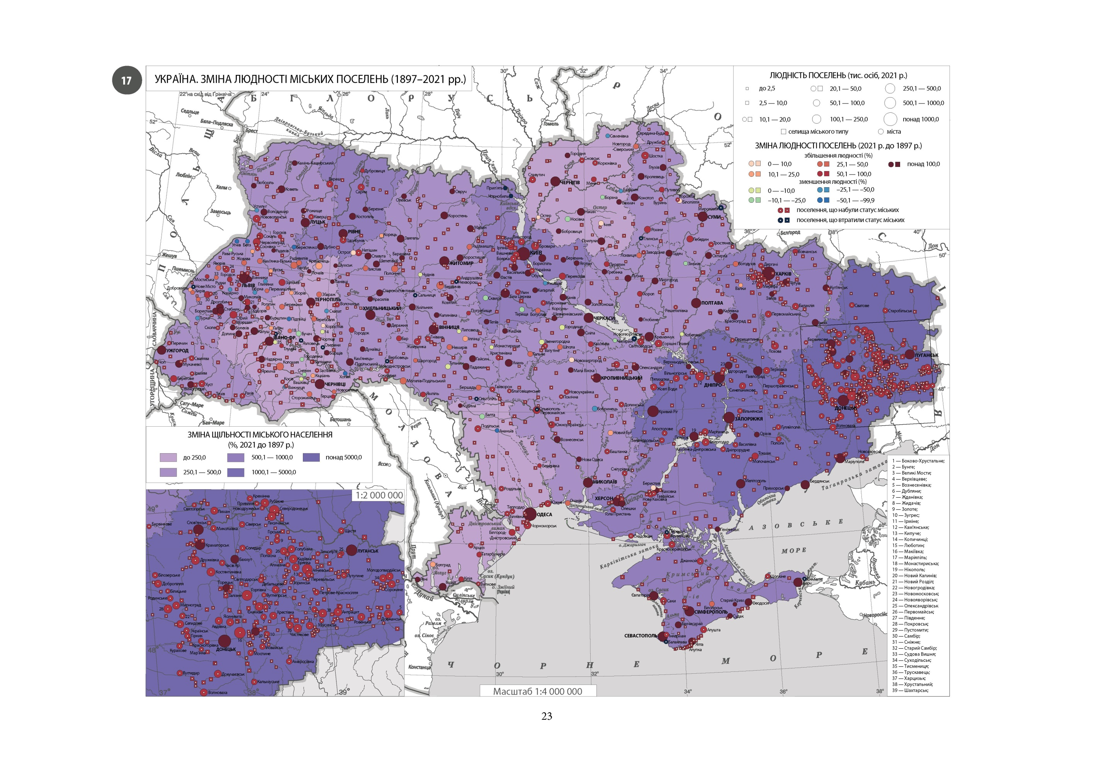

Slide 16
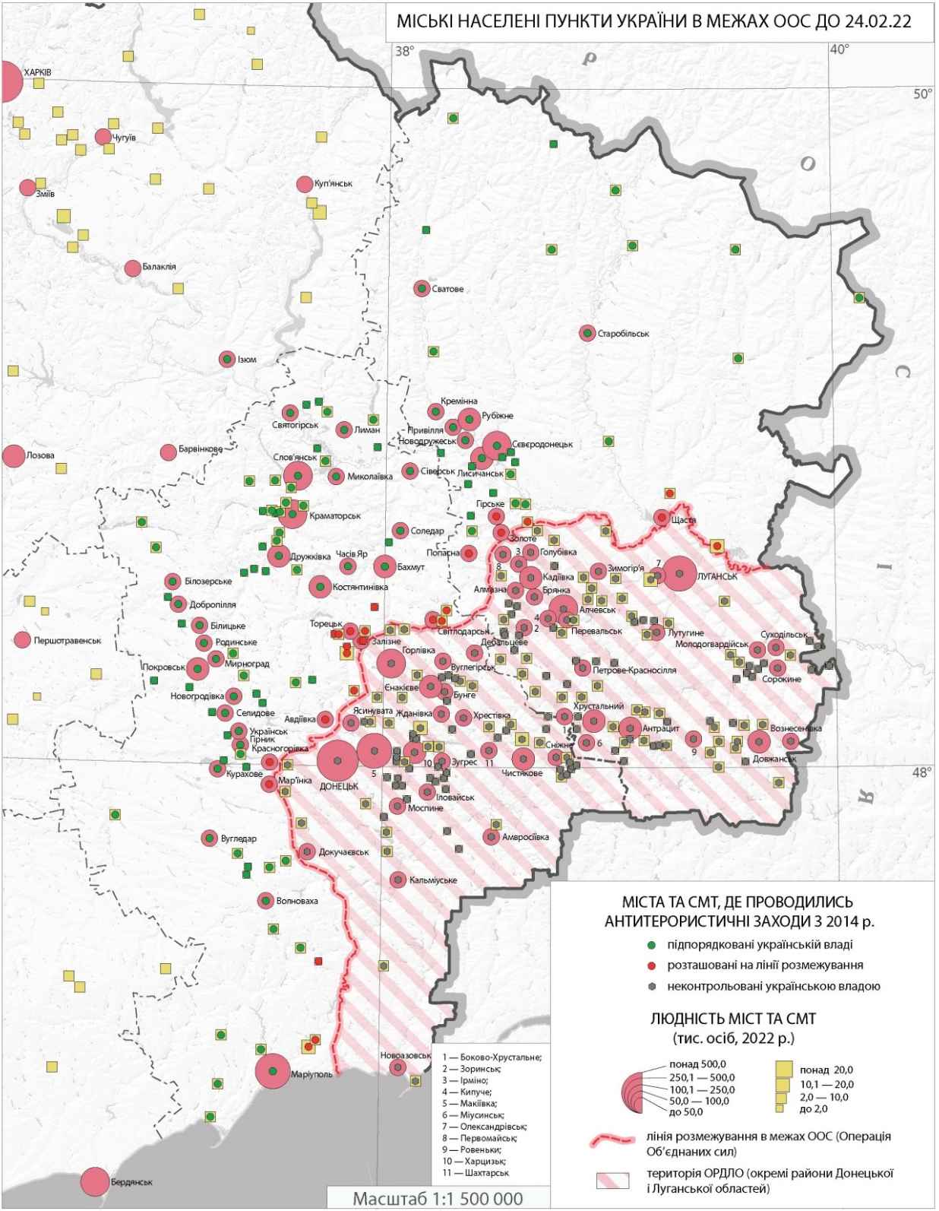
Urban Settlements within the
Joint Forces Operation (JFO)
until 24.02.2022
The series of maps of the urban settlement network concludes with a map showing the state of a part of Ukraine's urban network before the full-scale invasion of Ukraine by the russia. By this time, most of the industrialized cities in Donetsk and Luhansk oblasts were occupied by russia since 2014. In the administrative division of Ukraine, they were recognized as ORDLO - "separate districts of Donetsk and Luhansk regions". This map is one of a forthcoming series of historical maps on the war that russia launched against Ukraine 10 years ago.

Slide 17
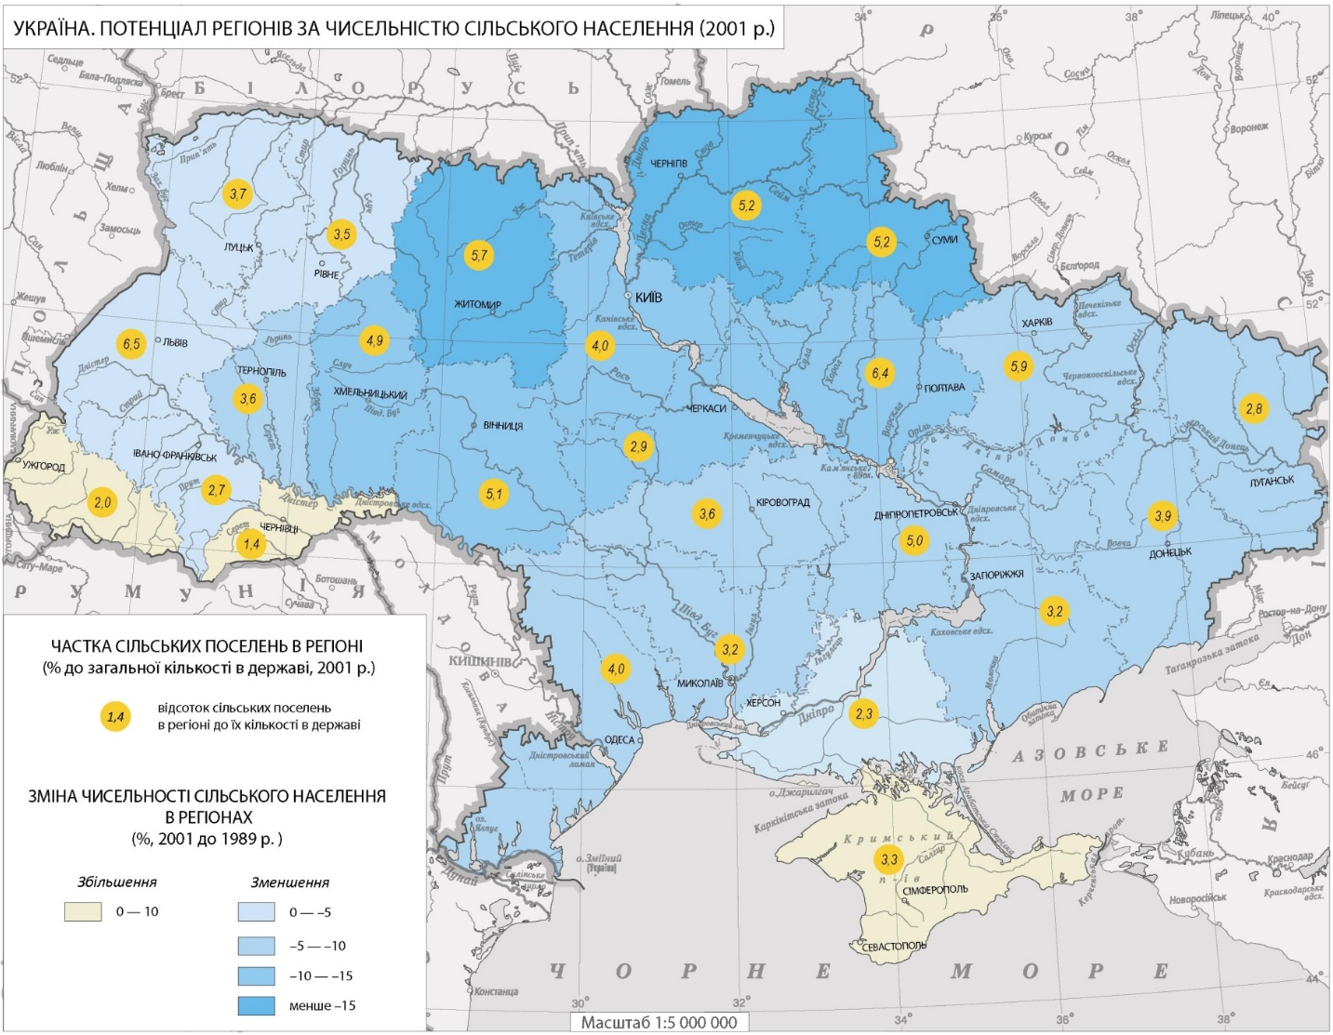
Regional Potential in Terms
of Rural Population
The map shows the changes in the rural population resulting from certain socio-economic processes. From a historical perspective, starting in 1959, the year of the end of the post-World War II reconstruction, the rural population in most regions of Ukraine began to decline. According to the 1989 census and beyond, Ukraine can already be classified as a fairly urbanized country with a share of the rural population of about 30%.
This maps provide information on the dynamics of the number, density and sizes of rural settlements in the regions. Between 1970 and 2001, the number of rural settlements decreased by 2,940, their average density fell from 5.3 to 4.8 units per 100 square kilometers, and their average population decreased from 683 to 554 people.

Slide 18
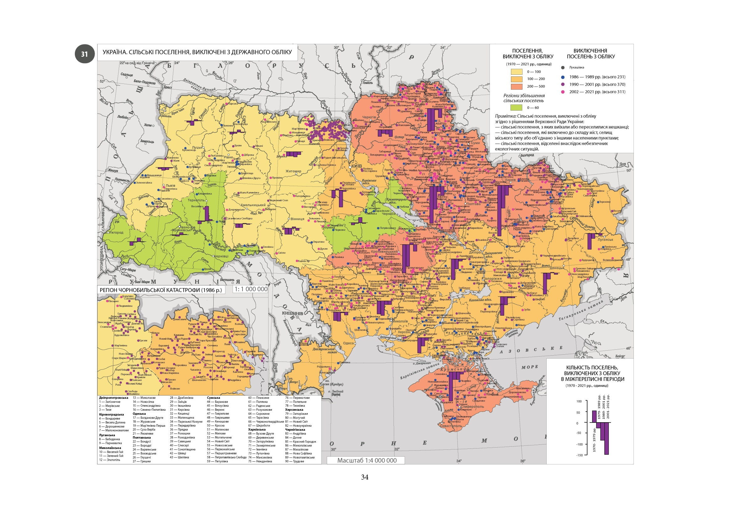
Rural Settlements Excluded
from the State Accounting
In the post-war period, the 1959 census counted the largest number of rural settlements - 42,229. Large-scale reforms in governance required changes primarily in the administrative and territorial structure. Therefore, already in 1970, the map of the network of rural settlements in Ukraine changed unrecognizably. The number of rural settlements decreased by 25.7%. Changes during the following intercensal periods were not as large-scale. In general, the number of rural settlements decreased by 9.8% between 1970 and 2001, and amounted to 28619 units in the last year of the period. The map shows one aspect of the reduction of the rural network of deregistration, i.e., the cessation of their existence as an accounting unit. Among the main reasons for this process is the loss of rural functions, their degradation, fragmentation, and decline due to economic, administrative, environmental, or other reasons. The ways of such transformations were consolidation with other villages and cities, or physical termination of the village's existence.

Slide 19
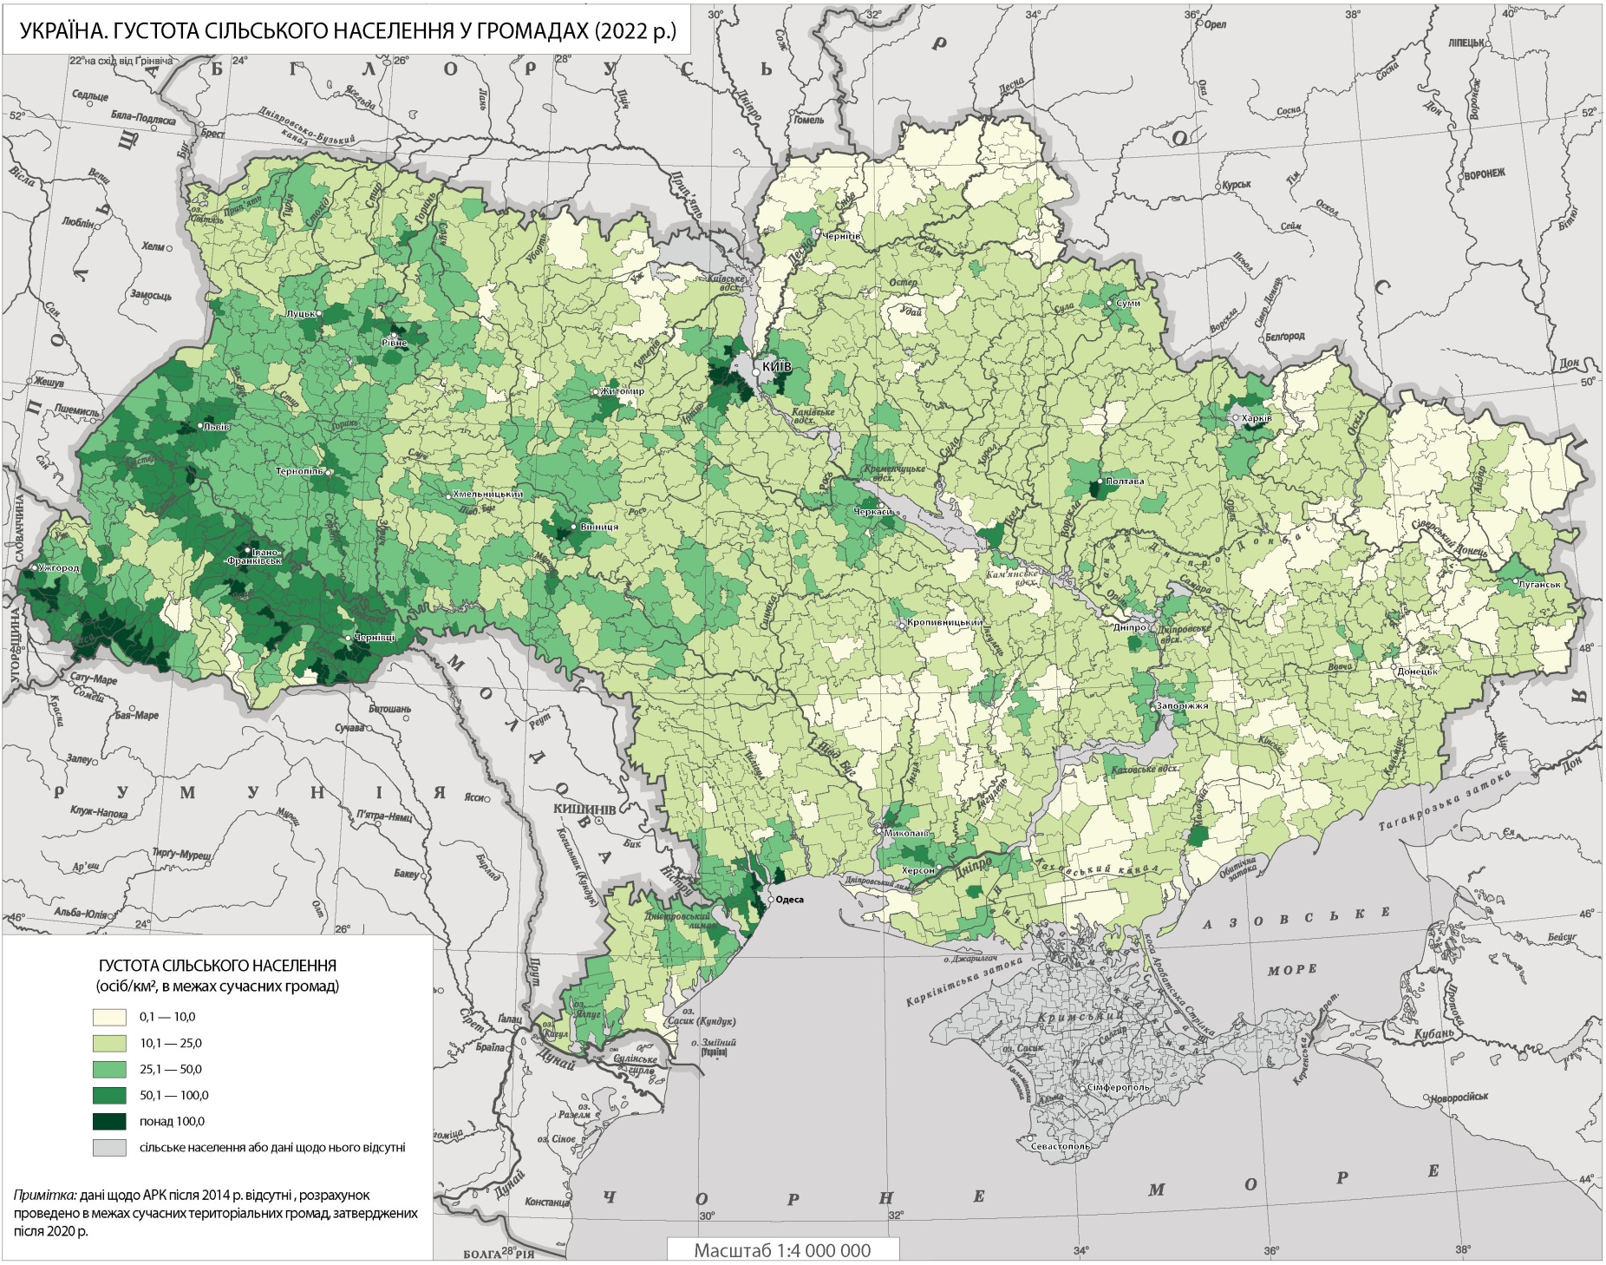
Rural Settlements Density
in Communities (2022)
In accordance with the administrative reform launched in 2020, administrative districts were liquidated and consolidated in Ukraine, and lower-order units, communities, were formed within them. This process is ongoing in Ukraine. The map provides an idea of the current state of the administrative and territorial division.

Slide 20
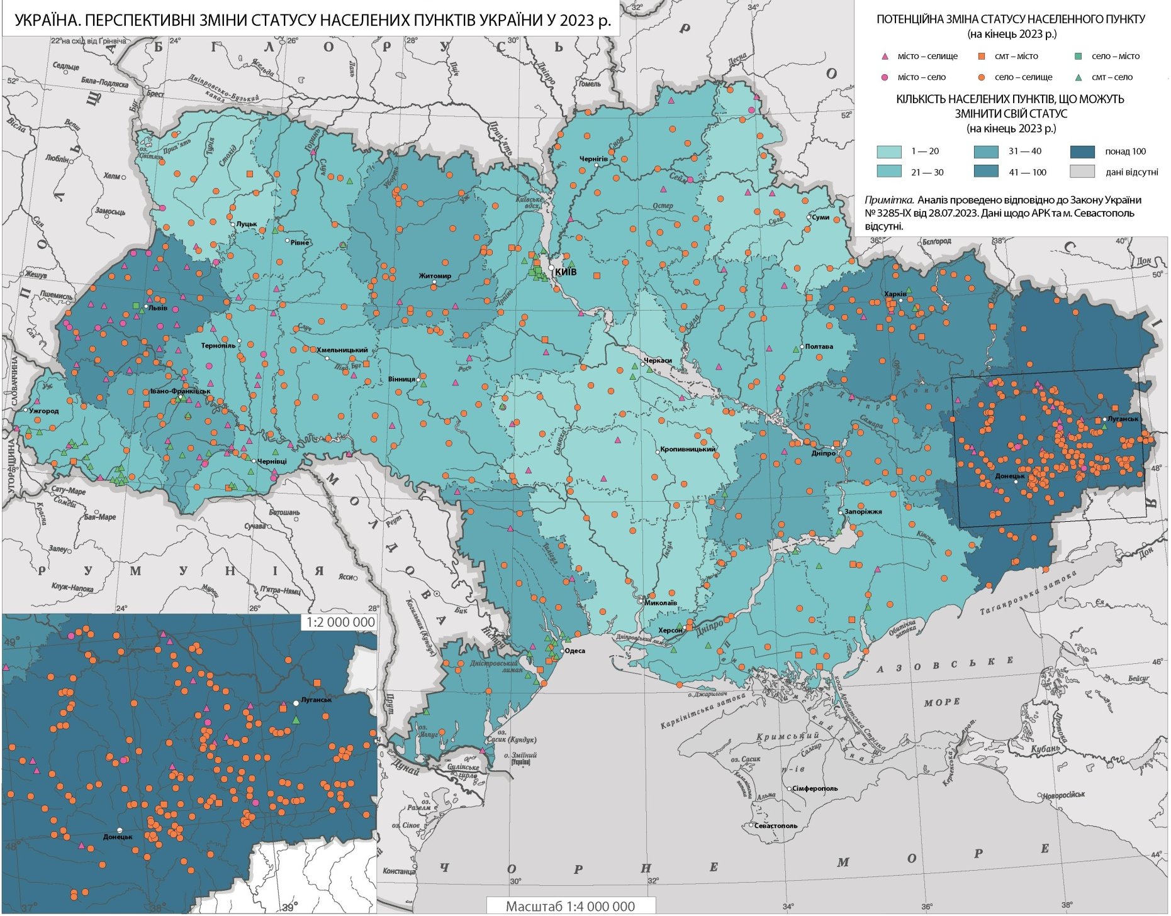
Prospective Changes in the
Status of Settlements
in Ukraine in 2023
According to the Law of Ukraine of 28.07.2023, another administrative reform in the population resettlement system is planned. This requires significant work by state and local authorities, as well as scientific justification for such changes. Currently, Ukraine is in a state of deep demographic crisis and destruction of the settlement network. Therefore, forecasting changes in its structure largely depends on the scale of these changes and strategic plans for the revival of the state.

Slide 21
Thank you for attention!
Cartography Department
of the Institute of Geography of the NAS of Ukraine
https://igu.org.ua/

