Slide 1





CLC+ case study applied on Slovak Republic
Modelové využitie systému CLC+ v podmienkach SR
Marcel Hudcovič ^{1), 2)} Ľuboš Balážovič ³⁾
²⁾
³⁾
¹⁾

Slide 2
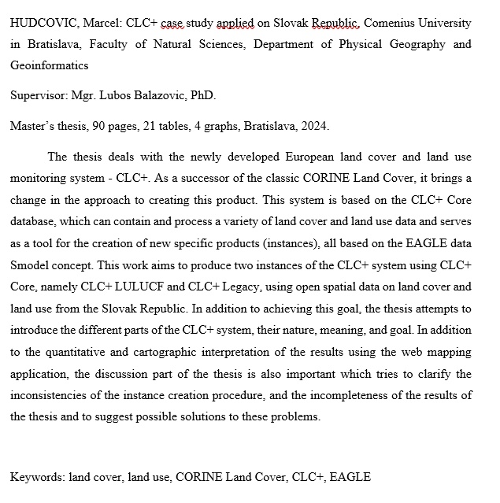

BACKGROUND
GeoKARTO 2022
Master’s thesis 2024

Slide 3
CLC vs CLC+
VISUAL INTERPRETATION
AUTOMATED DATABASE SOLUTION
EO DATA
HETEROGENOUS DATA
LULC PRODUCT
SYSTEM TO CREATE LULC PRODUCTS

Slide 4
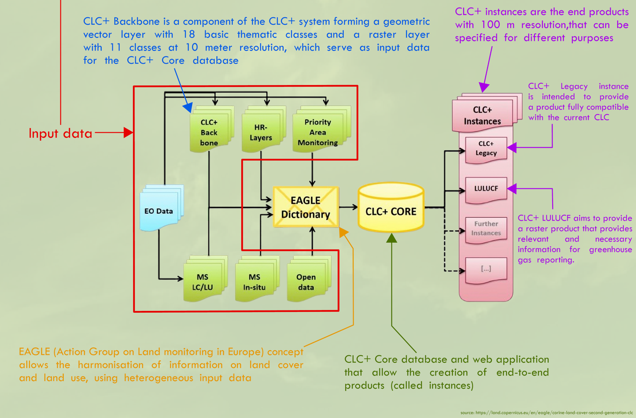

Slide 5
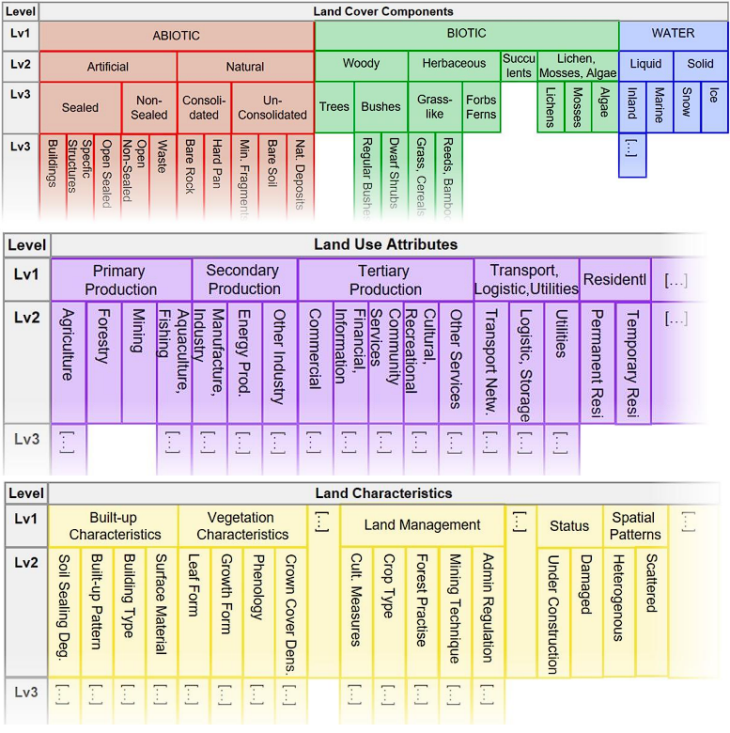
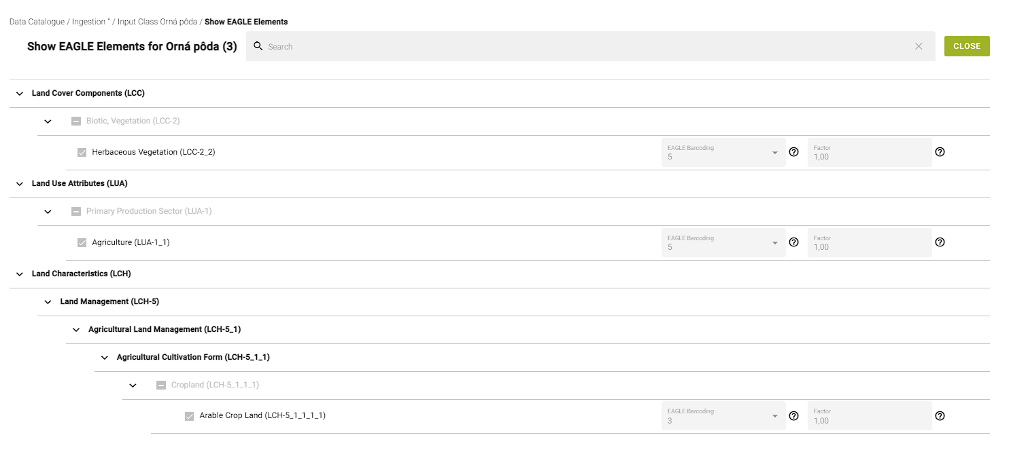
EAGLE MODEL CONCEPT APPLICATION
EAGLE MATRIX
EAGLE Elements use case
bar-coding

Slide 6
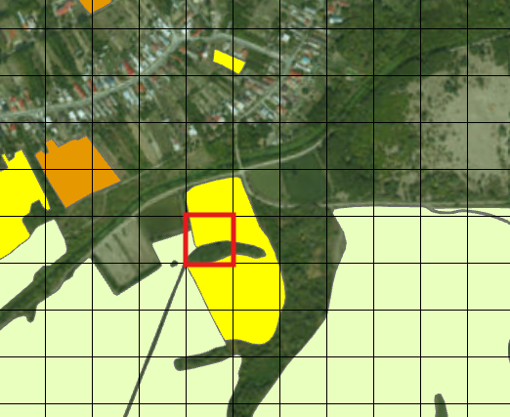
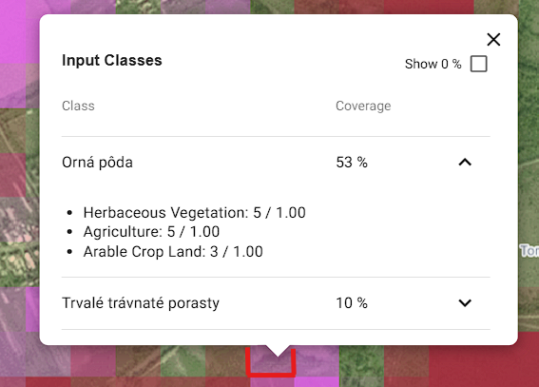
CLC+ Core = multi-use grid database
ArcGIS view
CLC+ Core view
Grid resolution = 100 m

Slide 7
CLC+ Core workflow
Uploading input data
Rules which compare the coverage value of selected EAGLE elements against other elements or threshold in specified order
Example:
Class 124 – Airports
Is coverage of EAGLE element Air Transport in cell higher than 50%?
EAGLE Element assignment to the classes
Output creation
Selection of input data classes we want to use
Defining output classes
YES
NO
Extraction of results
Classified as 124 - Airports
Next rule

Slide 8
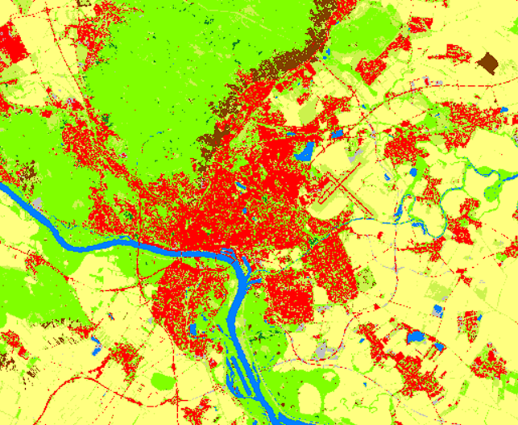
DATA USED IN CASE STUDY
CLC+ Backbone 2018 raster product
LPIS
INSPIRE datasets: Buildings, Transport networks, Hydrography
10 m resolution
11 essential land cover classes

Slide 9
AIM OF THESIS
CLC+ LULUCF
CLC+ LEGACY
information on land cover and land use for greenhouse gas reporting
consistent product compatible with CLC
Variant 1:
CLC+ Backbone
Variant 2:
CLC+ Backbone + LPIS
All available data
Comparison with CLC 2018
Comparison with reclassified CLC 2018

Slide 10
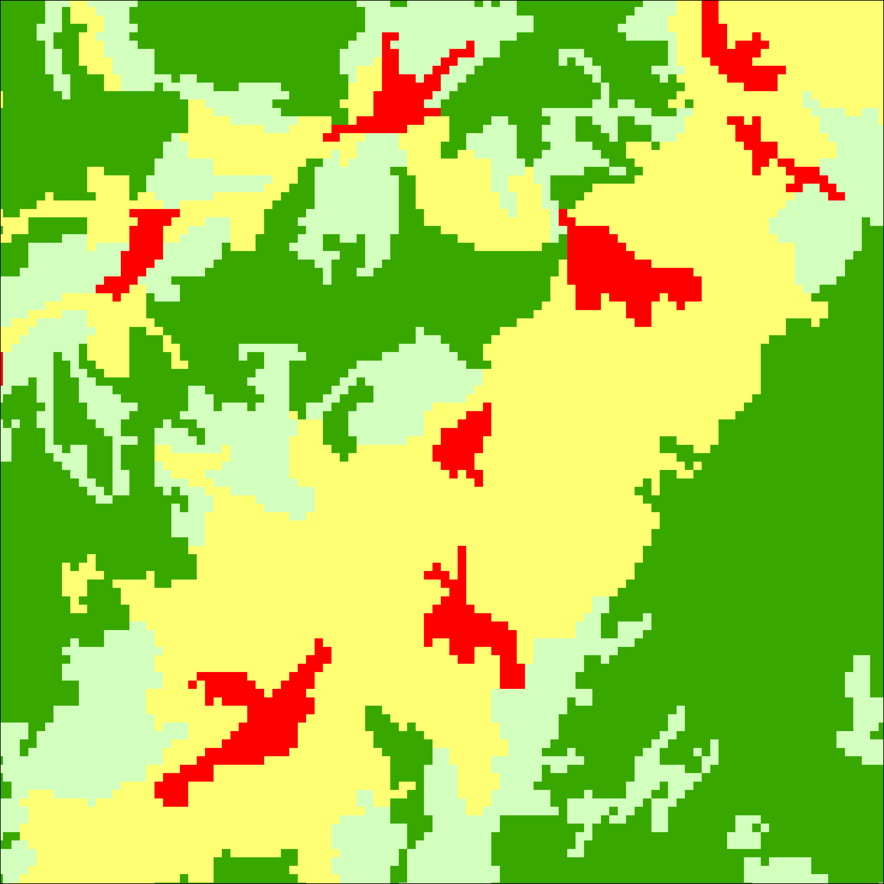
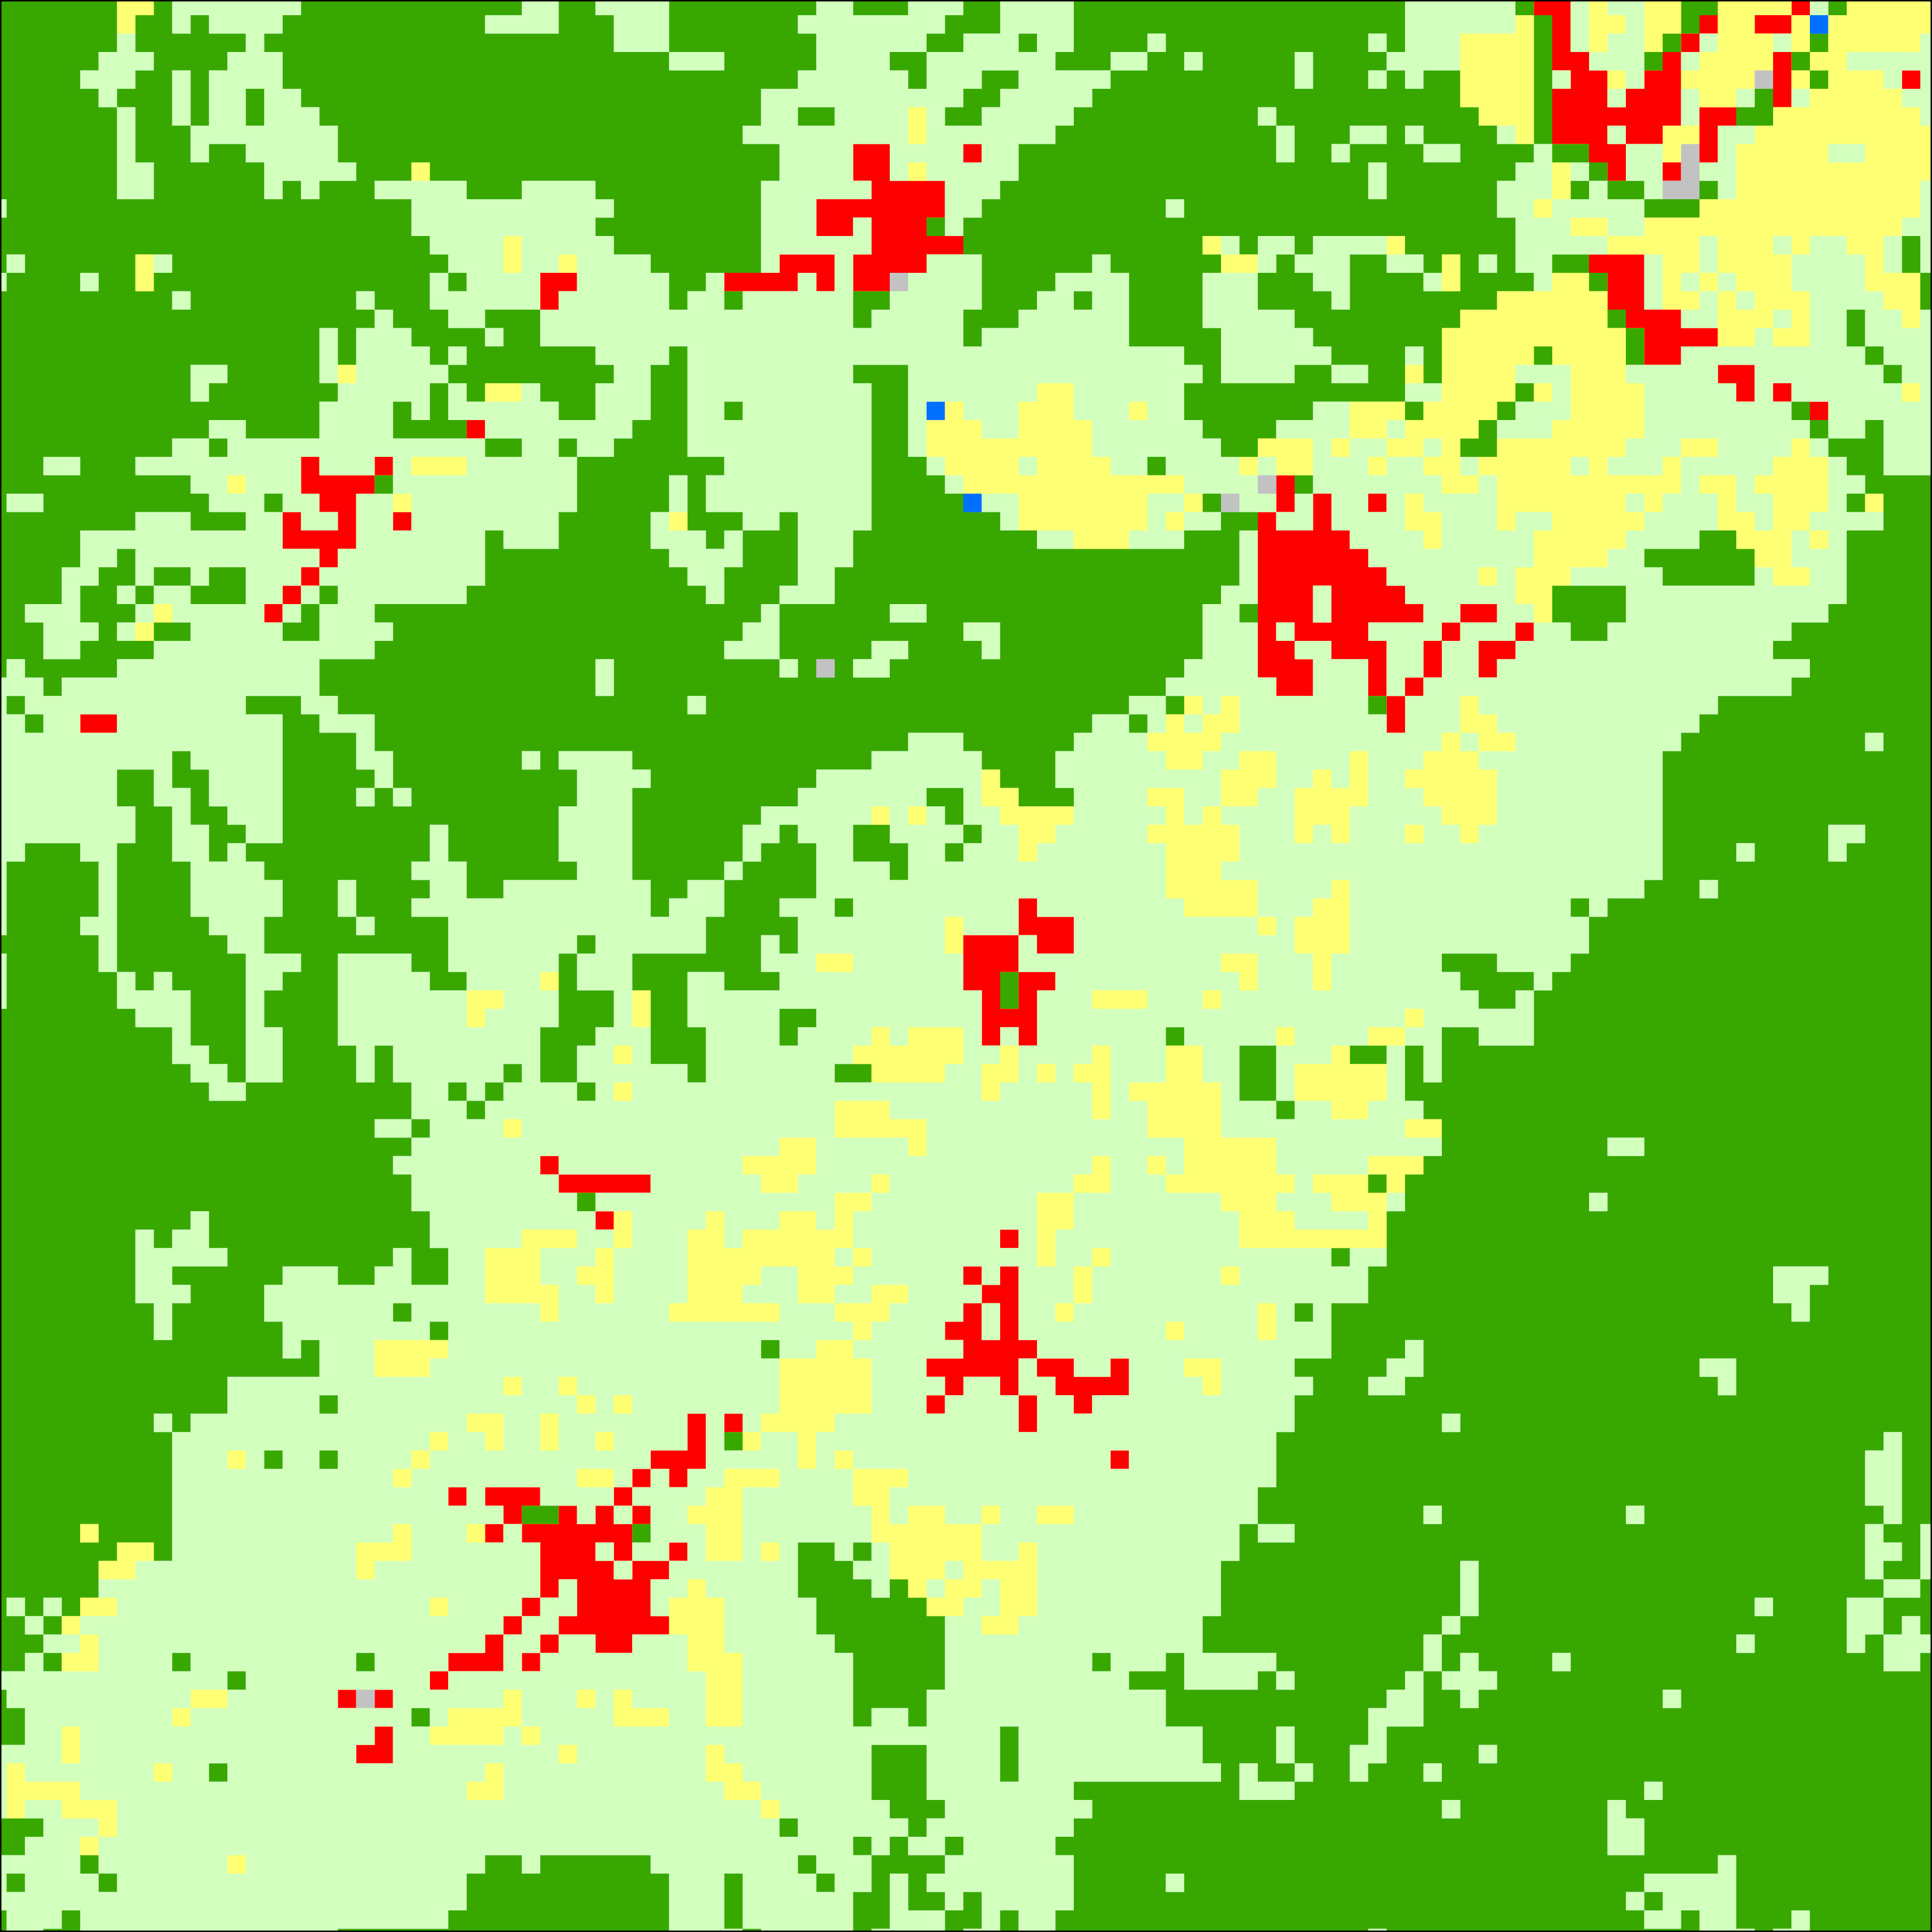
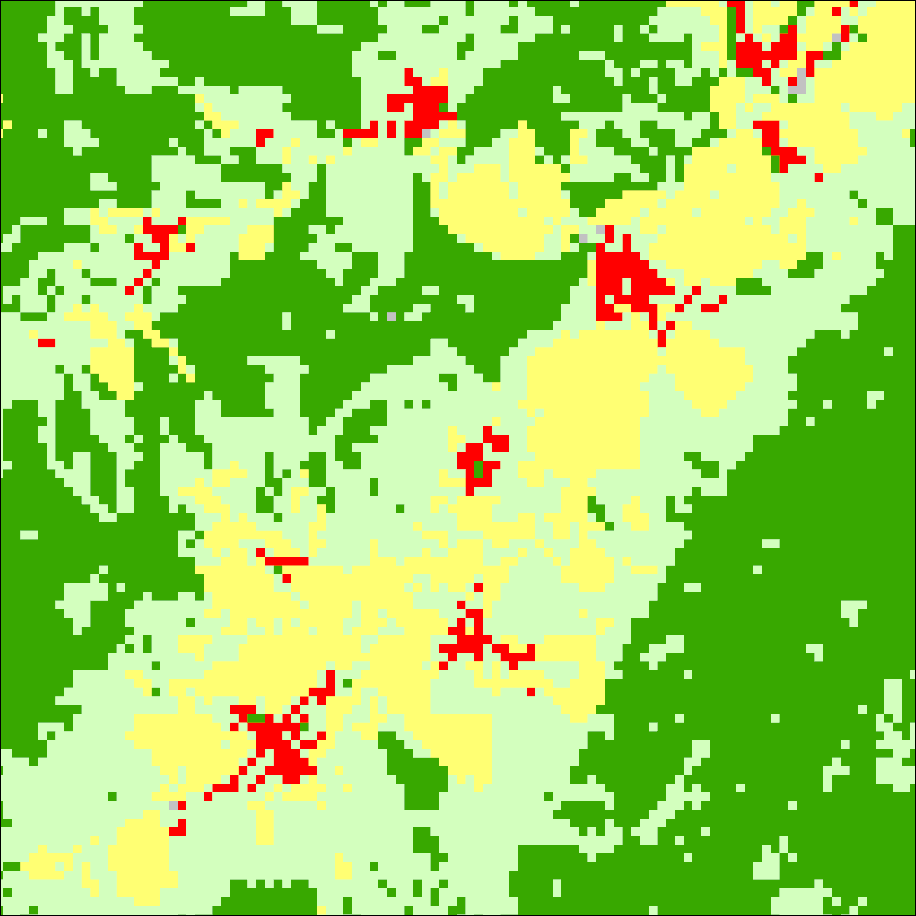
CLC+ LULUCF
Reclassified CLC2018
CLC+ LULUCF 2018
from CLC+ Backbone
CLC+ LULUCF 2018
from CLC+ Backbone and LPIS

Slide 11
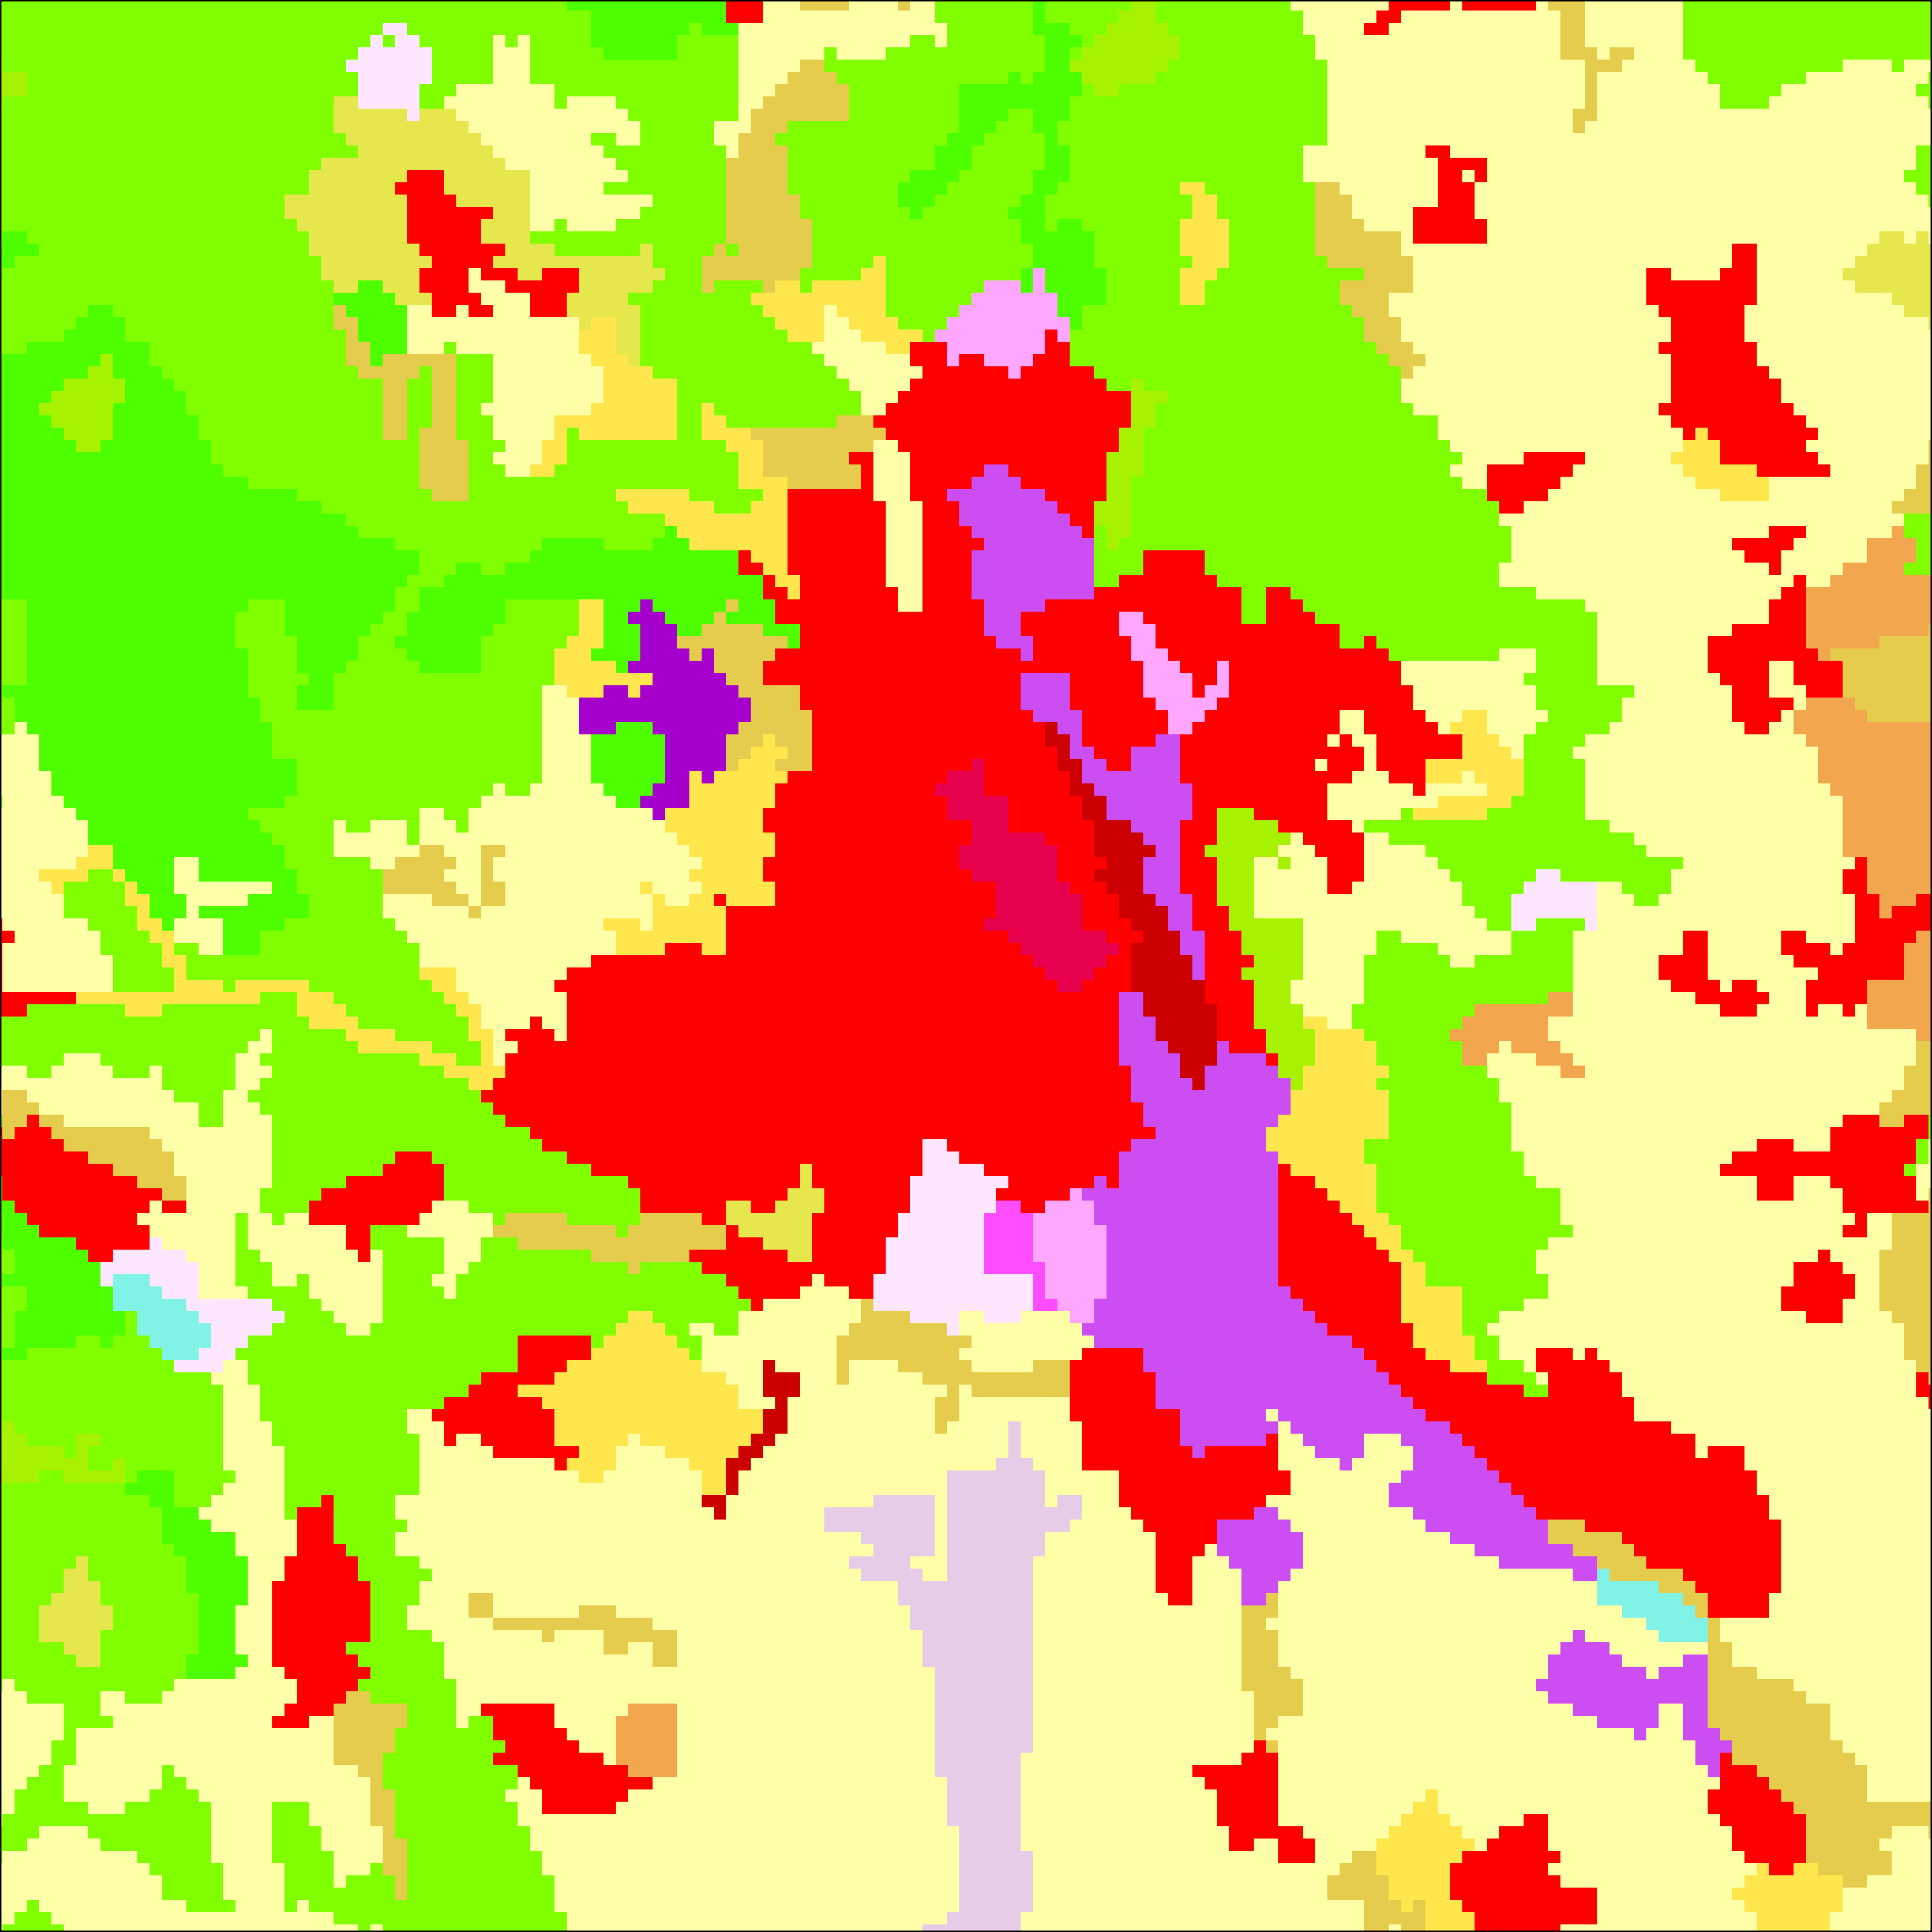
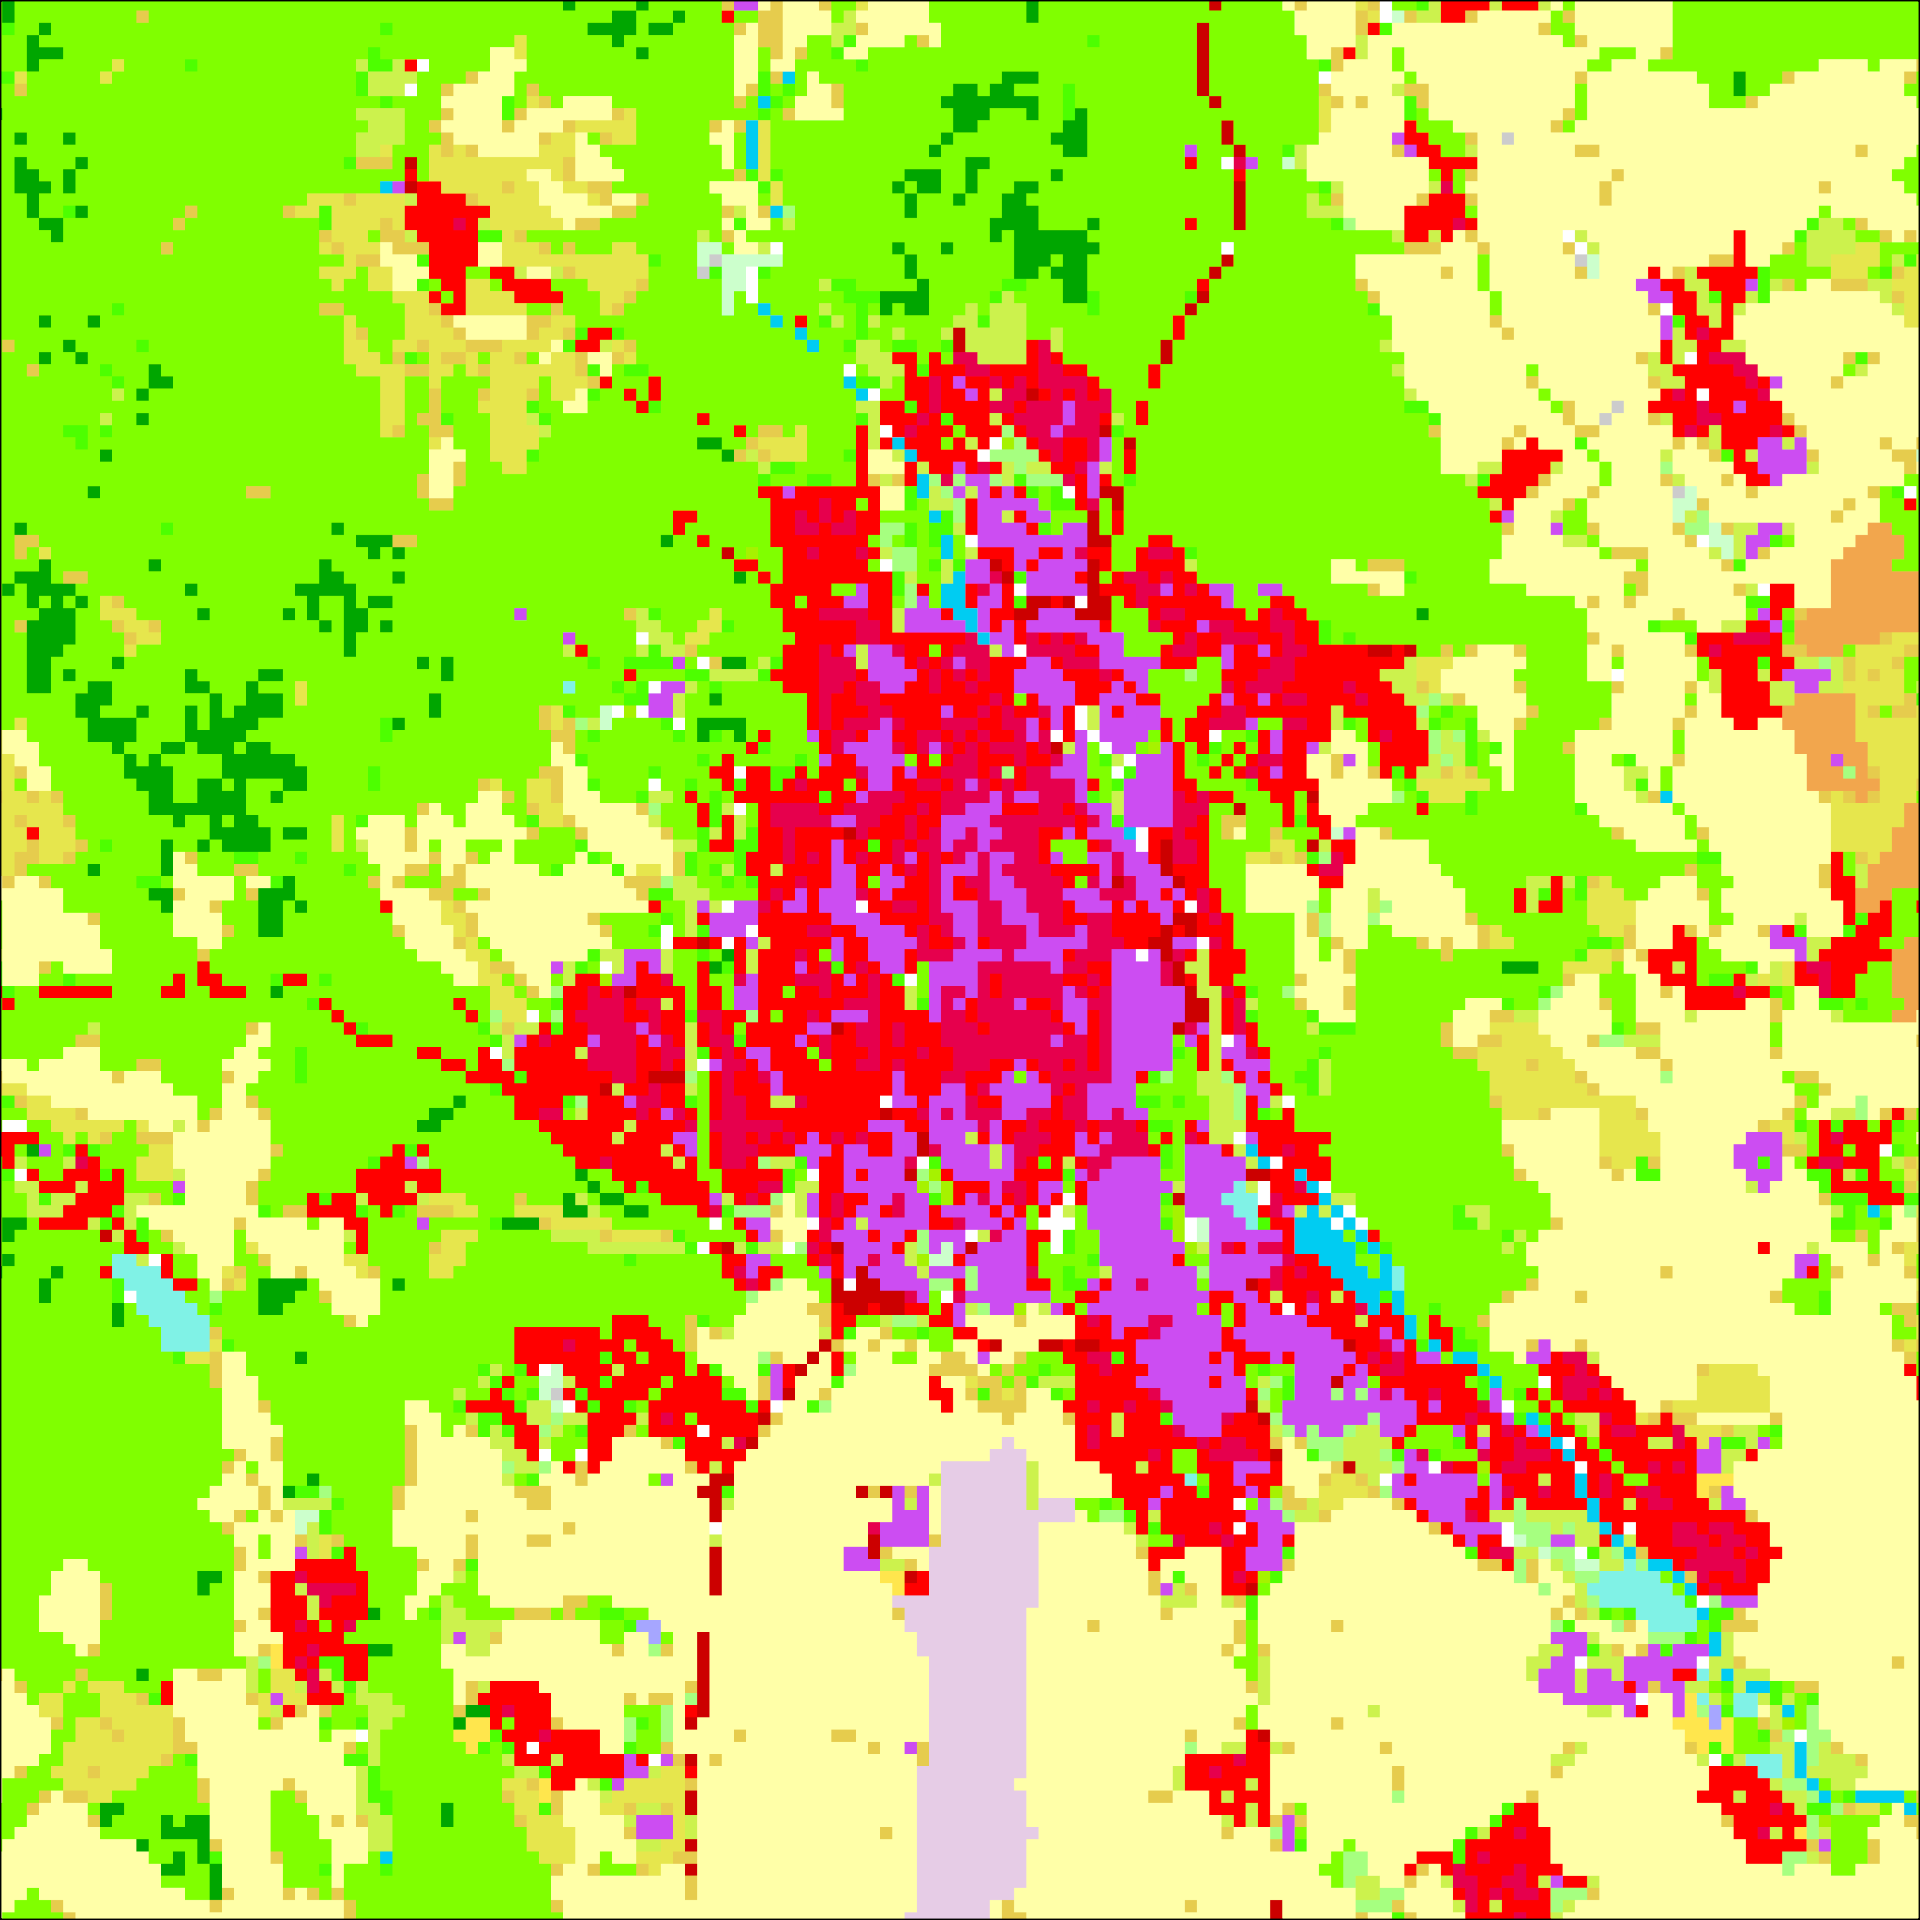
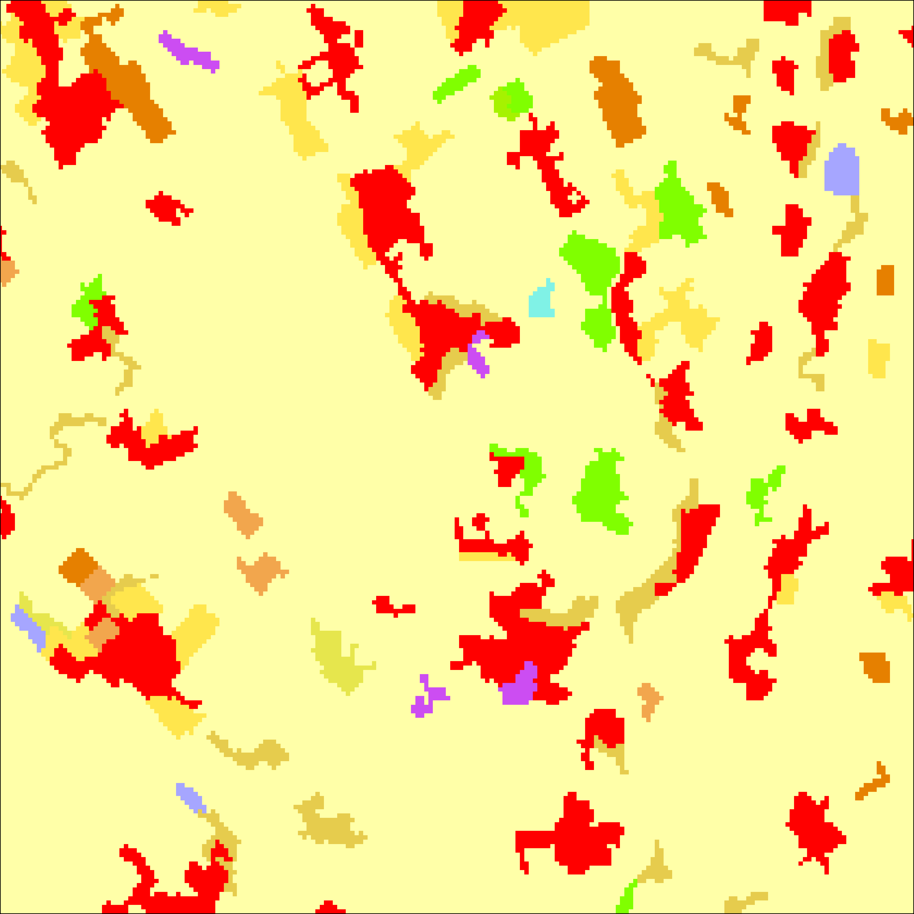
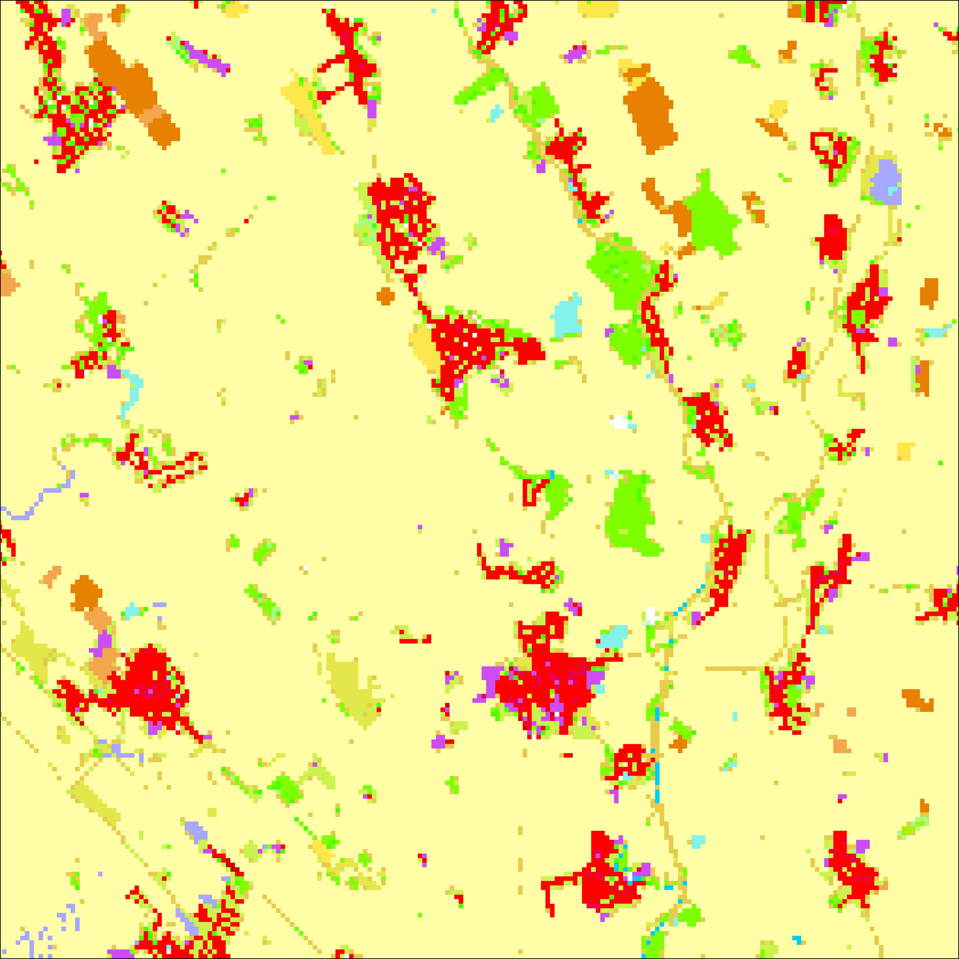
CLC+ Legacy
Classified 22 classes out of 32 in SR
Covered 99,69% area of SR
Overall comfornity:
  First híerarchical level: 89,96%
  Third hierarchical level 64,43%
CLC 2018
CLC+ Legacy 2018
CLC 2018
CLC+ Legacy 2018

Slide 12
CLC+ PROBLEMS IDENTIFIED DURING PRODUCTION
acquisition of the necessary input data
complicated classification of classes consisting of several land covers
complicated classification of classes for which visual interpretation is needed

Slide 13
CONCLUSION
CLC+
DATA DEPENDENT
System to create LULC products
LULC product
LACK OF INFORMATION ABOUT METHODOLOGY
UNCERTAIN FUTURE USE?

Slide 14


CLC+ case study applied on Slovak Republic
THANK YOU FOR YOUR ATTENTION
Master’s thesis
Modelové využitie systému CLC+ v podmienkach SR
Web APP
Marcel Hudcovič ^{1), 2)} contact: hudcovic3@uniba.sk
Ľuboš Balážovič ³⁾ contact: lubos.balazovic@sazp.sk
¹⁾
²⁾
³⁾

