Slide 1

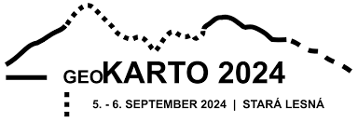
DETECTION OF WATER CURRENTS IN FLAT TERRAIN AREAS BASED ON LASER SCANNING DATA
Nikita YAKSHIN

Slide 2
MOTIVATION
Watercourses are dynamic geographical objects that change with time according to different conditions. They are important objects for maps for different purposes and for this reason it is essential to establish conditions for the representation of watercourses on maps according to different characteristics (size of the width of the watercourse, size of the depth of the watercourse, importance of the watercourse, etc.).

Slide 3
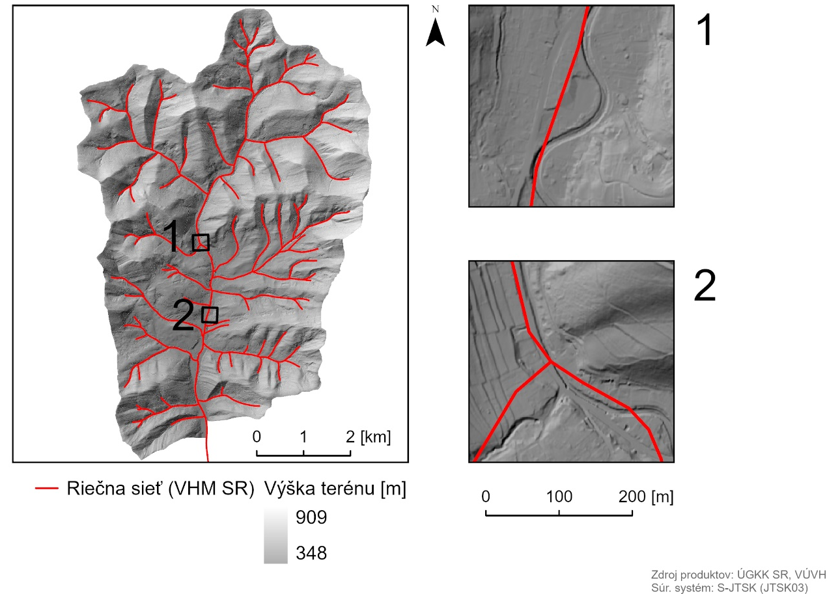
CURRENT STATE
The Slovak Water Management Enterprise is the administrator of water courses and basins in Slovakia
Forests of SR
Military Forests
Hydromelioration
Water management map of the Slovak Republic:
1: 50,000
plotted flows may differ by 10-100 m from digital information
Source: Master Thesis (Belaňová, Lieskovský)

Slide 4
CLASSIC METHOD

Slide 5
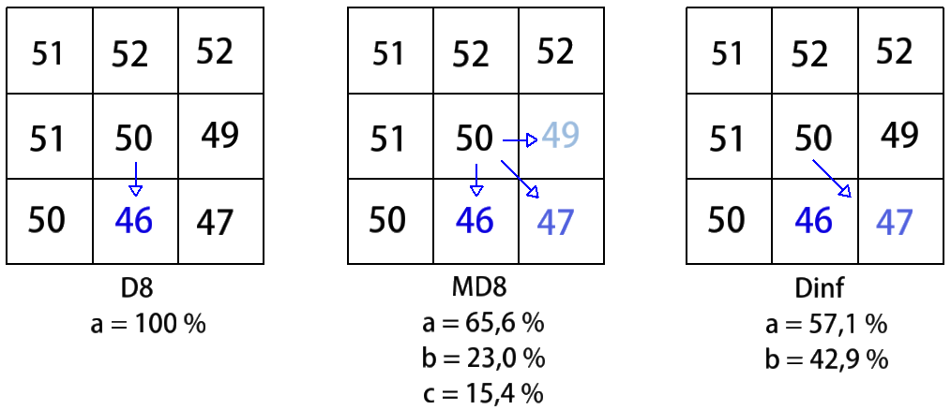
CLASSIC METHOD
Flow Direction and Flow Accumulation

Slide 6
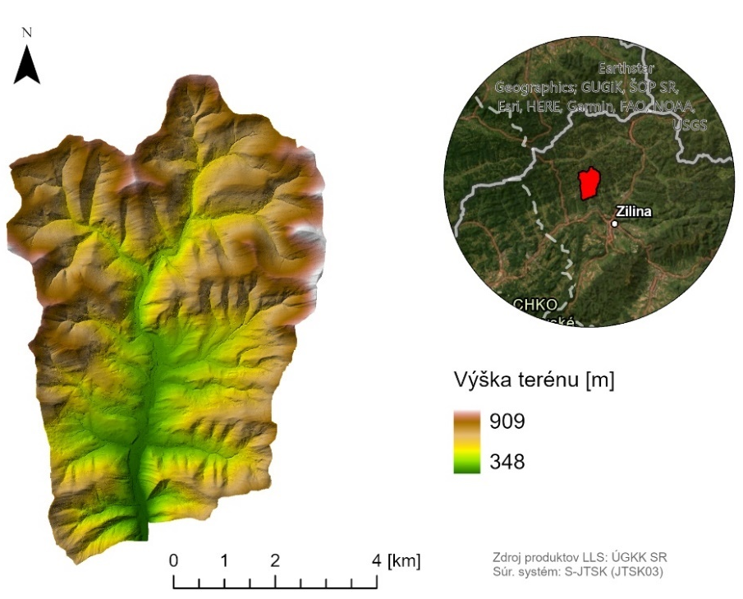
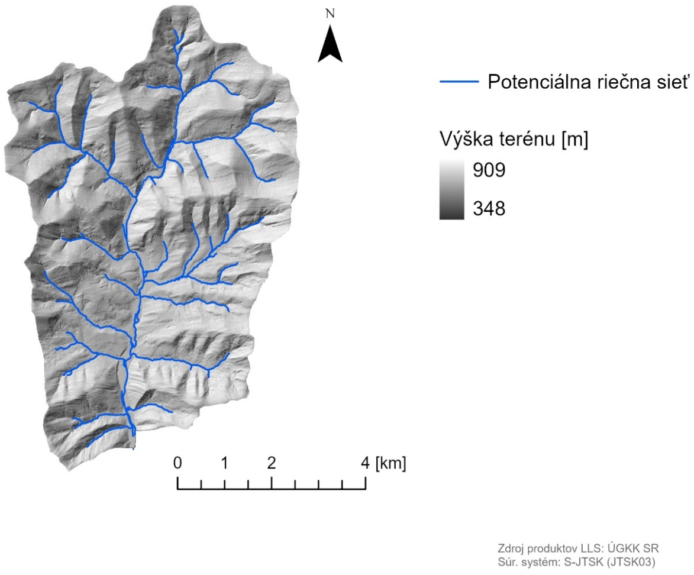
CLASSIC METHOD
Source: Master Thesis (Belaňová, Lieskovský)

Slide 7
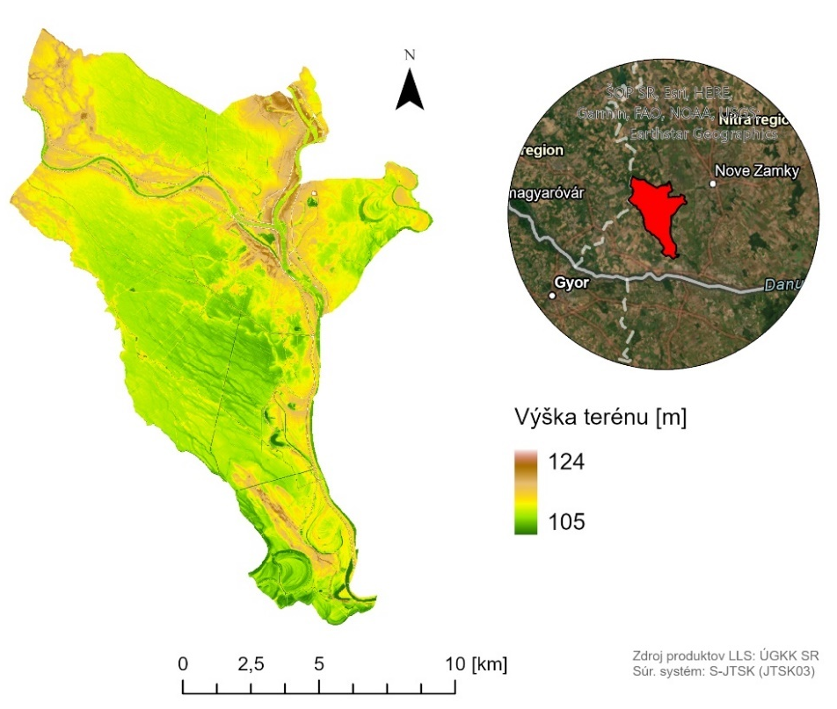
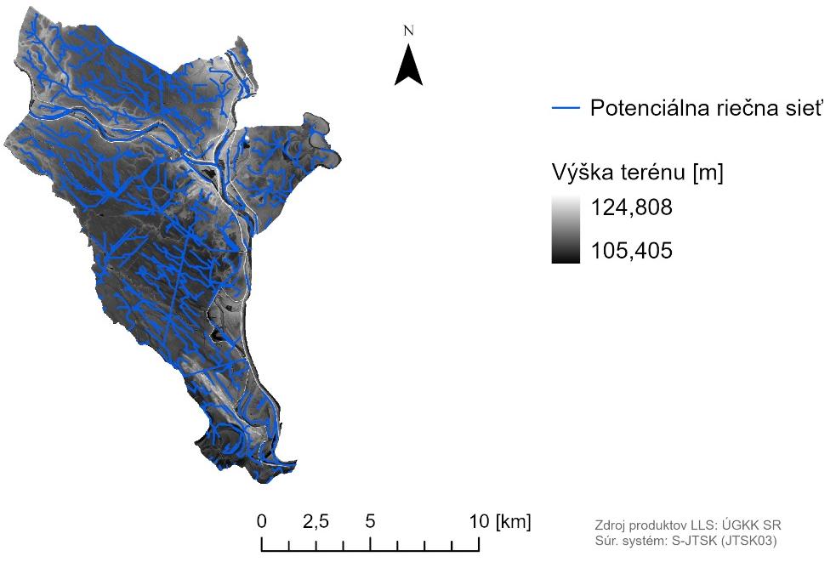
CLASSIC METHOD
Source: Master Thesis (Belaňová, Lieskovský)

Slide 8
PFF METHOD
The method involving the identification of an object's profile, followed by the classification of the object's type (described by Y. Lin et al.)
Pre-process
Edge extraction
Skeleton generation
Profile statistics
Profile functions

Slide 9
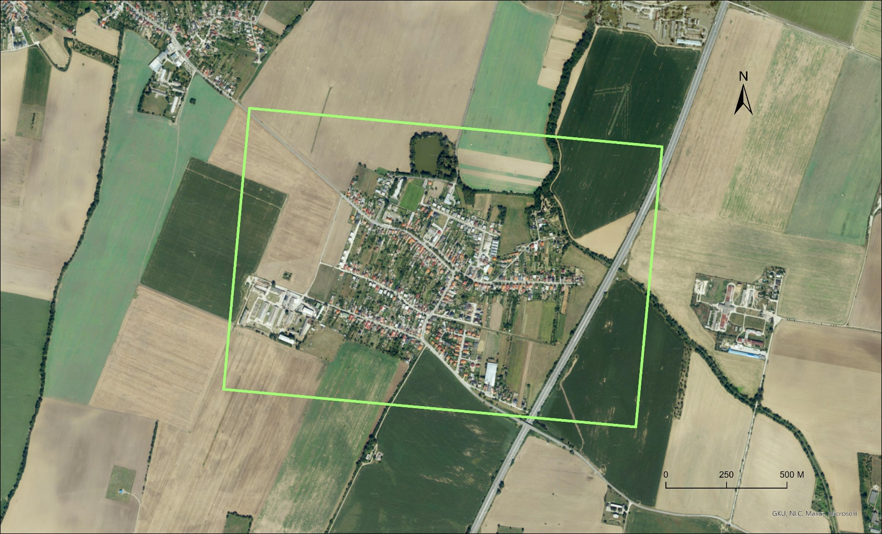
INVESTIGATED LOCATION
Veľké Orvište
Source of LLS data: ÚGKK SR

Slide 10
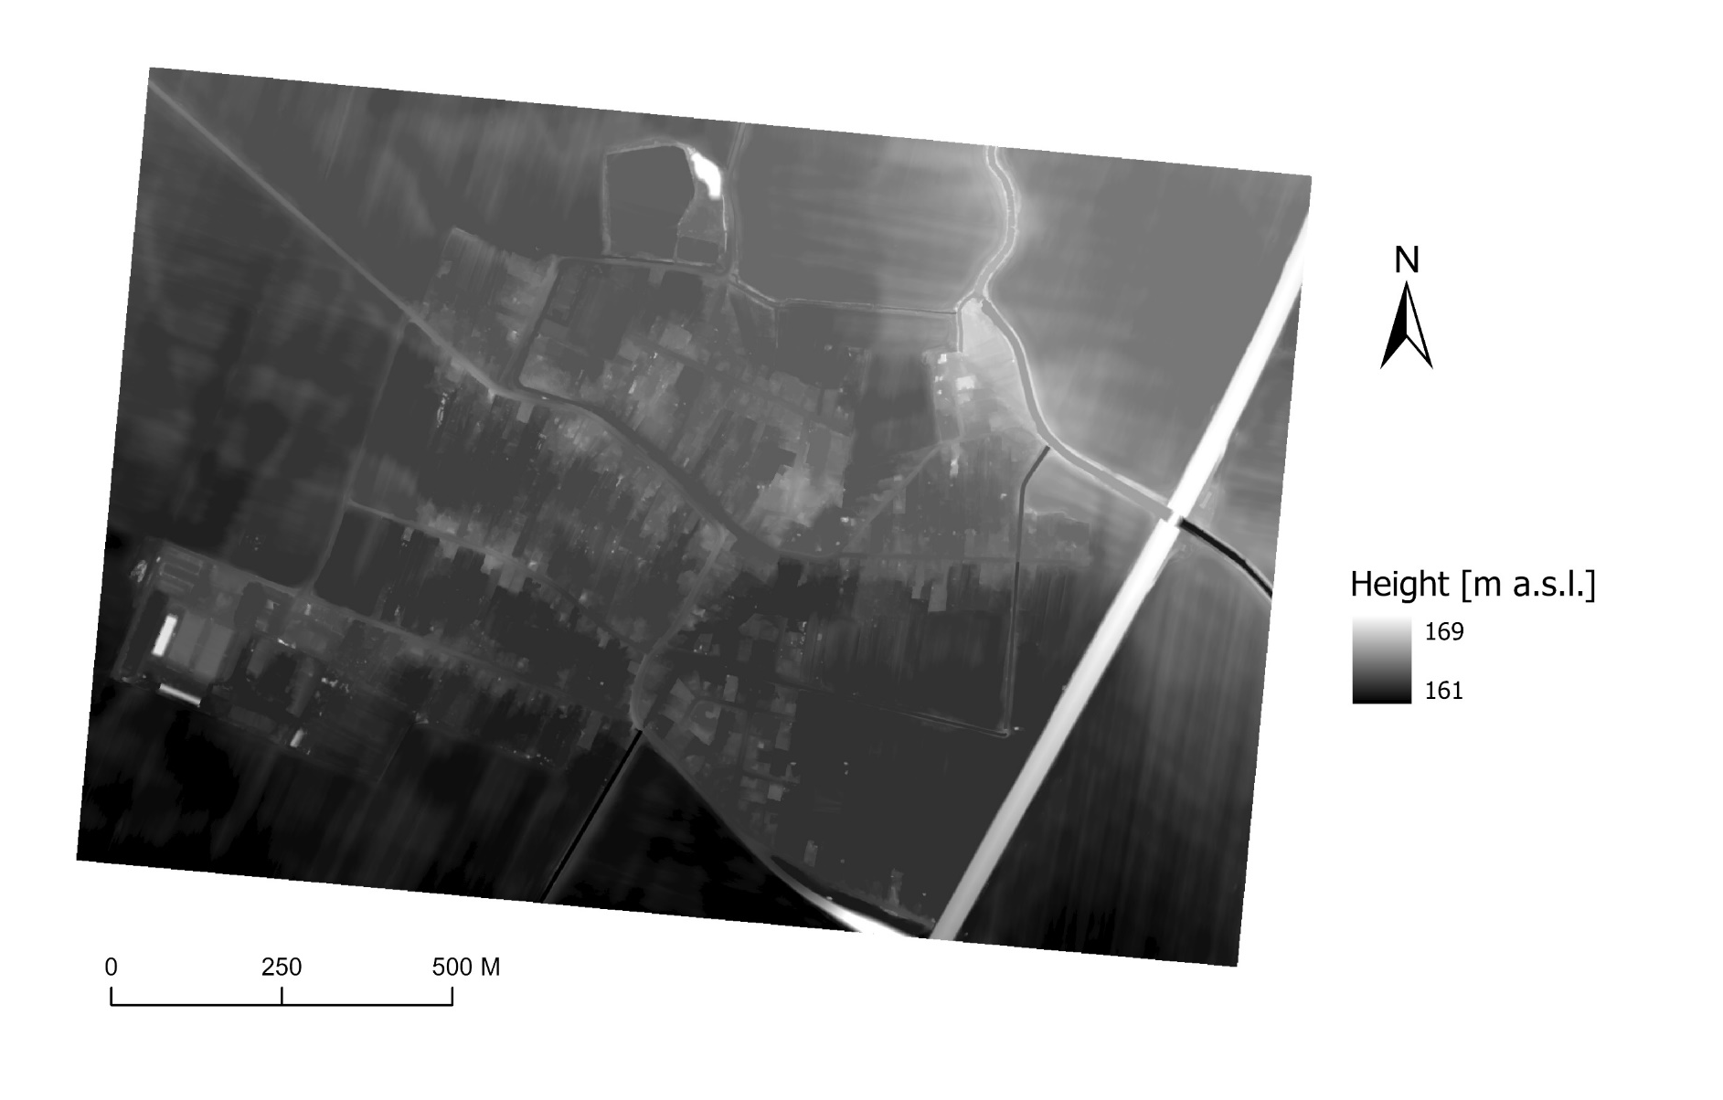

PFF METHOD
Pre-process
LAS dataset to raster
Fill - fills sinks in a surface raster to remove small imperfections in the data. (ArcGIS Pro tool reference)
Source of LLS data: ÚGKK SR

Slide 11
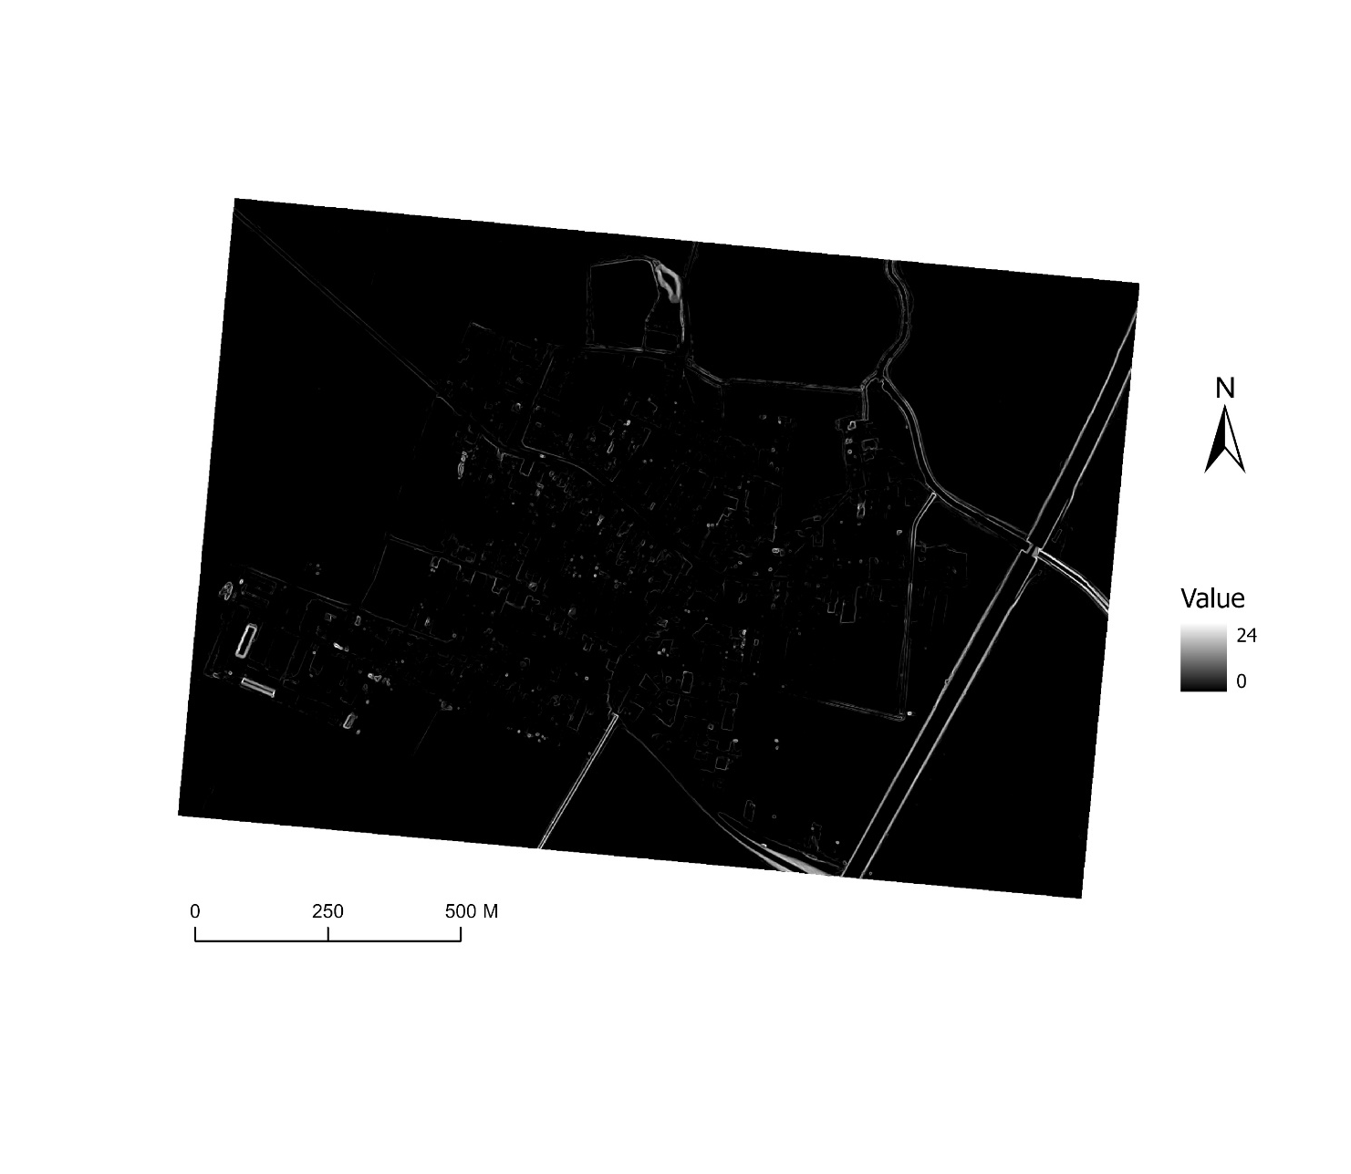
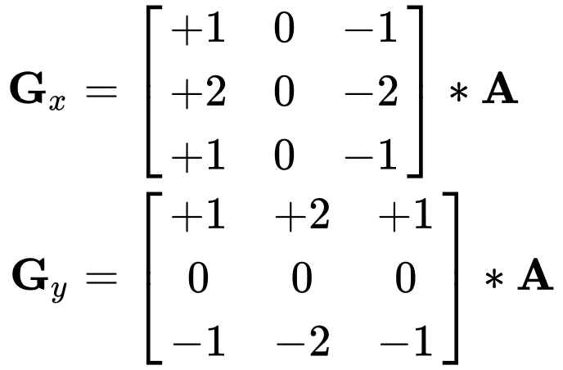
PFF METHOD
Edge extraction
Sobel operator
Source of LLS data: ÚGKK SR

Slide 12
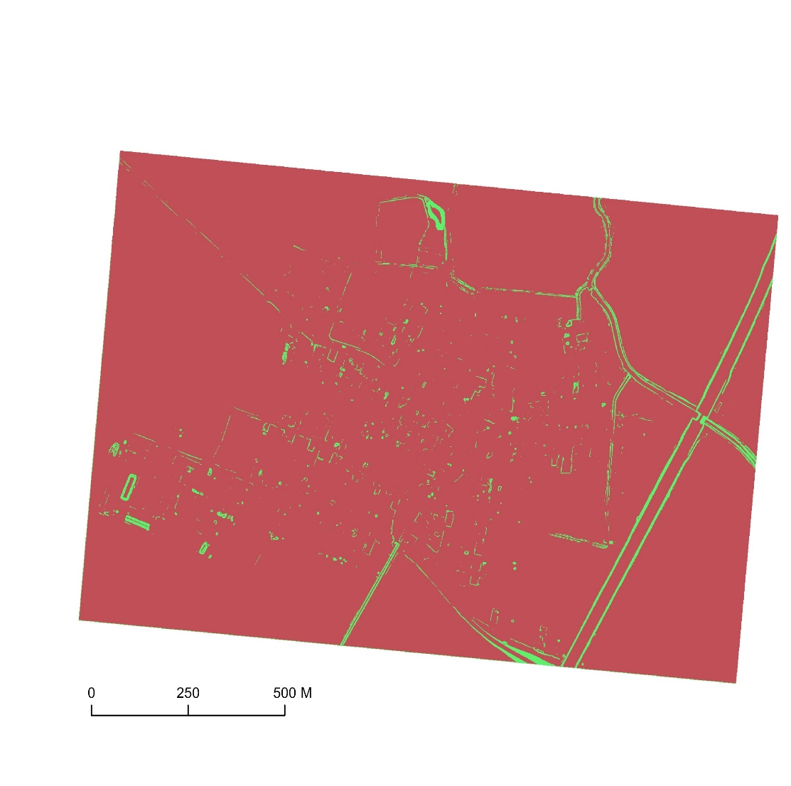
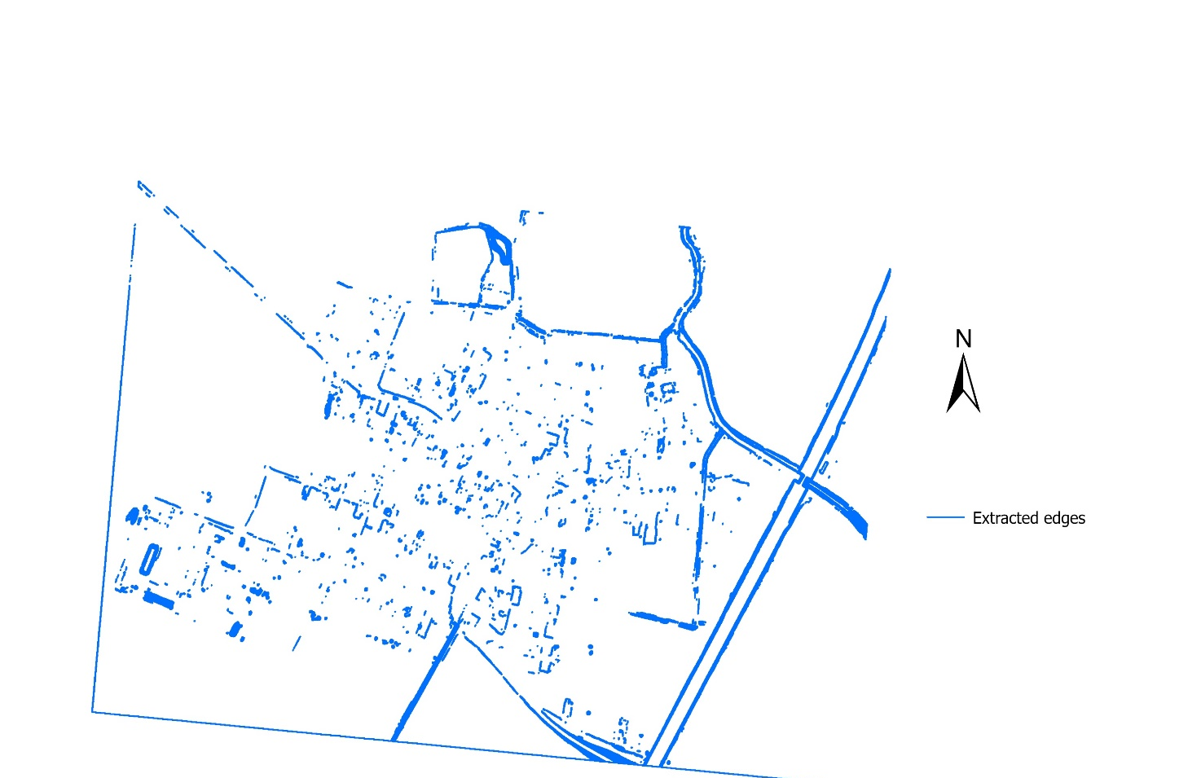
PFF METHOD
Edge extraction
Source of LLS data: ÚGKK SR

Slide 13
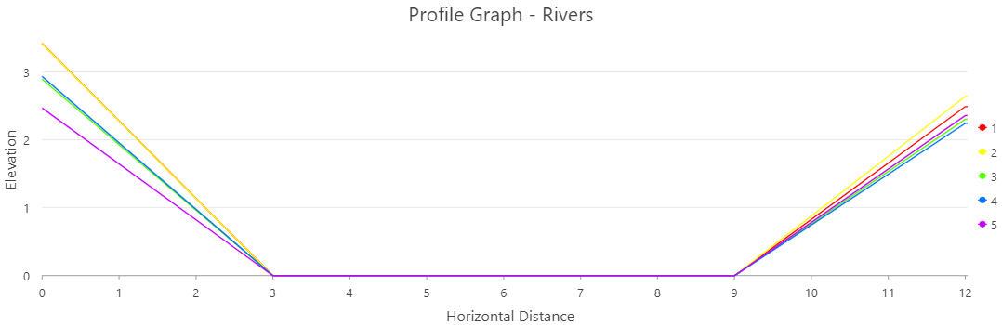
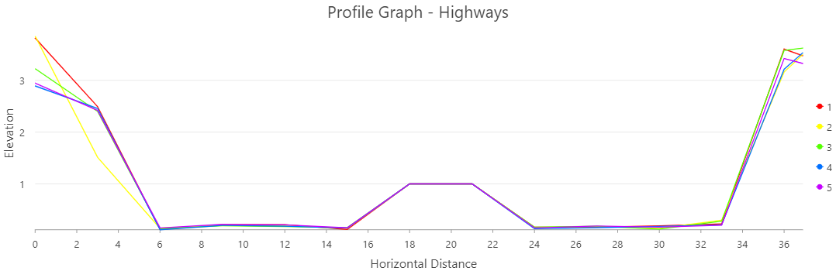
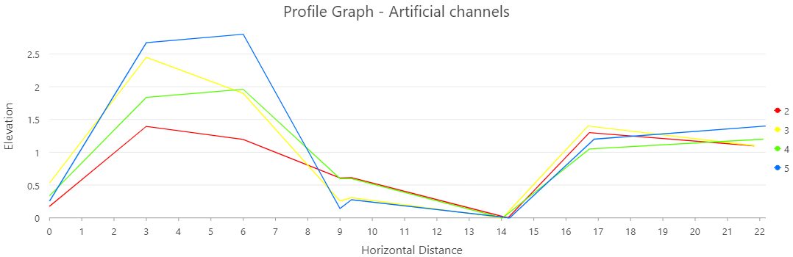
PFF METHOD
Ushape
Wshape
Mshape

Slide 14
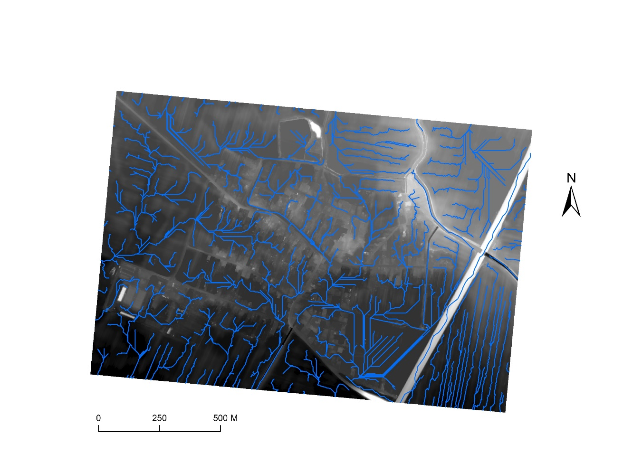
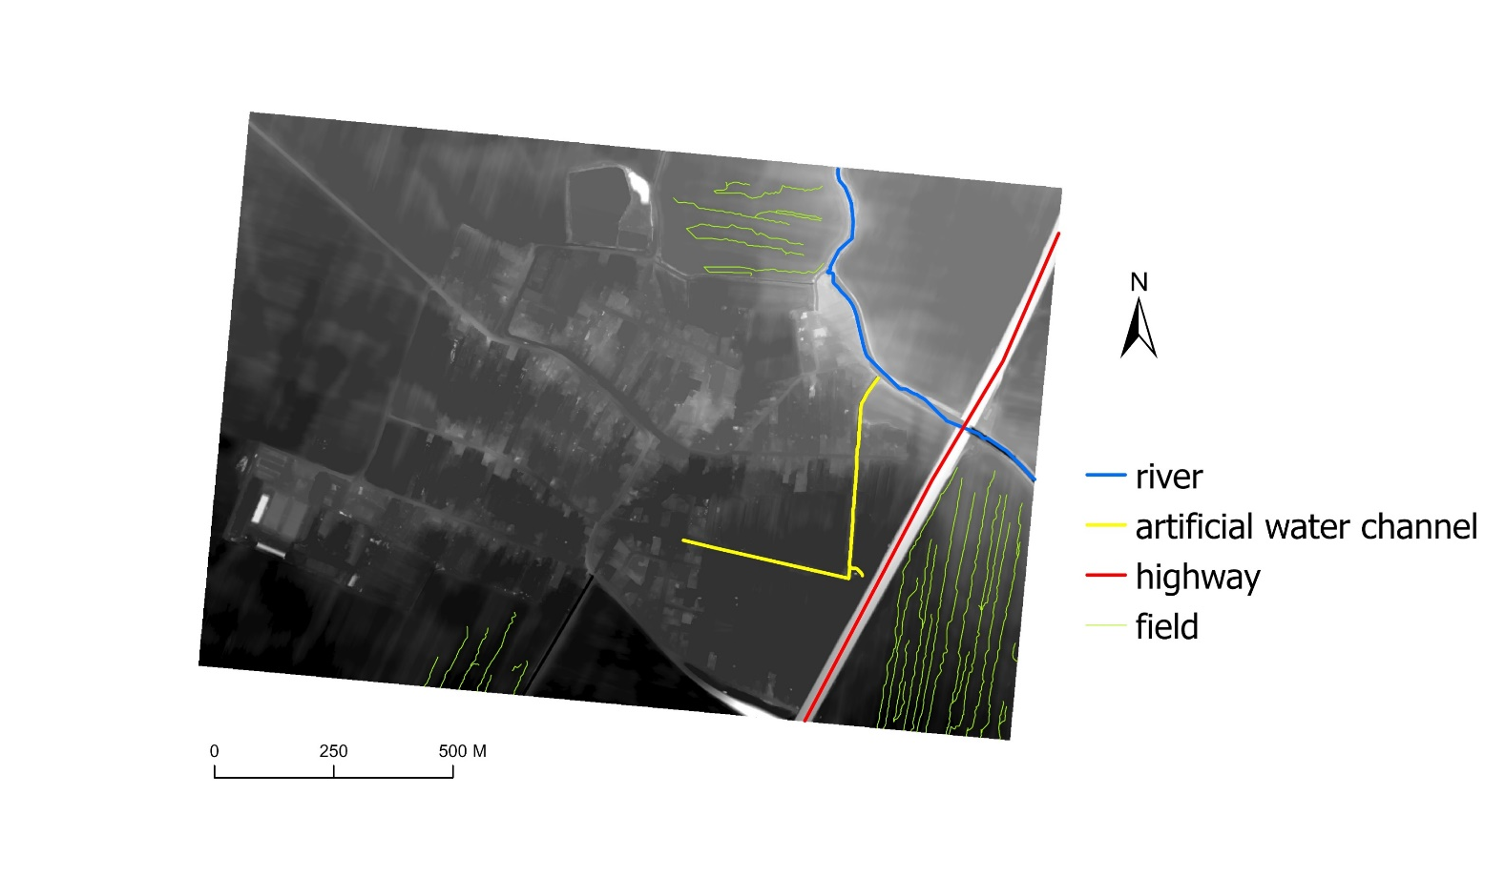
RESULTS
Source of LLS data: ÚGKK SR

Slide 15

RESULTS
Source of LLS data: ÚGKK SR

Slide 16
FUTURE STEPS
Automatization of algorithm
Combination of different methods for various types of issues
Creation of an algorithm with a set of tools for modeling river networks
Generalization for broader applications
Incorporating machine learning
Creation of an app / plugin
THANK YOU FOR YOUR ATTENTION

