Slide 1




UPDATING AND DENSIFYING
THE GEOGRAPHICAL NAMES
Ing. Mária KUBICOVÁ, Mgr. Zuzana MICHALKOVÁ, Ing. Eva MIKLUŠOVÁ

Slide 2
Geographical name
- proper name of an inanimate natural object and phenomenon on Earth and a man-made geographical object permanently located on Earth
(glossary of terminology: https://www.skgeodesy.sk/sk/terminologicky-slovnik/)
- unique identifier, the need for standardisation
Geographical nomenclature
- set of geographical names (glossary of terminology)
Standardisation of geographical names
- the process of establishing a single name by a naming authority for a geographical object on Earth or for extraterrestrial objects, ensuring the correct written form as well as binding conditions for its use are established (glossary of terminology)
TERMINOLOGY

Slide 3
GEOGRAPHICAL names' AUTHORITIES IN THE SLOVAK REPUBLIC
National Council of the Slovak Republic - names of regions and districs
The Government of the Slovak Republic - names of municipalities
Ministry of Internal Affairs of the Slovak Republic - names of municipalities´ parts
Municipalities – names of streets and public areas
ÚGKK SR – names of geographical names from the territory of the SR, from the area outside the SR, names for extra-terrestrial features, a method of transliterating geographical names from a non-Latin writing system into the Latin alphabet
The AIMS OF STANDARDISATION
to improve conveying of information
to avoid confusion and misunderstanding in the use of names
to raise the educational, cultural and social level of the population
to contribute to the increase of national representation and international prestige of the state (participation in international meetings of the United Nations)

Slide 4
THE LEGISLATIVE FRAMEWORK FOR NATIONAL STANDARDISATION
- Act of the National Council of the Slovak Republic No. 215/1995 Coll. on Geodesy and Cartography, § 18
- Decree of the Geodesy, Cartography and Cadastre Authority of the Slovak Republic No. 300/2009 Coll., amending and supplementing Act of the National Council of the Slovak Republic on Geodesy and Cartography, § 14 - § 17
- Guidelines for the standardisation of geographical names from 2015, as amended by Amendment No 1 from 2018
https://www.skgeodesy.sk/files/sk/slovensky/ugkk/geodezia-kartografia/standardizacia-geografickeho-nazvoslovia/dokumenty-k-cinnosti/smernica_s_dodatkom.pdf

Slide 5
    SUBJECT OF STANDARDISATION
Names of geographical objects from the territory of the Slovak Republic
a) water bodies and water structures,
b) protected areas,
c) formations in vertical dissection of the Earth surface,
d) specific settlement objects,
e) historical, cultural, purpose-built objects,
f) geomorphological units,
g) individual vegetation types.
Names of geographical objects from the area outside of the Slovak Republic
a) states, dependent territories, oceans, seas, submarine bodies and Antarctic bodies not subject
to the sovereignty of any State,
b) protected objects, caves, lakes, towns, marshes, seas, capes, areas, islands, plateaus, coasts, mountains, peninsulas, depressions, straits, canals, deserts, rivers, saddles, straits, reservoirs, waterfalls, mountains, bays.

Slide 6
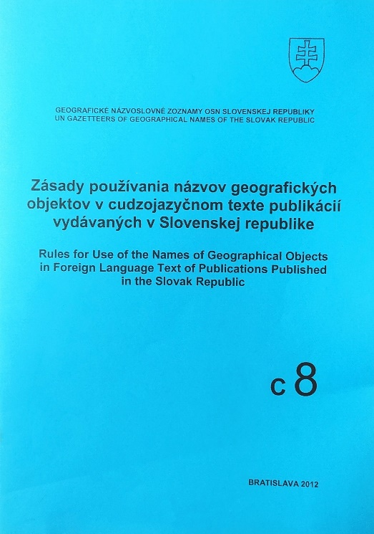
BINDING OF THE GEOGRAPHICAL NOMENCLATURE STANDARDISATION
for publishers of cartographic works
specialist publications
for use in the press and other means of mass communication
in the official activities of public authorities
PROMOTION
Toponymic guidelines for map and other publications‘ editors, 2010 https://www.skgeodesy.sk/files/sk/slovensky/ugkk/geodezia-kartografia/standardizacia-geografickeho-nazvoslovia/dokumenty-k-cinnosti/TNdotlaAe.pdf
Rules for the use of geographical objects names in foreign language text
of publications published in the Slovak Republic, 2012 https://www.skgeodesy.sk/files/sk/slovensky/ugkk/geodezia-kartografia/standardizacia-geografickeho-nazvoslovia/dokumenty-k-cinnosti/ZAsady.pdf
Information seminars organised in the years 2010 and 2017

Slide 7
Advisory BOARDS IN THE PROCESS OF STANDARDISATION
Commission for Geographical Names at the Geodesy, Cartography and Cadastre Authority of the SR
was established in 1970
advisory board to the president of ÚGKK SR
1st section deals with names from the territory of the SR,
2nd section deals with names from the areas outside the SR
executive body - secretariat
composed of representatives of professional and scientific departments, central authorities, universities and experts from departmental organisations
https://www.skgeodesy.sk/files/sk/slovensky/ugkk/geodezia-kartografia/standardizacia-geografickeho-nazvoslovia/dokumenty-k-cinnosti/nazvoslovna-komisia-ugkk-sr.pdf
Geographical names councils within cadastral departments of district offices
https://www.skgeodesy.sk/files/sk/slovensky/ugkk/geodezia-kartografia/standardizacia-geografickeho-
nazvoslovia/dokumenty-k-cinnosti/nazvoslovny-zbor-ou-ko.pdf

Slide 8
DATABASE OF GEOGRAPHICAL NAMES
administrator - GKÚ BA
first spatial database of standardised names from the territory of the Slovak Republic was created
in the period 1995-2003
sources - Base map of SR 1 : 10 000 (1983-1994), Base map of 1: 50 000 (1974-1981), Water management map 1: 50 000
part of ISGKK and ZBGIS
update – continuously
additional attributes: type of object, date of standardisation, previous standardised name, variant name, geographical coordinates, data on jurisdiction within the cadastral area, municipality, district and county, for mountains their height, for watercourses affiliation to the river basin and a unique identifier
densifying the content (since 2015) by names from cadastral and forestry maps and managed watercourses names

Slide 9
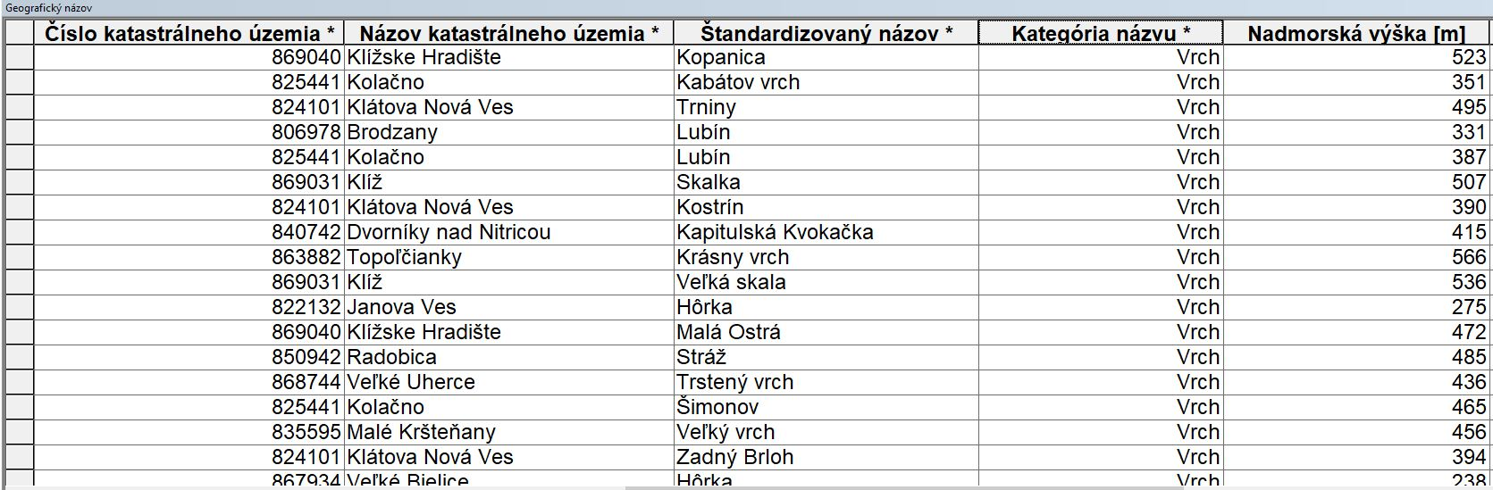
Example OF additional ATtributes for category "Peak"

Slide 10
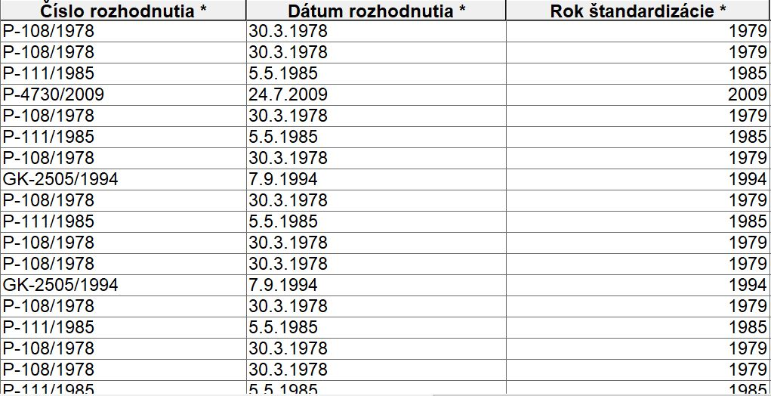
Example OF additional Attributes for category "Peak"

Slide 11
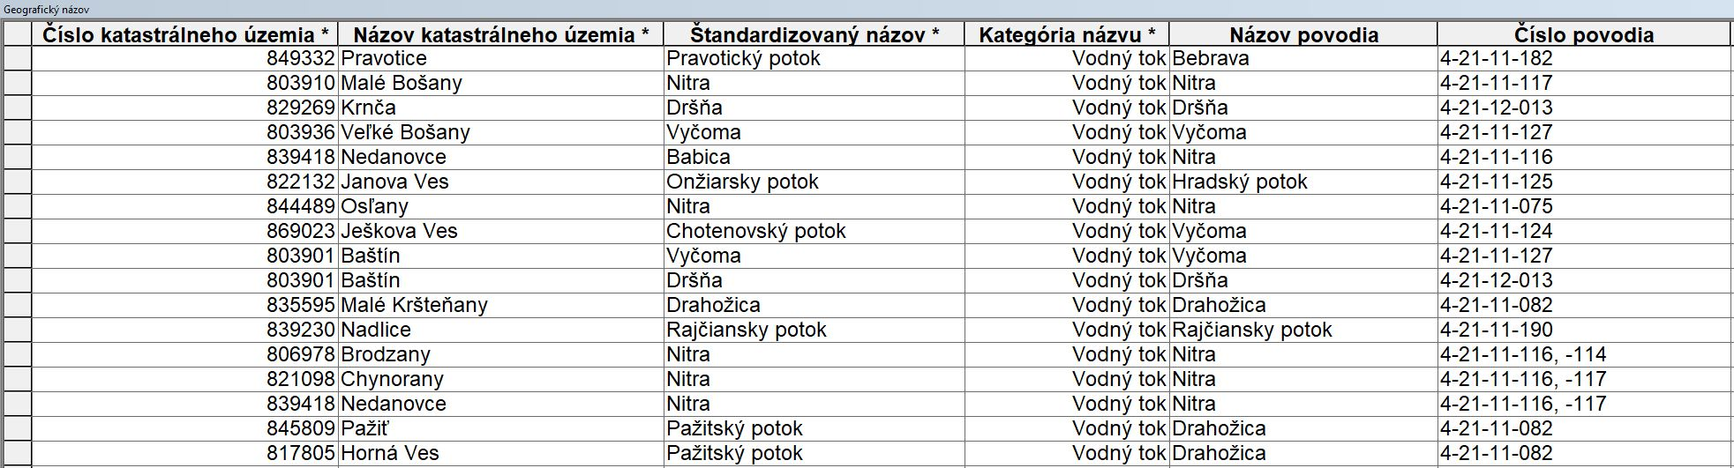
Example OF additional ATtributes for category "watercourse"

Slide 12
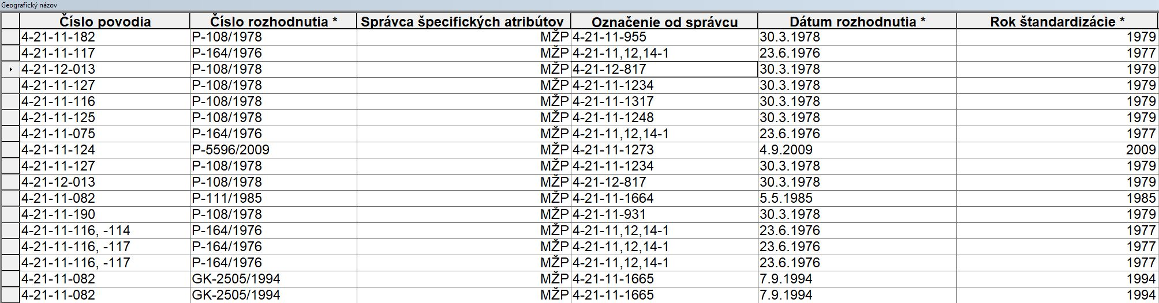
Example OF additional ATtributes for category "watercourse"

Slide 13
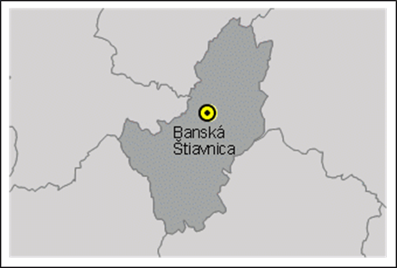
Project of densifying the content of the database of standardised geographical names by names from cadastral maps, forestry maps and managed watercourses names
Basic information about the project:
beginning in 2015
pilot district Banská Štiavnica
the work process is carried out in 3 phases
names in all cadastral areas of one district are considered
disputed names are verified with local experts
Materials used : historic maps (1:2880, 1:5000), ZM SR (1:10 000; 1:50 000),
water management map (1:50 000), military topographic map TM (1:25 000),
orthophotomosaic of the Slovak Republic, DMR 5.0

Slide 14
Project of densifying the content of the database of standardised geographical names by names from cadastral maps, forestry maps and managed watercourses names
1st phase
comparing names from cadastral maps and forest maps with standardised names from the ZBGIS database on the basis of maps
determining the position of the object, category and further manipulation of the object
completing of the attribute table
automatic generation of maps and name tables using scripts
sending the materials to to District Office Cadastral Departments (KOOÚ) for verification
or assessment.

Slide 15
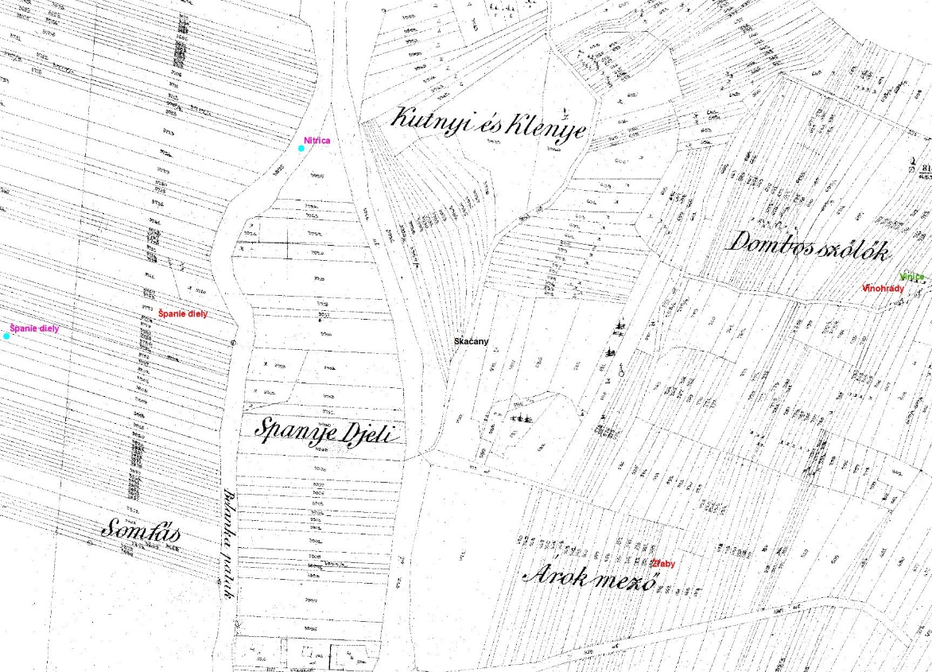
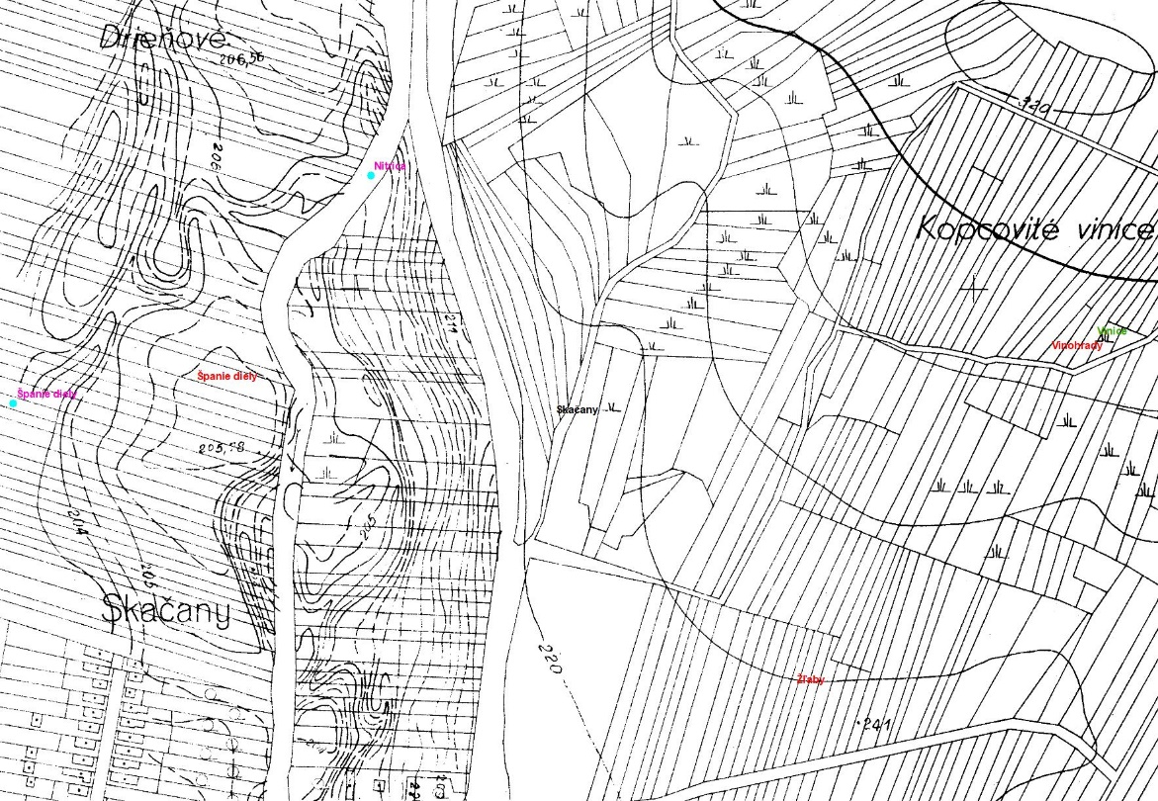
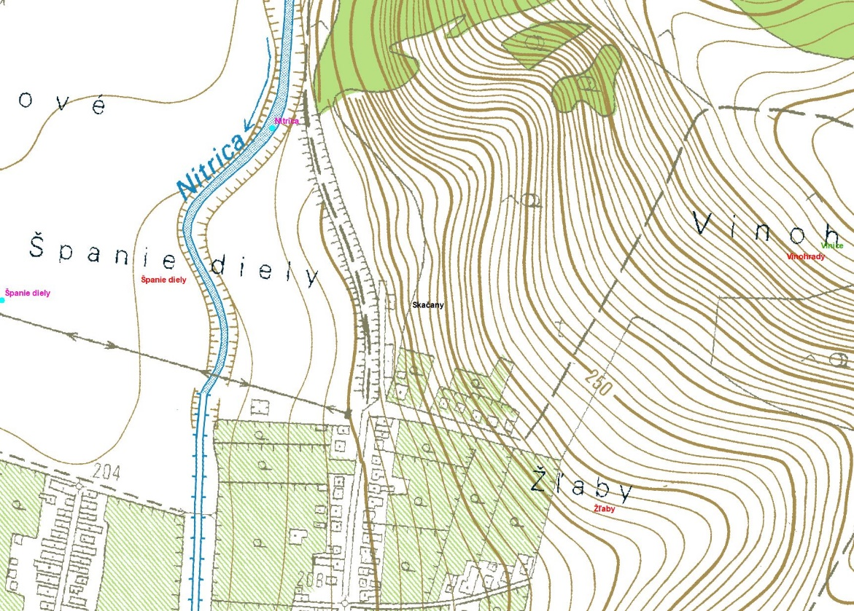
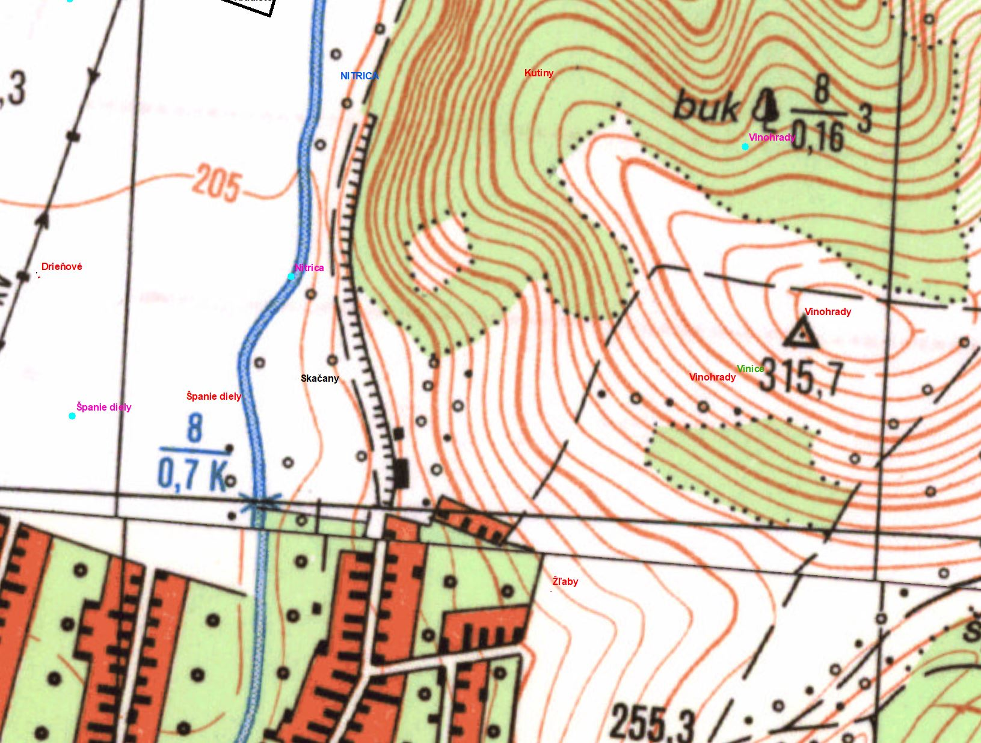
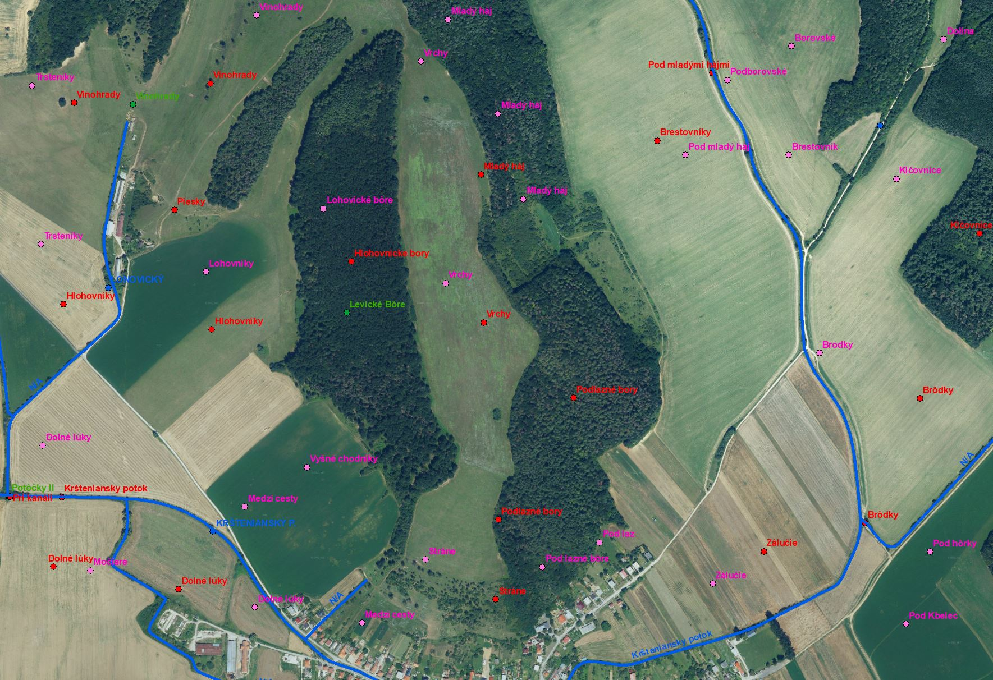
1st phase
Examples of used maps

Slide 16
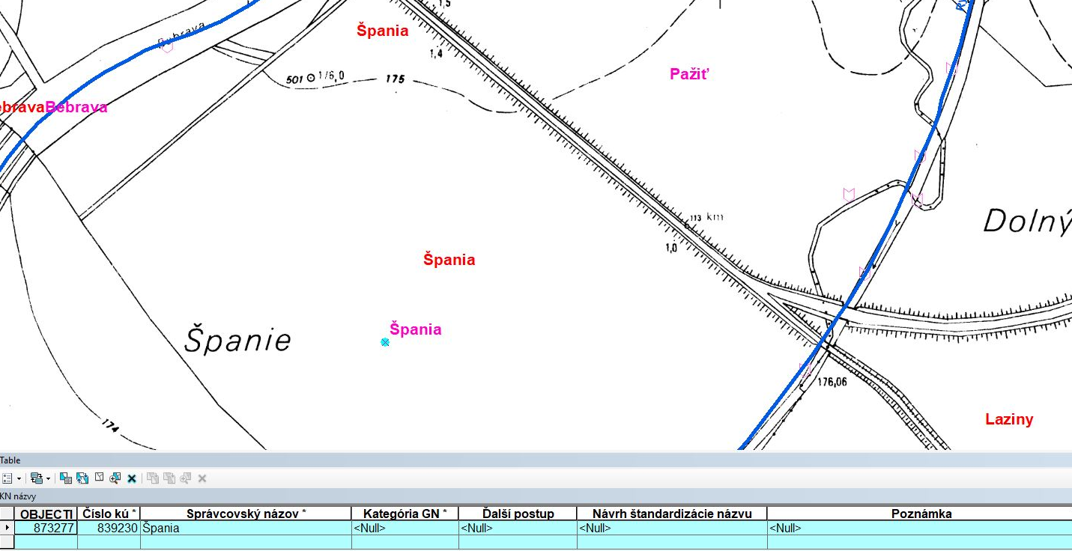
1. phase
EXAMPLE OF OBJECT "GN" FROM "KN" Label "ŠPANIA„ on a 1:5 000 map with attribute table

Slide 17
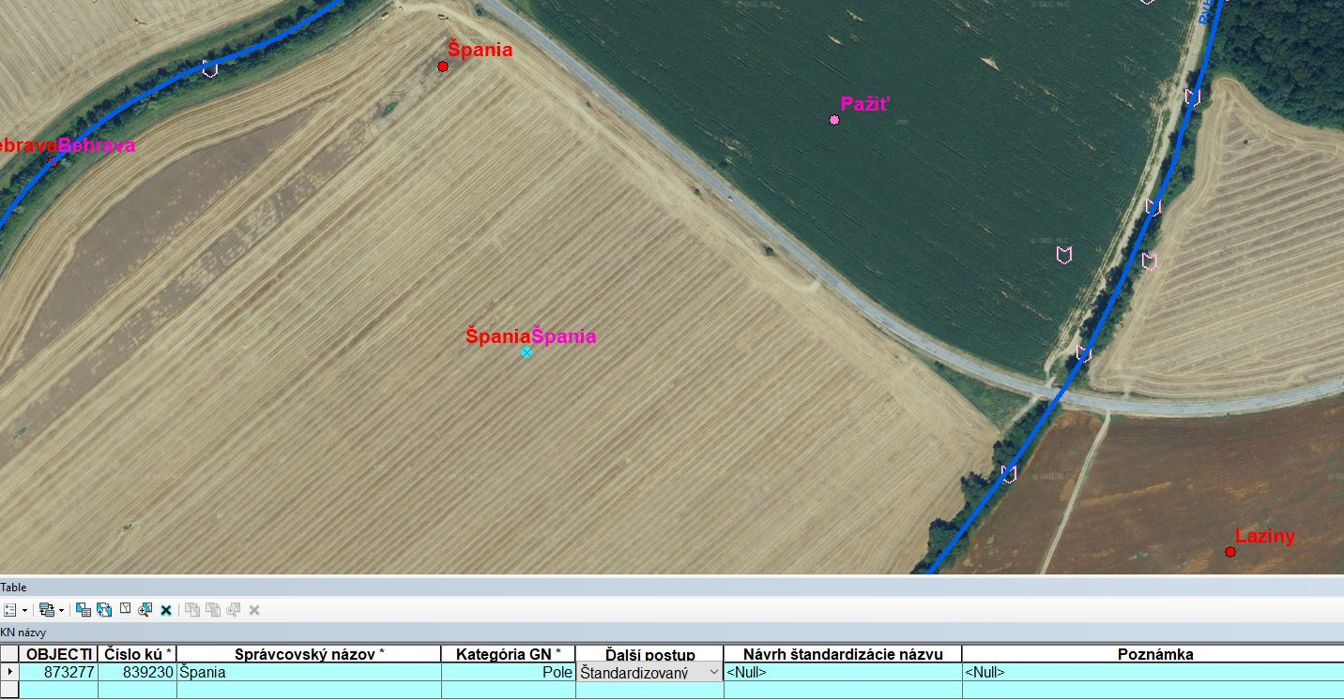
1. phase
EXAMPLE OF OBJECT "GN" FROM "KN" LABEL
on orthophotomap with filled attributes

Slide 18
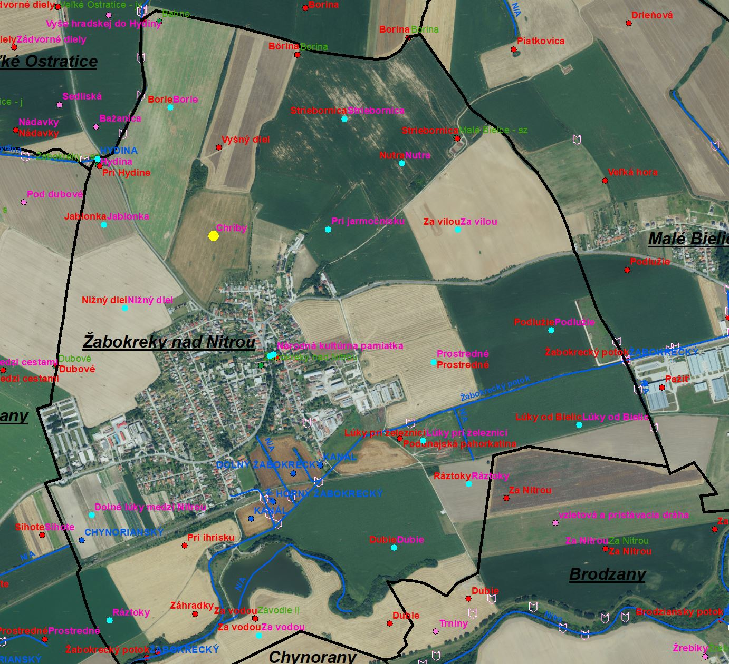
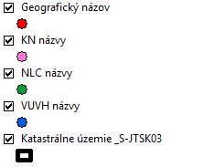
1. phase
EXAMPLE OF THE CADASTRAL AREA "ŽABOKREKY NAD NITROU"
ON THE ORTHOPHOTOMAP WITH GEOGRAPHICAL NAMES
LEGEND

Slide 19
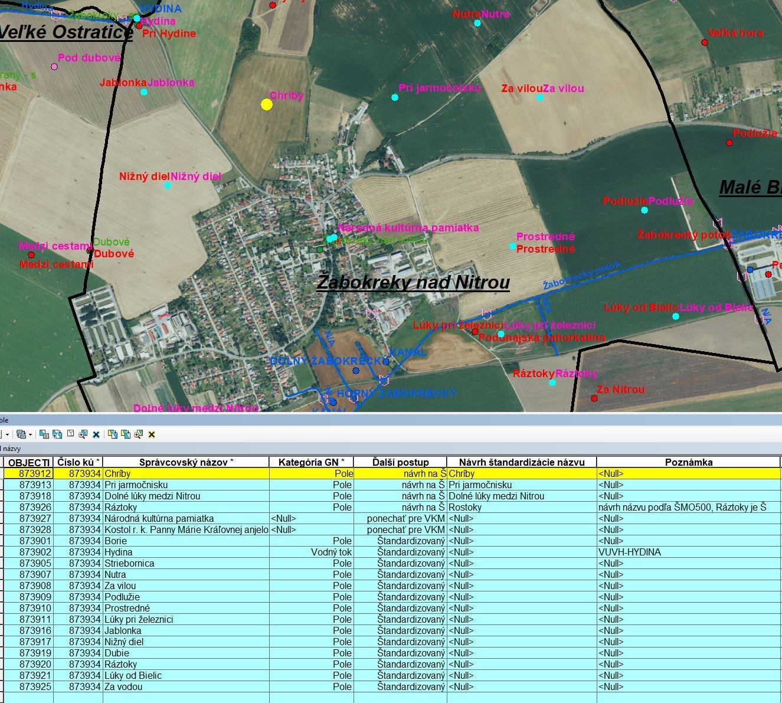
1. phase
EXAMPLE OF THE CADASTRAL AREA "ŽABOKREKY NAD NITROU"
ON THE ORTHOPHOTOMAP
WITH FILLED IN ATTRIBUTE TABLE
LEGEND

Slide 20
Project of densifying the content of the database of standardiSed geographical names by names from cadastral maps, forestry maps and managed watercourses names
2nd phase
- accepting the agreed documents from District Office Cadastral Departments (KOOÚ)
- incorporating relevant proposals
- preparing of materials for the Commission on Geographical Names (NK) meeting
- discussion of names at meeting of the Commission on Geographical Names

Slide 21
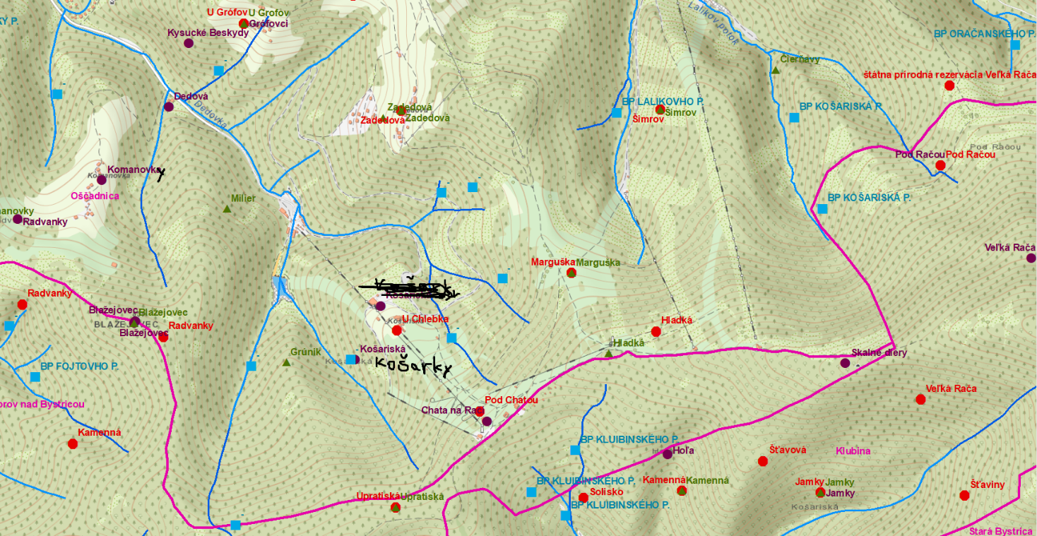
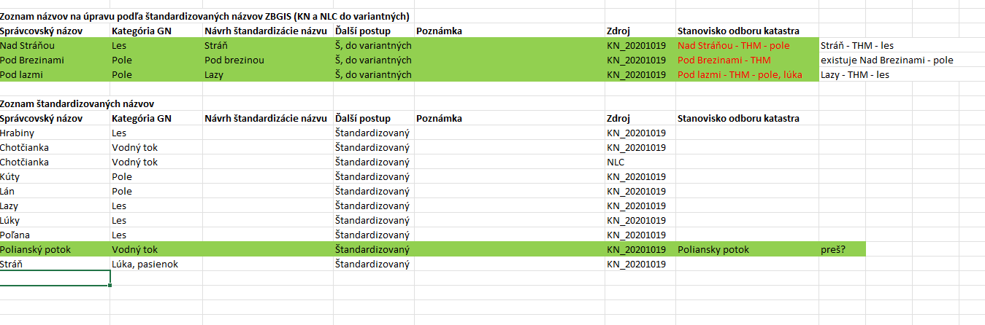
EXAMPLE of THE map, TABle
of District Office Cadastral Departments (KO OÚ) PROPOSALS
2nd phase

Slide 22
Project of densifying the content of the database of standardised geographical names by names from cadastral maps, forestry maps and managed watercourses names
3rd phase
- incorpoarting proposals of the NK, verification of disputed points
- in accordance with the law, requesting the opinion of the Ministry of Culture of the Slovak Republic (MK SR) and the Ministry of the Environment of the Slovak Republic (MŽP SR)
- after accepting the agreed documents, creating decisions on standardisation of names
- incorporating approved names into ZBGIS database
- filling out variant and historic names
- creating the VGI-format file with all geonames and sending it to District Office Cadastral Departments (KOOÚ)

Slide 23
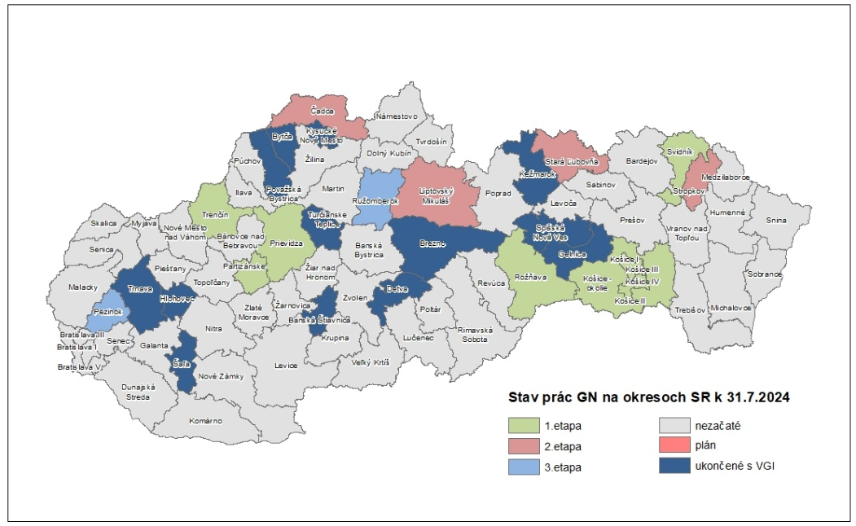
PROJECT STATUS
Finished districts:
Banská Štiavnica, Šaľa, Hlohovec, Kysucké Nové Mesto, Turčianske Teplice, Považská Bystrica, Bytča, Brezno, Detva, Trnava, Kežmarok, Gelnica, Spišská Nová Ves, Pezinok, Ružomberok
(15 districts – 21 % of the SR)
Districts in process:
Čadca, Liptovský Mikuláš, Prievidza, Rožňava, Stará Ľubovňa, Stropkov, Svidník, Košice okolie, Trenčín, Košice, Partizánske
(11 districts - 15 % of the SR)
Finished districts + districts in process:
26 districts = 36 % of 100 %
By 2015, the database contained 135 562 standardised names.
Since 2015 (in scope of the project), 15 728 standardised names were added.

Slide 24
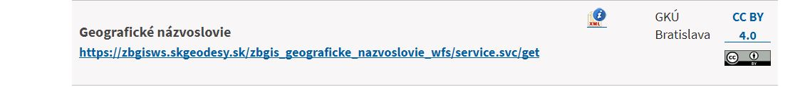
GEOGRAPHICAL NAMES ARE AVAILABLE FOR FREE
Formats:
GPKG EsriSHP Esri GDB CSV
https://www.geoportal.sk/sk/zbgis/na-stiahnutie/
Freely available map services WITH GEOGRAPHICAL NAMES
Web Map Service WMS
https://www.geoportal.sk/sk/sluzby/mapove-sluzby/wms/wms-zbgis.html
Web Feature Service WFS
https://www.geoportal.sk/sk/sluzby/mapove-sluzby/wfs/

Slide 25
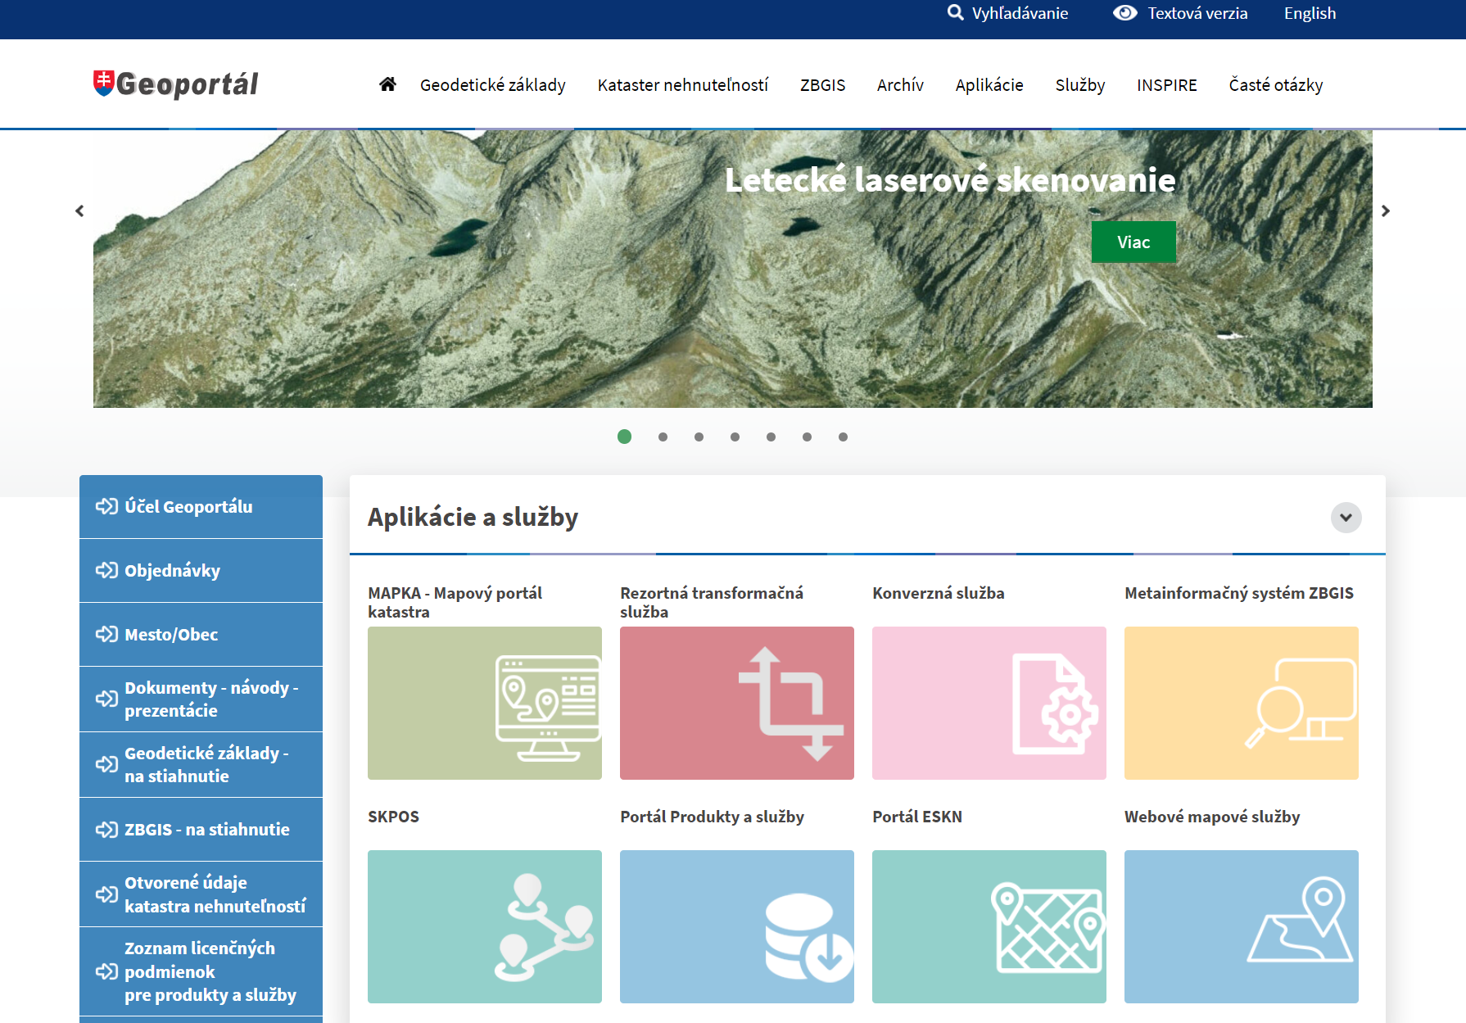

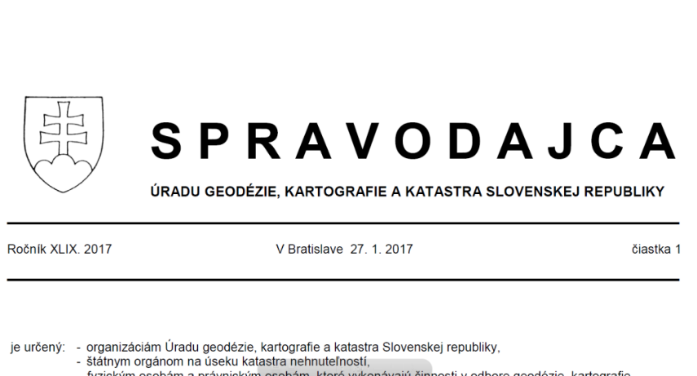
Publication of the results of the standardisation of geographical names
https://www.skgeodesy.sk/sk/ugkk/rezortne-periodika/#Spravodajca
https://zbgis.skgeodesy.sk/mapka/
https://www.skgeodesy.sk/sk/ugkk/rezortne-periodika/#Nazinfo

Slide 26
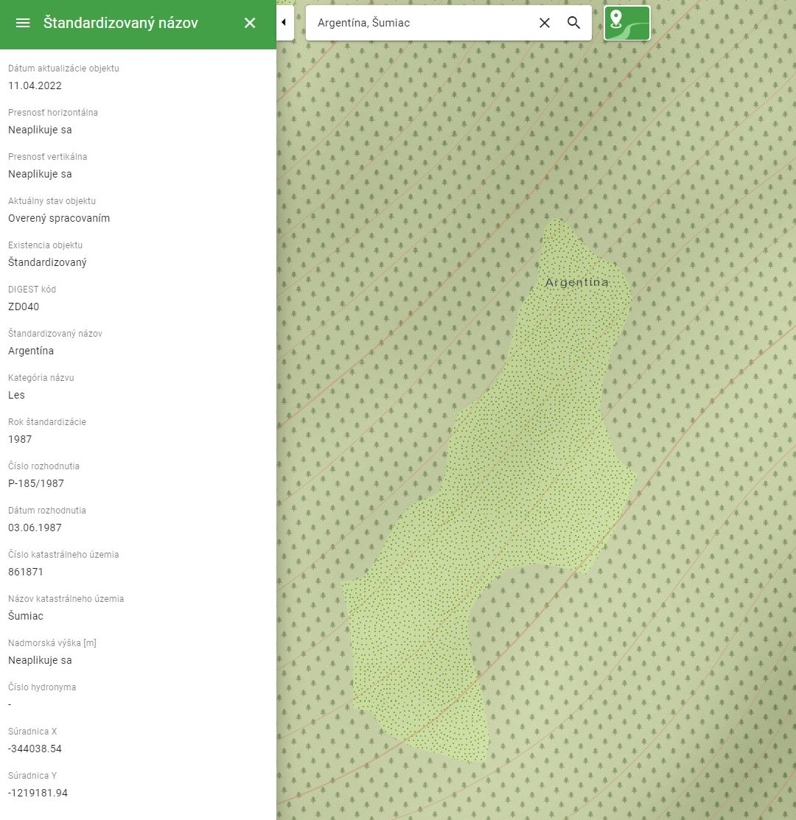
Searching in "MAPKA"
by STANDARDISED name

Slide 27
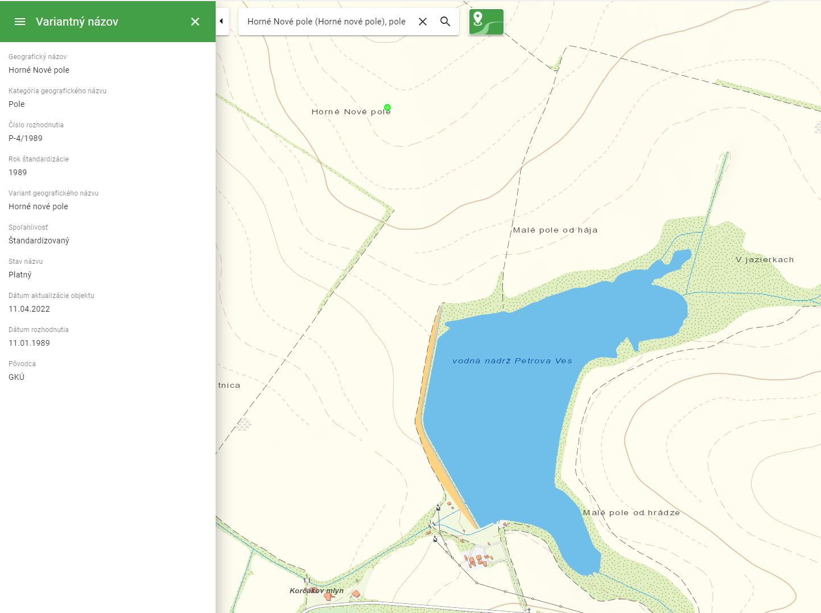
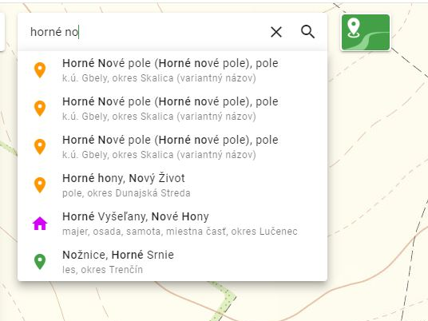
Searching in "MAPKA" by variant name

Slide 28
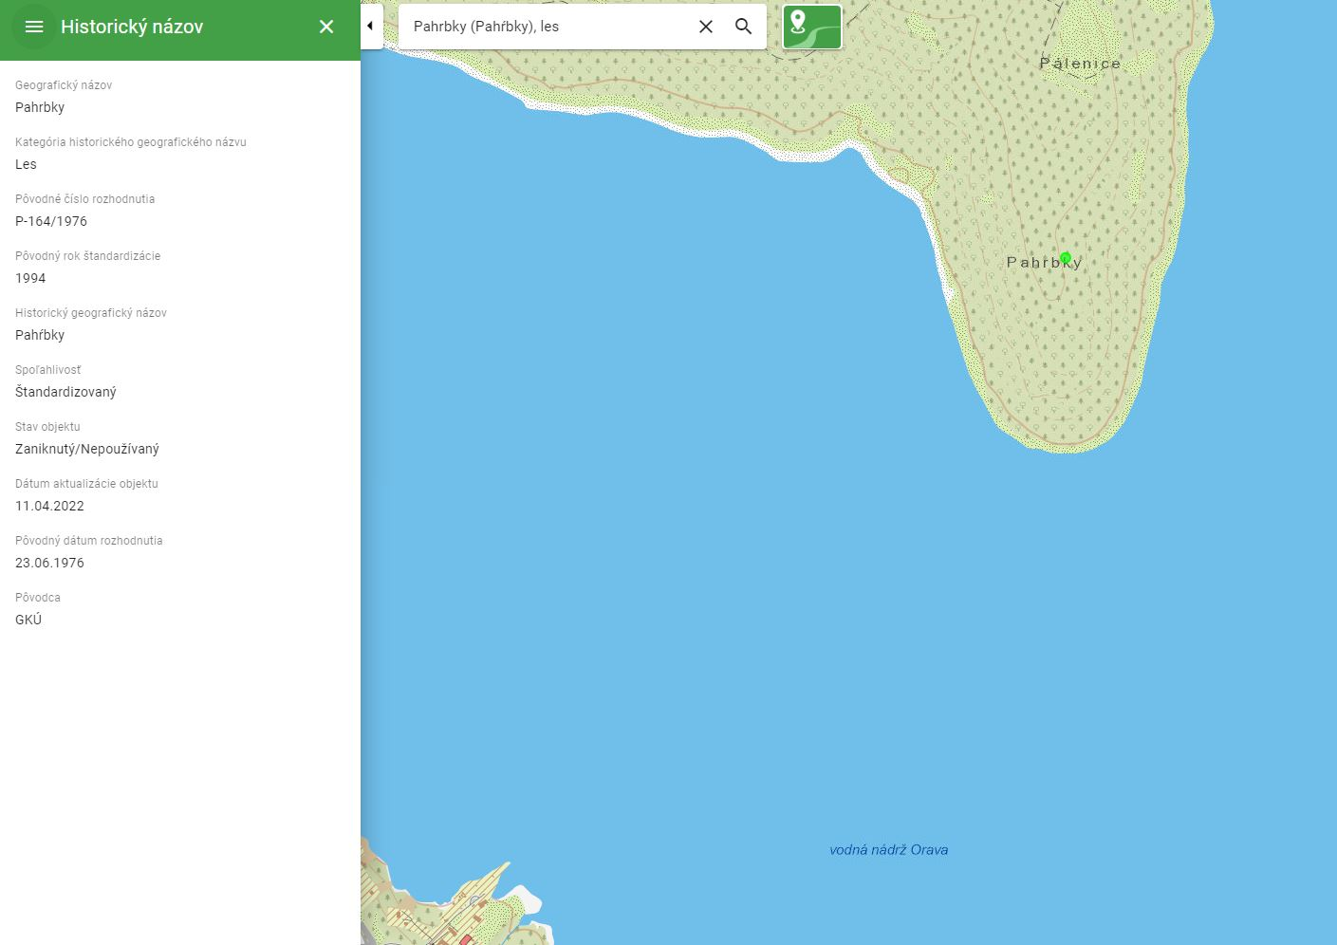
Searching
in "MAPKA"
by HISTORical
name

Slide 29
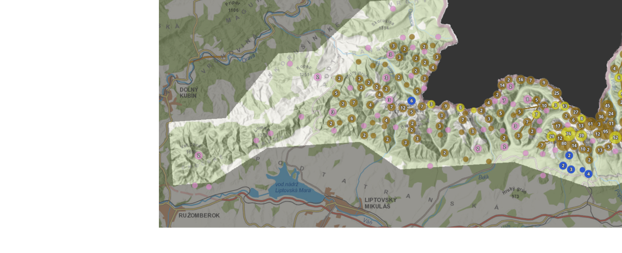
project "Comprehensive Revision and Updating of Geonames in the Tatra Mountains, including refinement of heights and positions of objects geomorphological features in the Tatra Mountains"
- project started in 2021
- test locality – the Tatra Mountains
- analysis of the location of existing SGN and correction of verified inaccuracies on the annotationslevel
- determination of existing SGN heights according to the new DMR 5.0 and comparison with the values reported by different entities
- proposal of the location of the SGN to mathematically determined positional extremes and extension by objects from available sources
- for professionals was created acess to edit the proposals of location and form of the name in online ArcGIS application

Slide 30
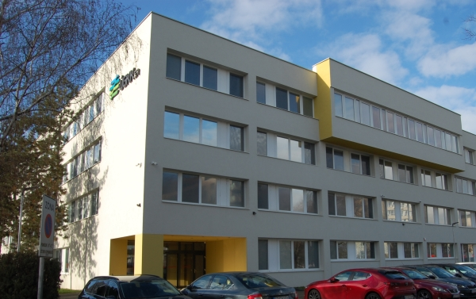


THANK YOU FOR YOUR ATTENTION!
The Geodesy, Cartography and Cadastre Authority of the Slovak Republic:
https://www.skgeodesy.sk/sk/
Geodetic and Cartographic Institute Bratislava:
https://www.gku.sk/gku/
Geoportal:
https://www.geoportal.sk/sk/geoportal.html
maria.kubicova@skgeodesy.sk
zuzka.michalkova@skgeodesy.sk
eva.miklusova@skgeodesy.sk

