Slide 1
Automated creation of weather maps using global forecast and reanalysis models
GeoKARTO 2024
Peter Pavličko, Adam Šolc
5. - 6. September 2024 | Stará Lesná

Slide 2
Context
Rystad Energy – independent energy research and business intelligence company providing data, tools, analytics, and consultancy services to clients exposed to the energy industry across the globe
Modelling of the global energy system dynamics and future scenarios​
Increasing demand for information derived from real-time data; spatial data play a significant role in this process​
Technological innovations and advances allow analyzing data in a more complex way and in real-time timeframes and predict future scenarios​
Weather - significant impact on energy consumption and the energy sector in general
Weather data typically used on regional level analysis (from country to global region level, ie. Germany, West Europe, Texas)

Slide 3
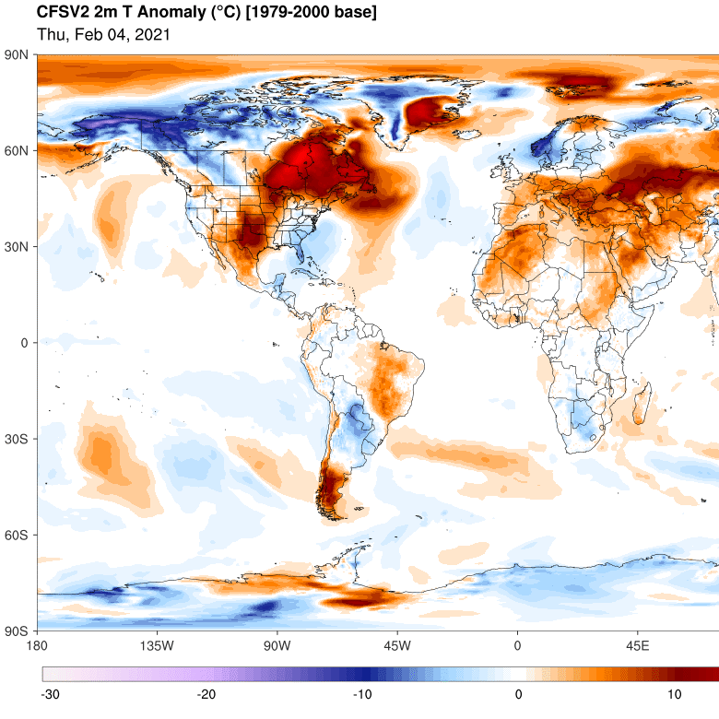
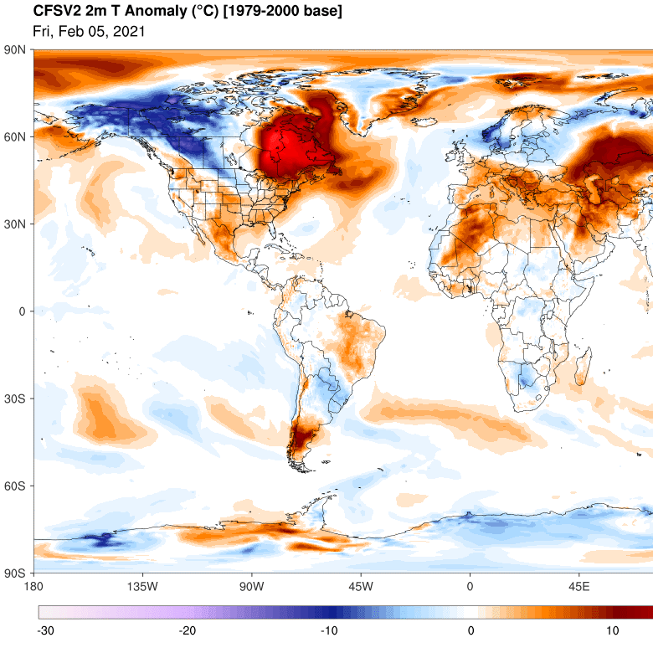
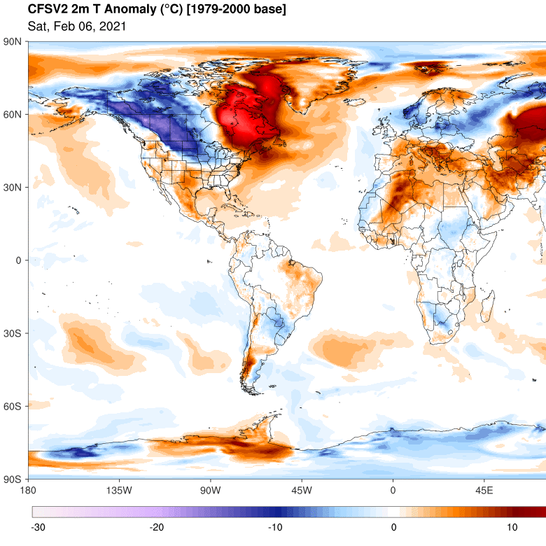
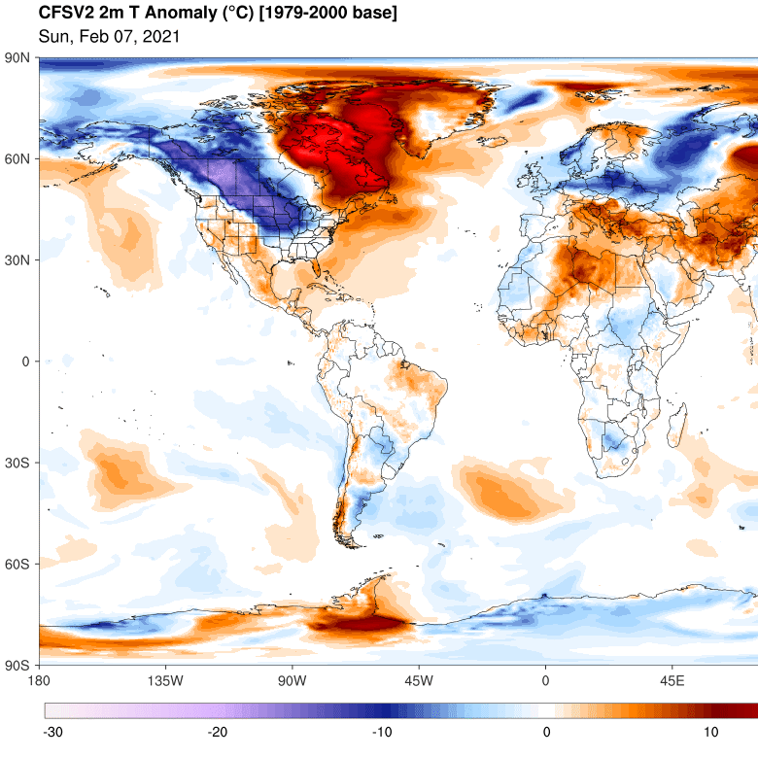
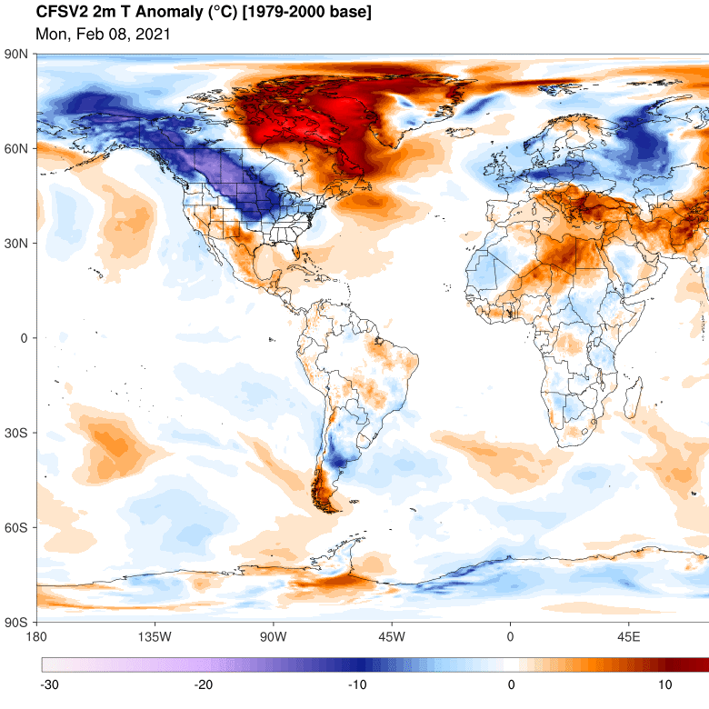
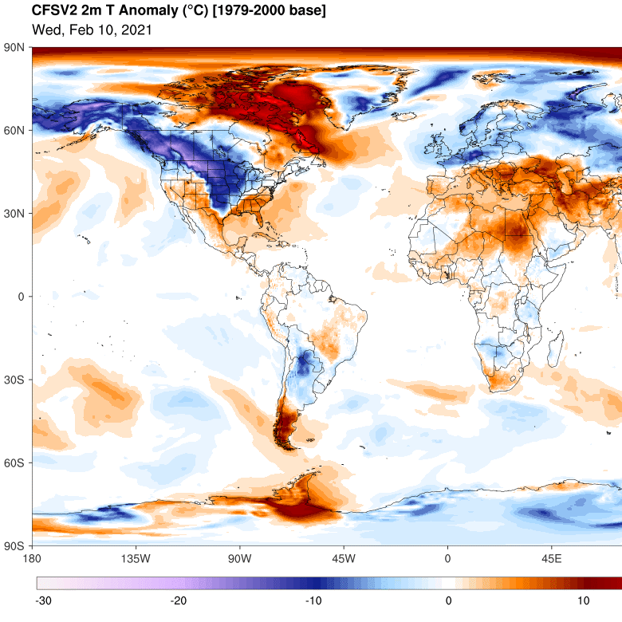
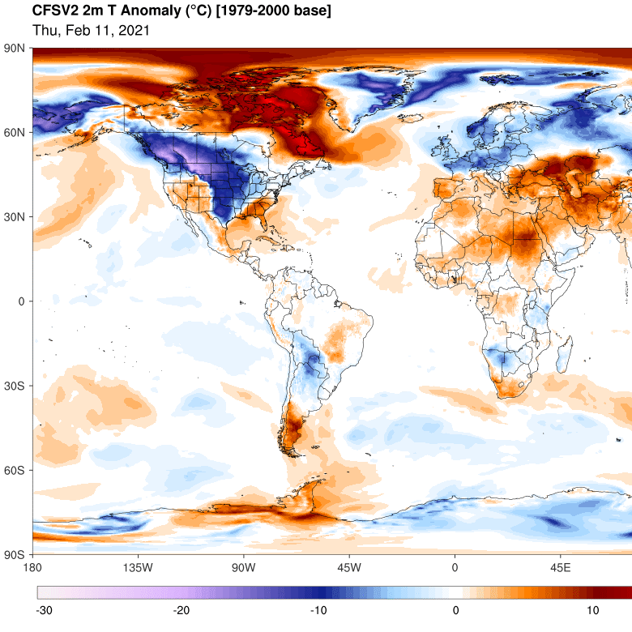
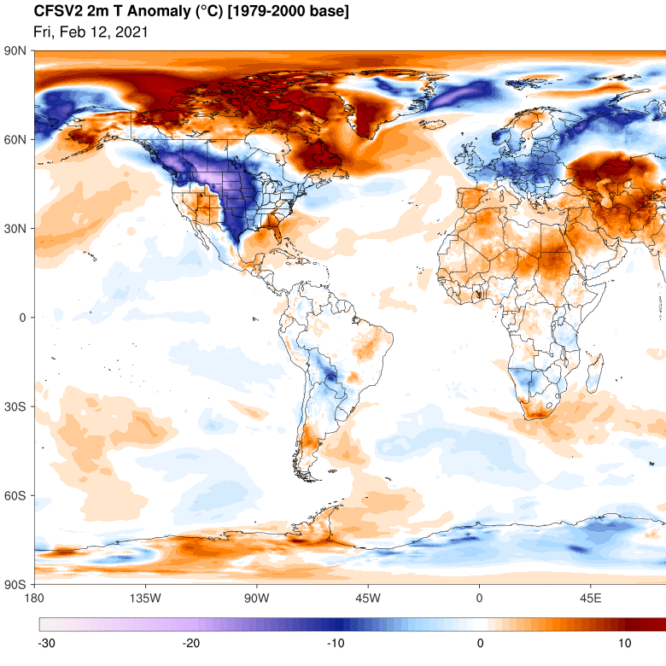
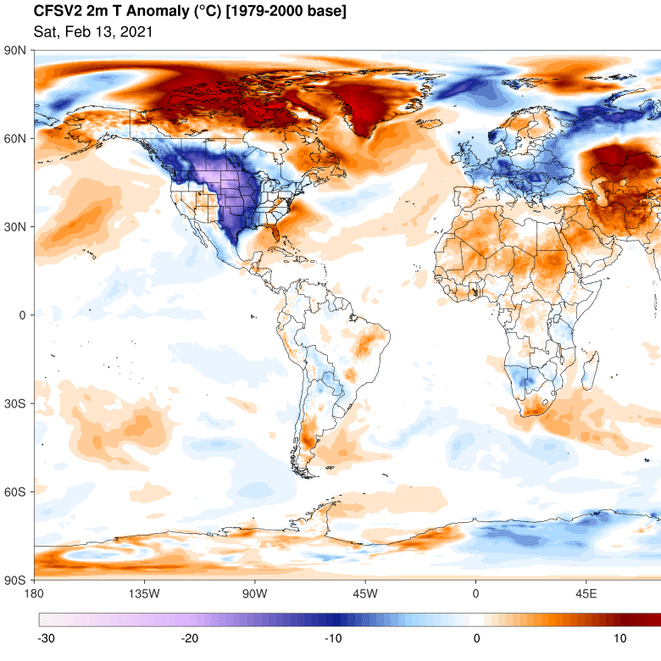
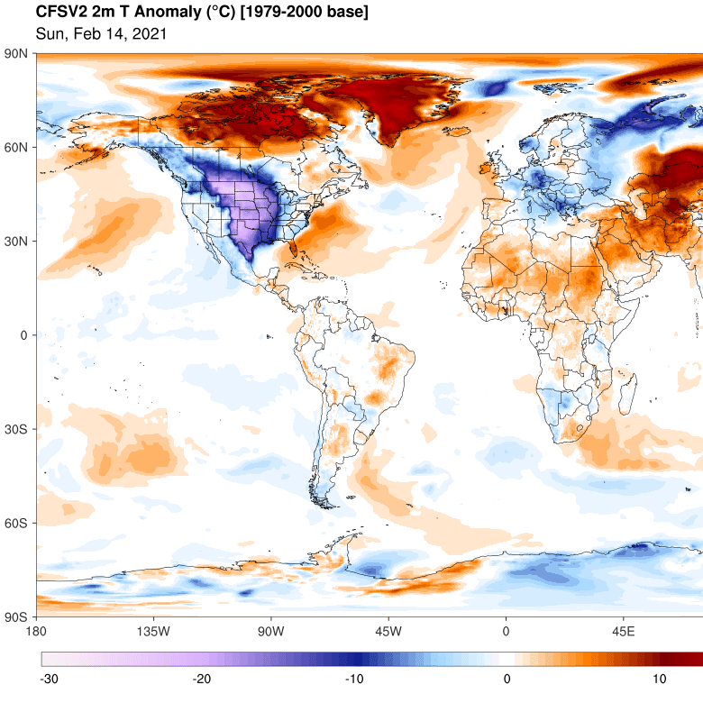
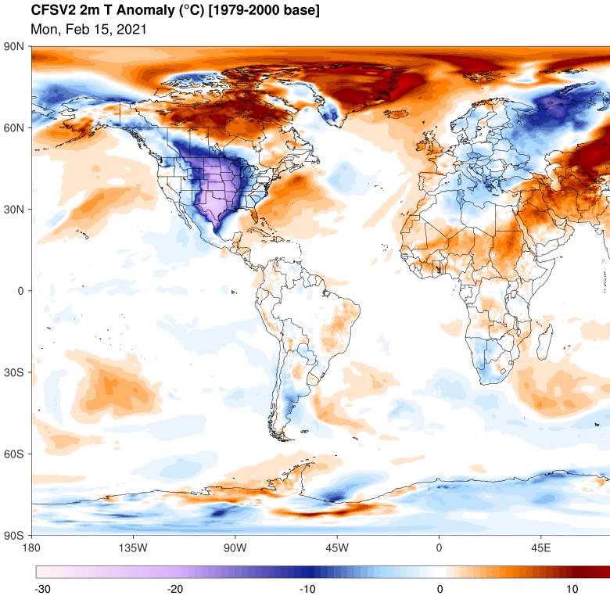
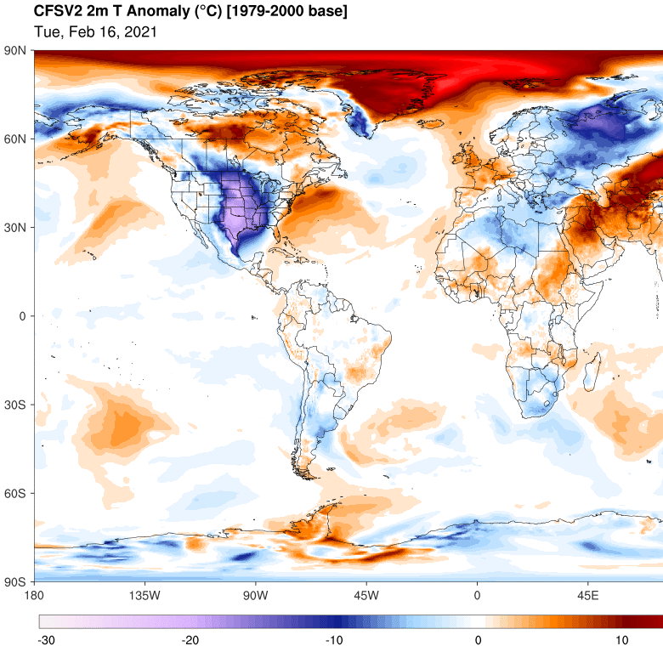
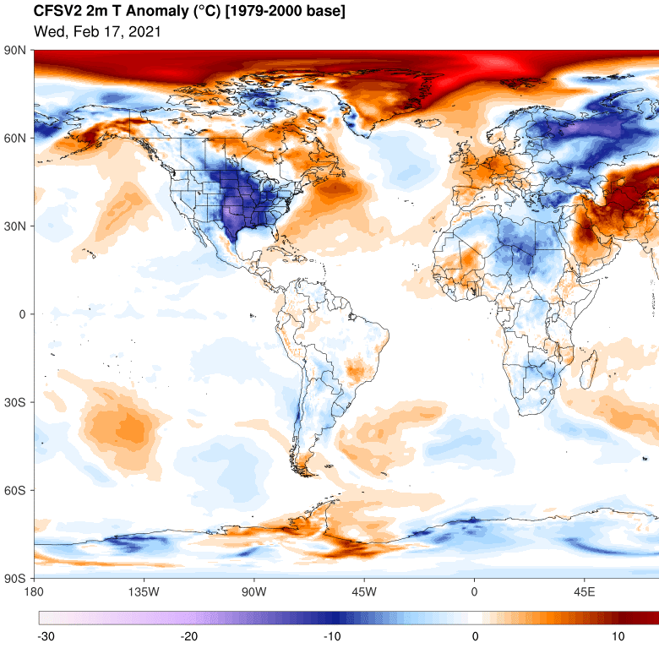
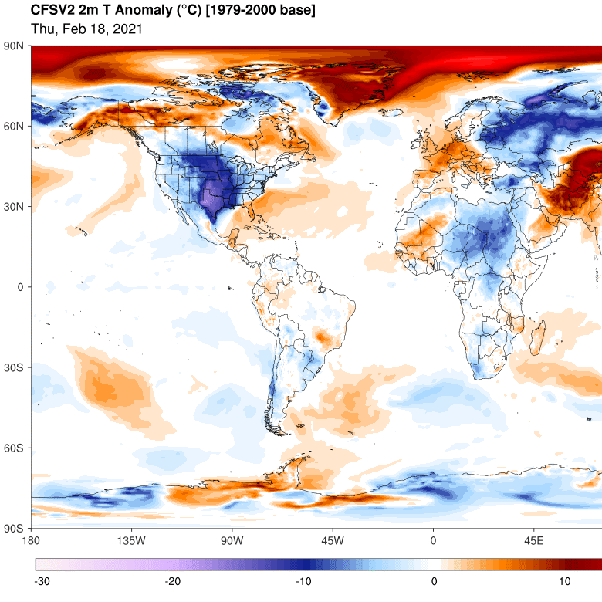
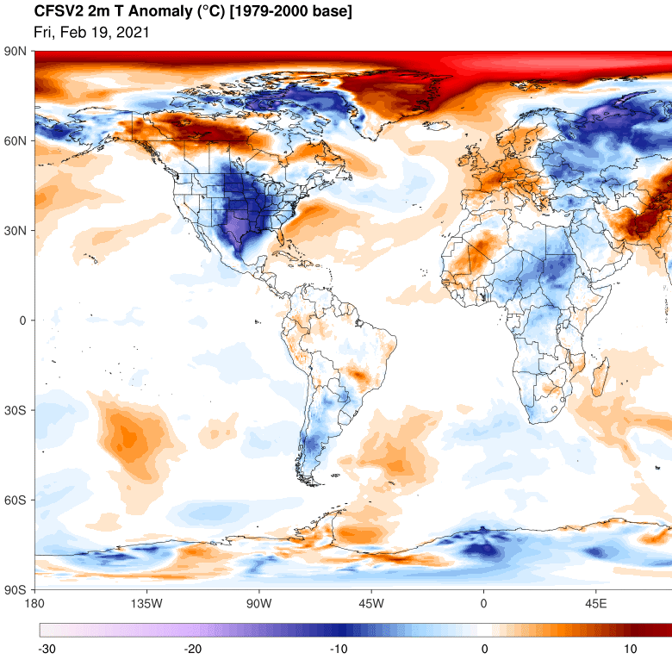
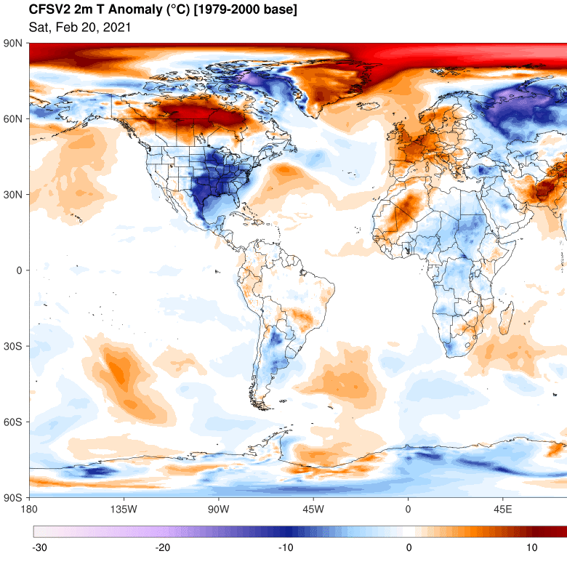
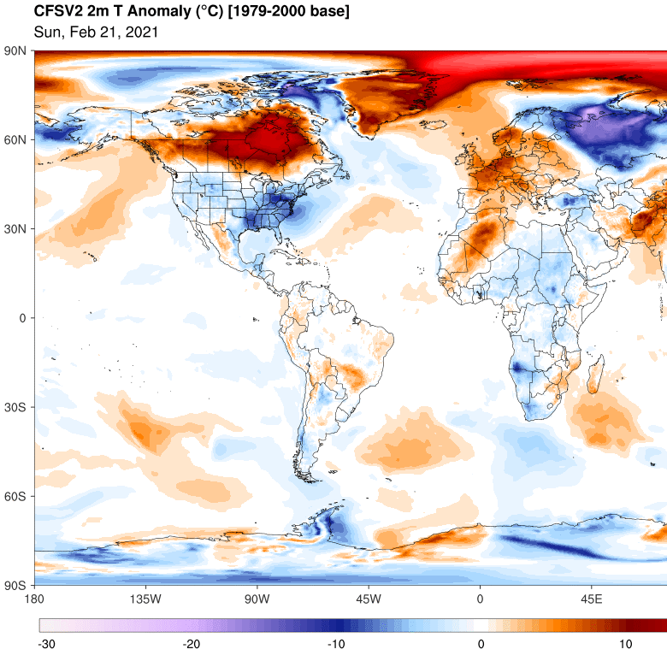
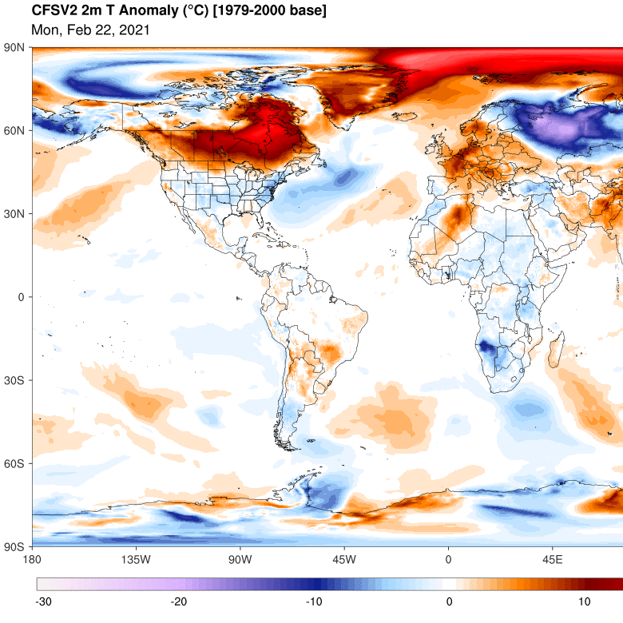
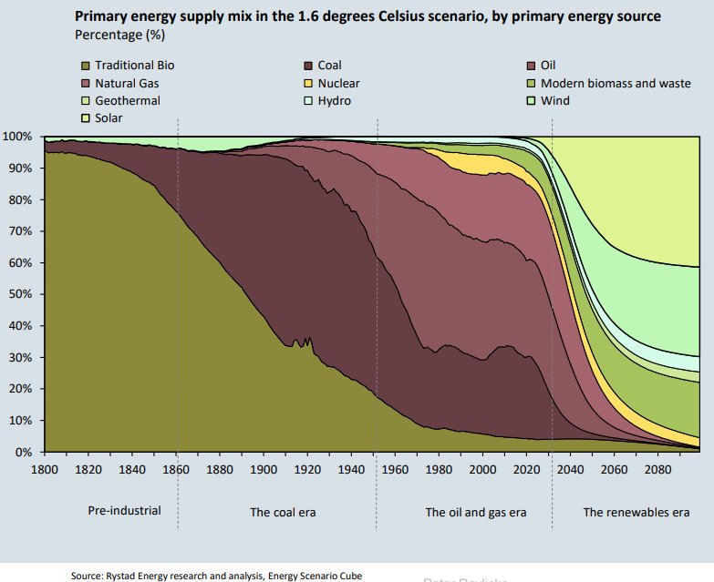
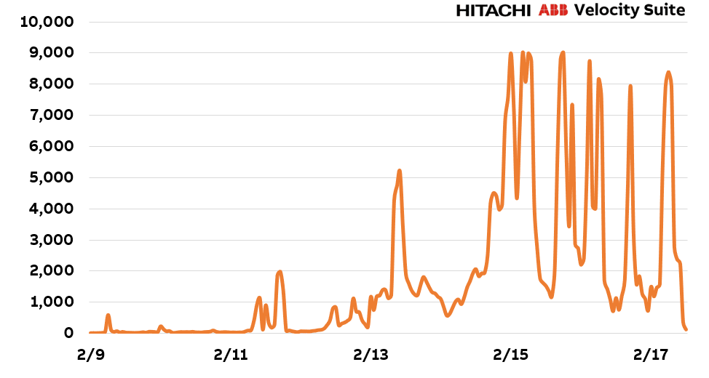
Weather
Weather – a significant factor, impact on
Short-term:
energy consumption (heating, cooling) => demand (market)
power generation from renewables (wind, solar, water resources)
Long-term – primary energy source; future energy scenarios
1. ERCOT real-time average hourly electricity prices, Feb. 9-17, 2021, $/MWh Source: Hitachi ABB Power Grids

Slide 4
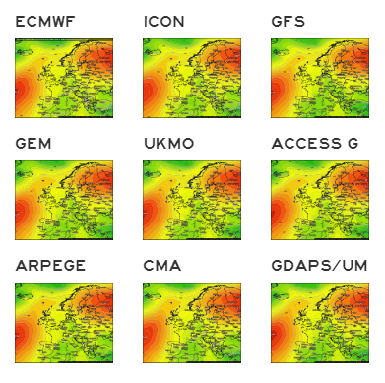
Research on weather forecast data availability
Global models
ECMWF HRES(~9km)
ECMWF EPS (~14km)
ICON (~13km)
GFS (~23km)
GEFS (~23km)
MULTI (~12km)
UKMO (~10km)
ACCESS-G (~27km)
ARPEGE (~46km)
CMA (~23km)
GDAPS/UM (~10km)
GFS and ECMWF – the most relevant models in terms of accuracy and resolution​
​ECMWF requires a license to get data in NetCDF or GRIB format https://www.ecmwf.int/en/forecasts/accessing-forecasts/payment-rules-and-options/tariffs
GFS data is not copyrighted and is available for free in the public domain under provisions of U.S. law. ​
NASA GMAO – GEOS products, no restrictions, alternative, but not that robust as GFS ​
Notes:
Tento slajd zobrazuje zoznam globálnych predpovedných modelov, ich relevantosť a dostupnosť..

Slide 5
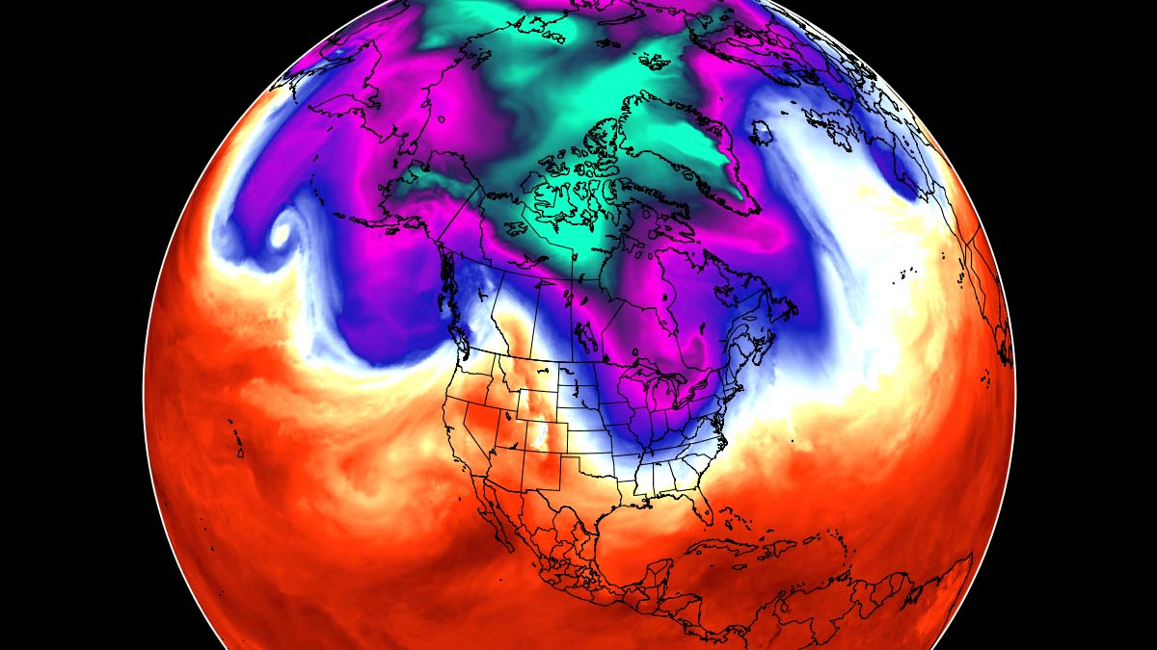
Global Forecast System (GFS)
Global numerical weather prediction system containing a global computer model run by the US’ National Weather Service
Model is run four times a day, produces forecast for up to 16 days in advance
127 vertical layers – subsurface level to upper stratosphere (~55km height), the latest version ( mesopause (~80km)
Equally spaced long/lat grid (0.25 degree) with temporal resolution of 1 hour out to 120 hours, then 3 hours for days 5-16

Slide 6
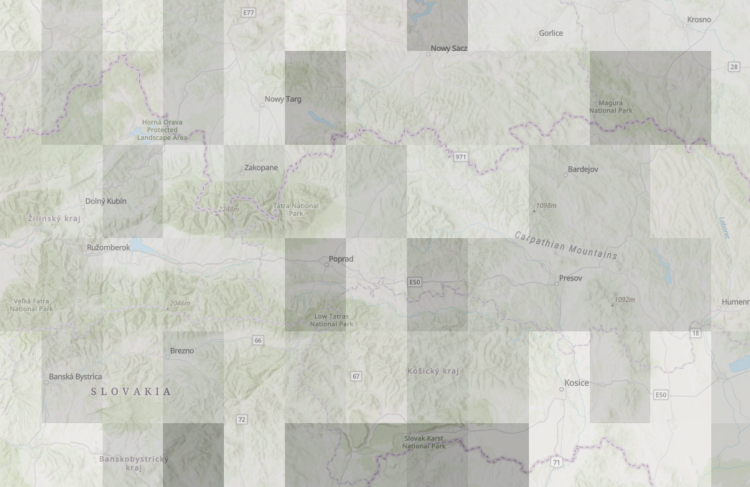
GFS model resolution example
Forecast is available 4xDay at 00/06/12/18UTC
Grid resolution 0.25*0.25 degree (~20km)
18km

Slide 7
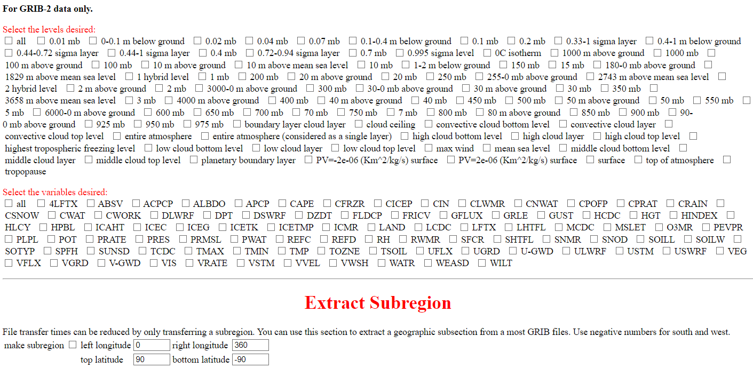
GFS REST API Access
Model variables and levels - specific Url links, GRIB format
Inventory file: https://www.nco.ncep.noaa.gov/pmb/products/gfs/gfs.t00z.pgrb2.0p25.f000.shtml

Slide 8
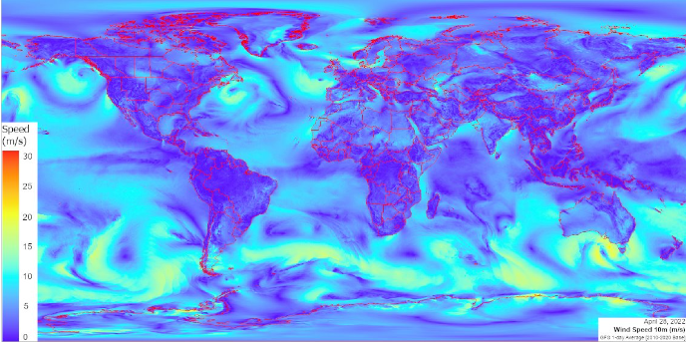
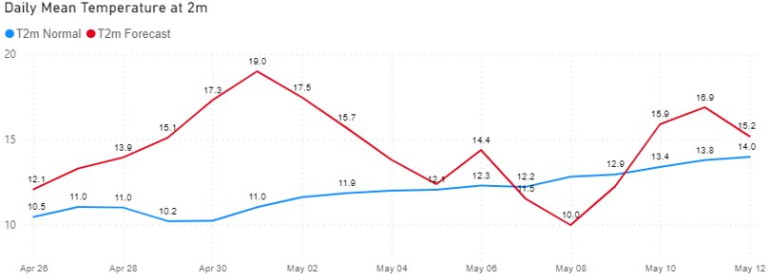
Data processing and map generation
ArcGIS Pro and ArcPy (Python library for ArcGIS)
Map templates
Export layout
Maps in raster format
Spatial statistics
(avg, min,max)
GFS GRIB
Convert
ArcGIS CRF
Daily rasters
Zonal statistics
SQL table
Administrative boundaries
(polygon)

Slide 9
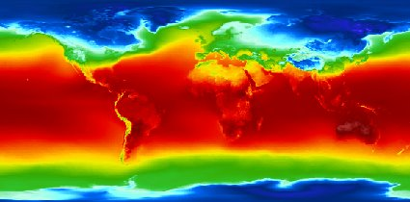
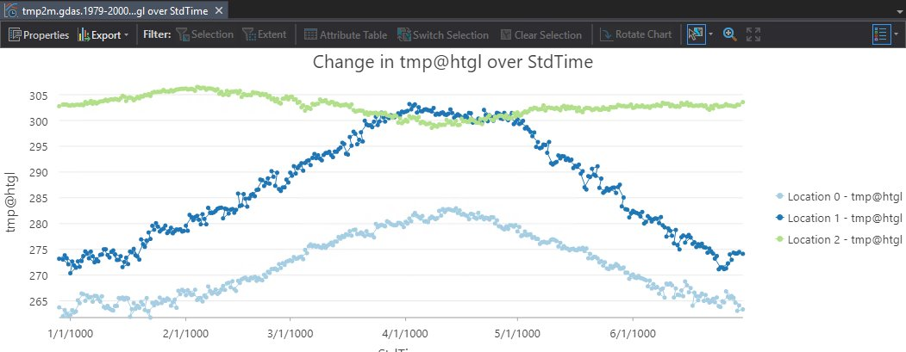
Reanalysis – looking back to history
Definition: “Reanalysis is a scientific method for developing a comprehensive record of how weather and climate are changing over time. In it, observations and a numerical model that simulates one or more aspects of the Earth system are combined objectively to generate a synthesized estimate of the state of the system. A reanalysis typically extends over several decades or longer, and covers the entire globe from the Earth’s surface to well above the stratosphere.” Source: https://reanalysis.org
Several global models publicly available (ECMWF ERA5, NCEP CFSR/CFSv2, NASA MERRA V2)
Grid resolution, temporal resolution, and format the same as weather forecast models
Climate normals can be derived from reanalysis
Anomaly maps (ie. temperature anomaly maps); regional climate trends

Slide 10
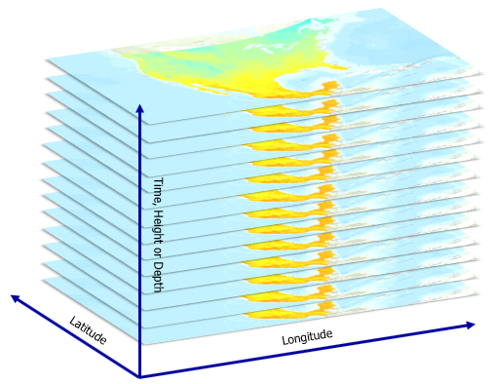
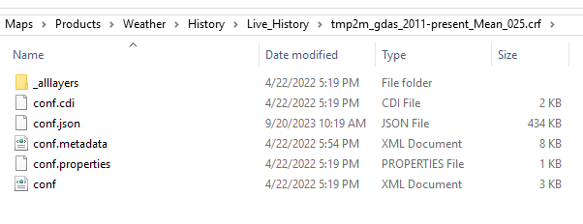
Multidimensional raster data
Common storage formats for multidimensional data: netCDF, GRIB, and HDF
ESRI introduced Cloud Raster Format (CRF); default in ArcGIS products since 2018
Designed to optimize storage and processing of large raster datasets in the cloud or distributed environment; more performant for reading and writing than NetCDF
We store each parameter in a separate CRF file (e.g. temperature, wind speed, etc.)

Slide 11
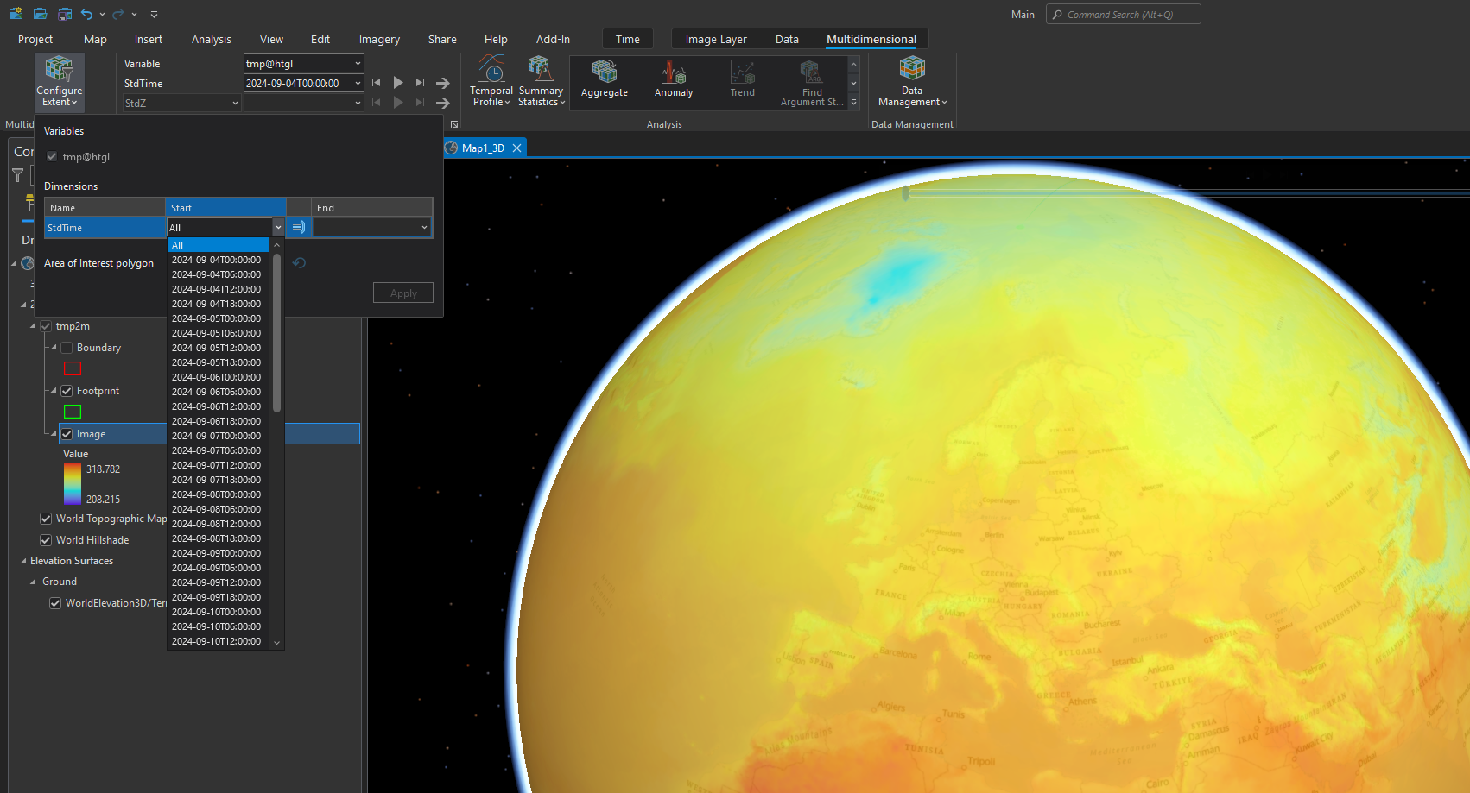
Working with CRF in ArcGIS Pro

Slide 12
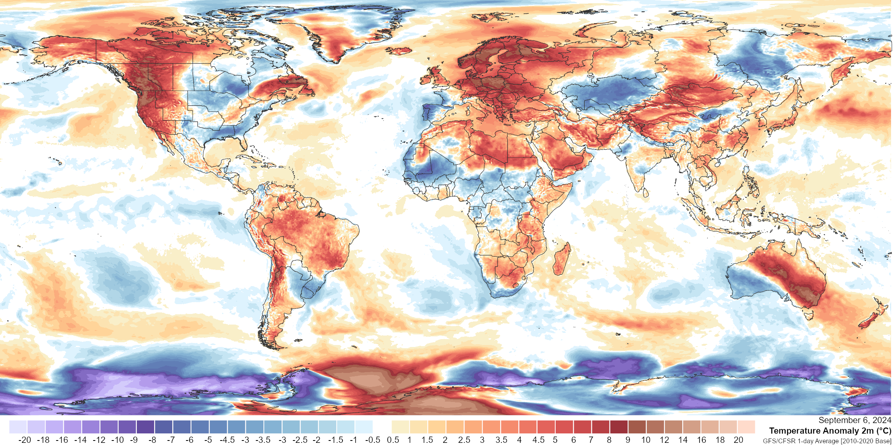
Examples

Slide 13
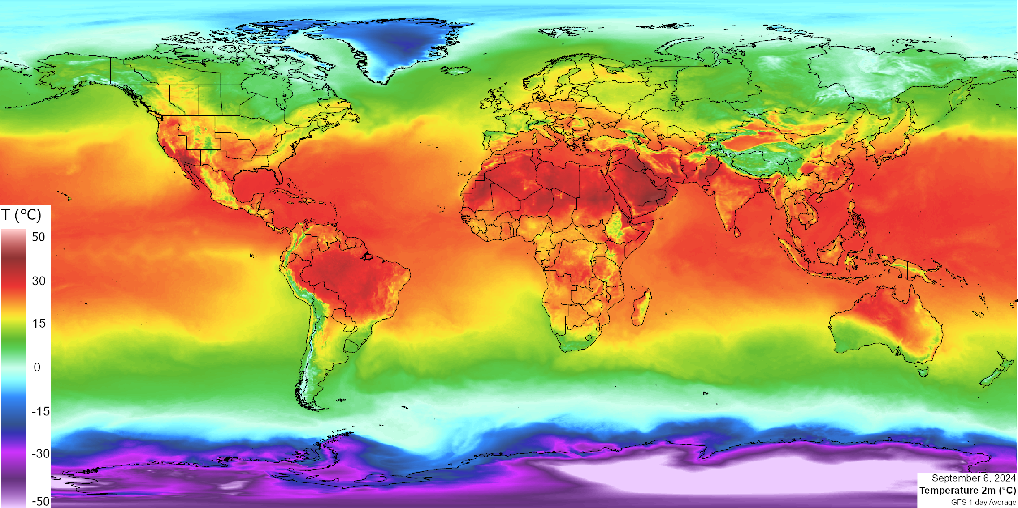

Slide 14
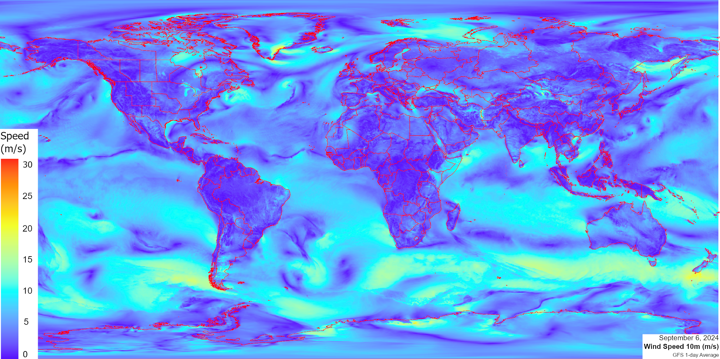

Slide 15
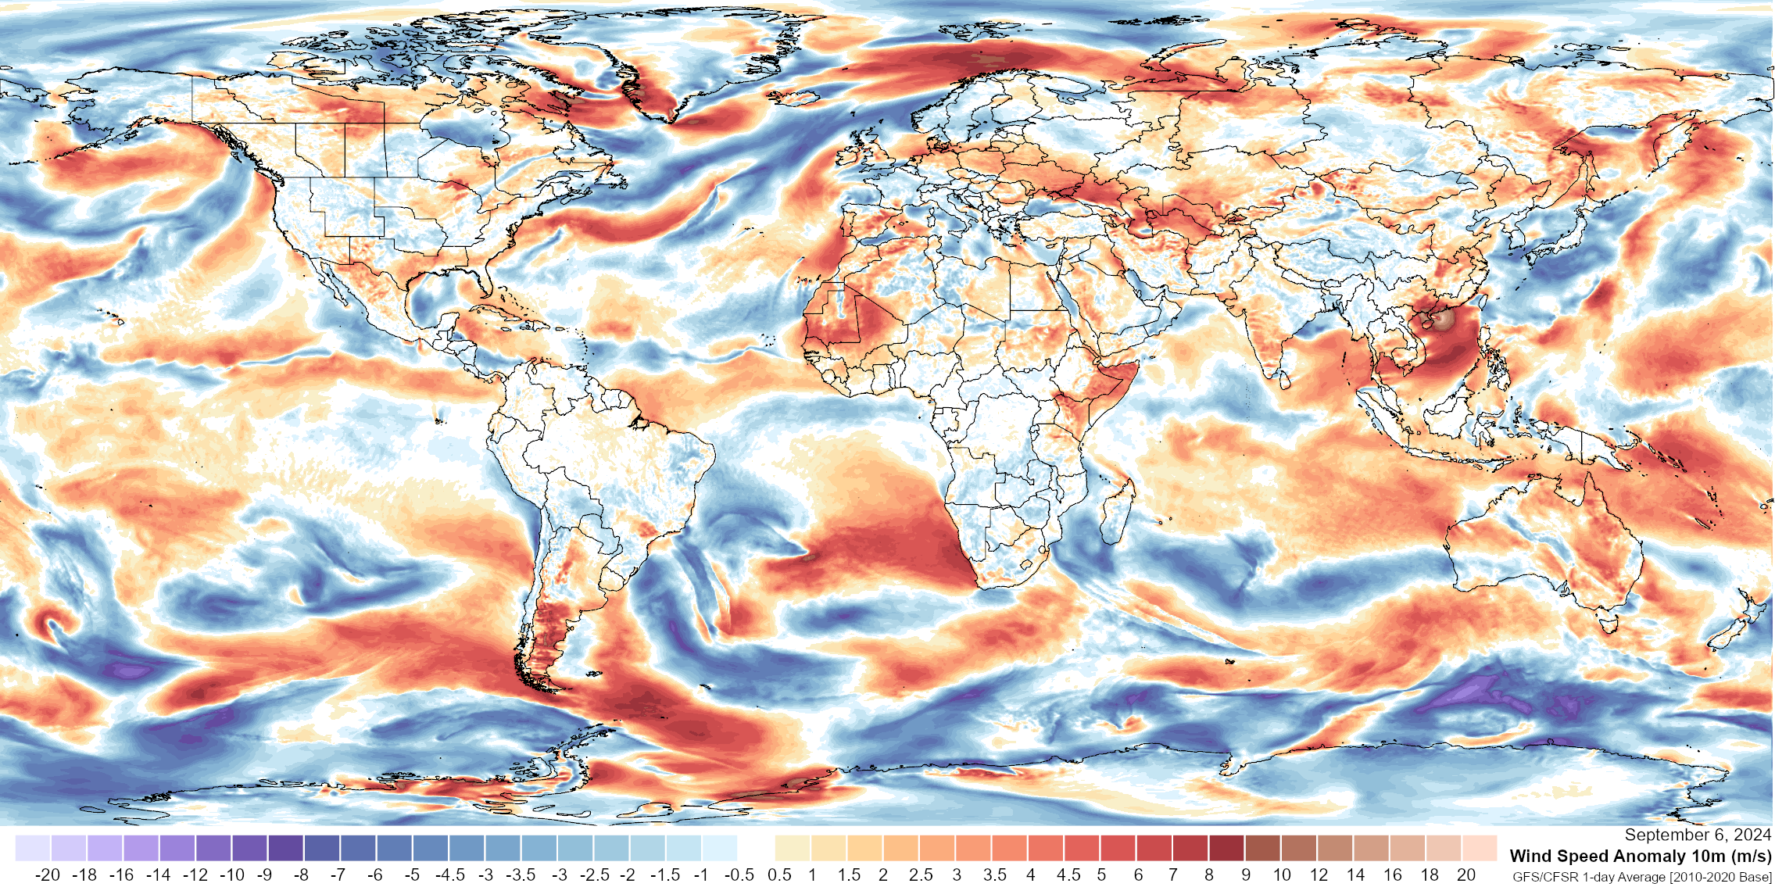

Slide 16
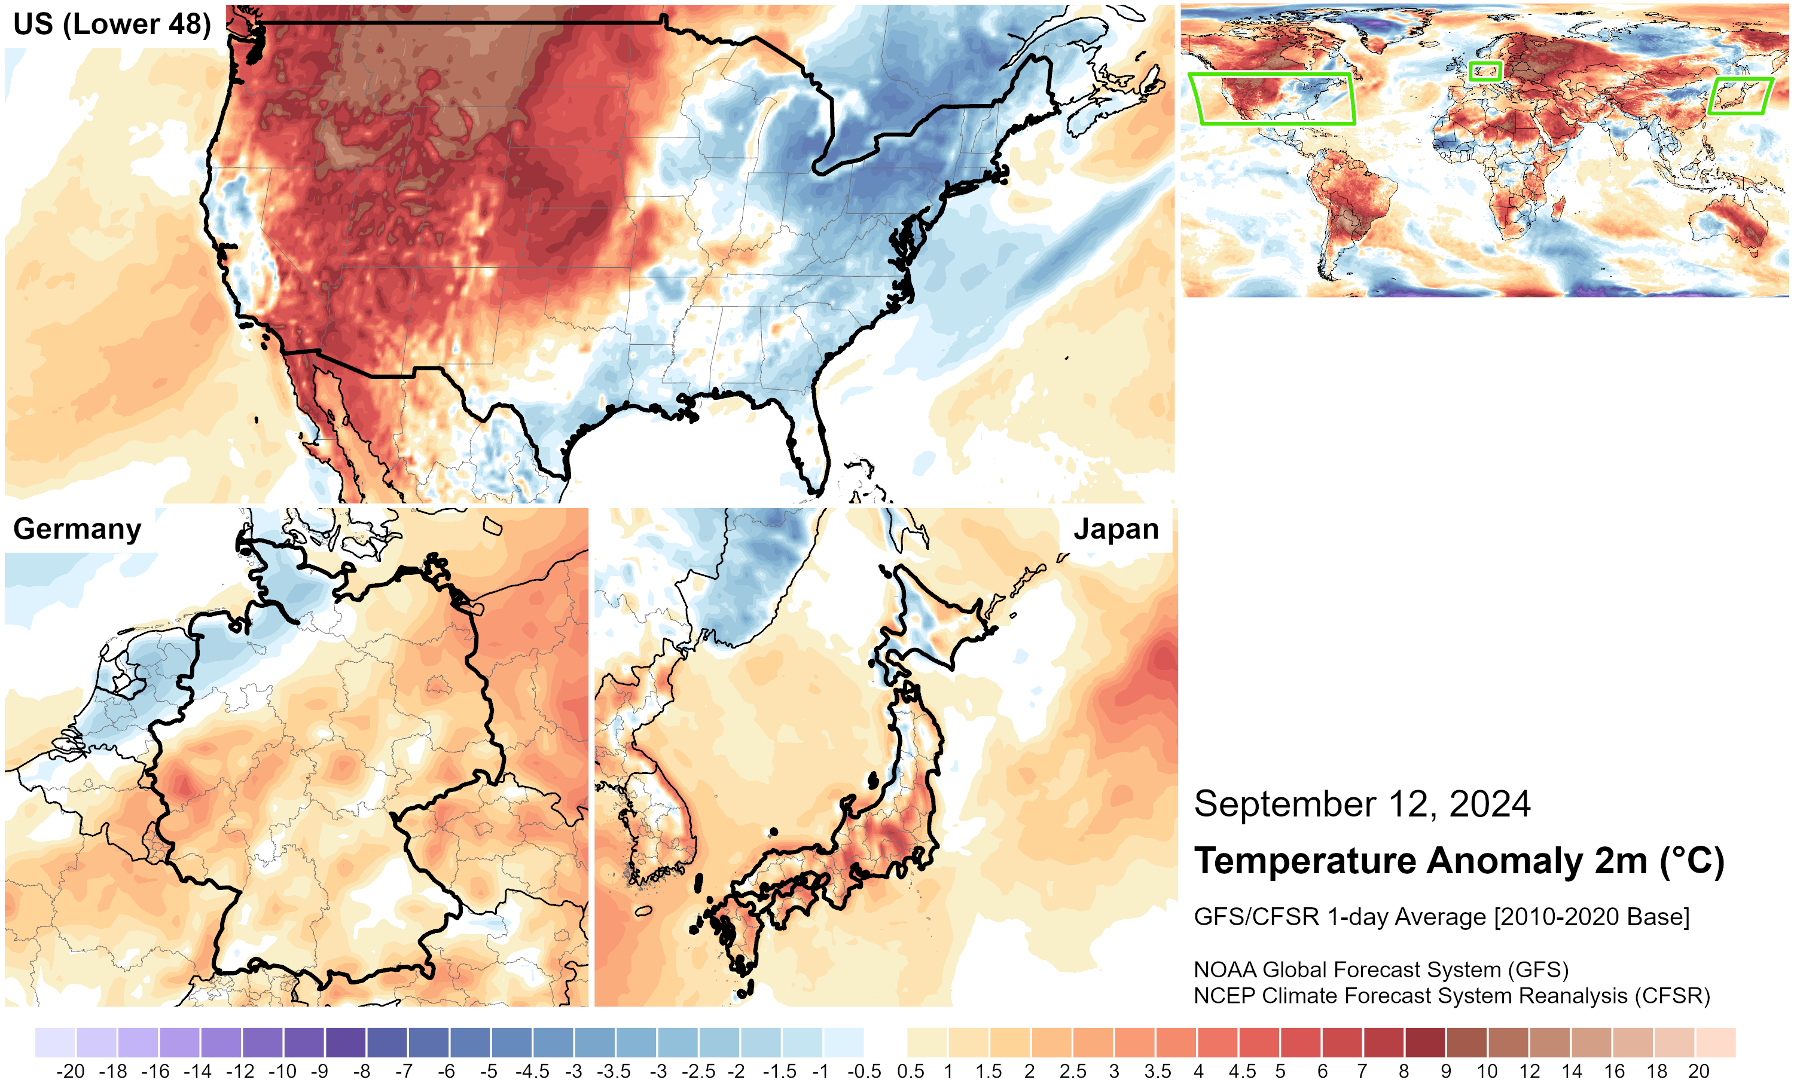

Slide 17
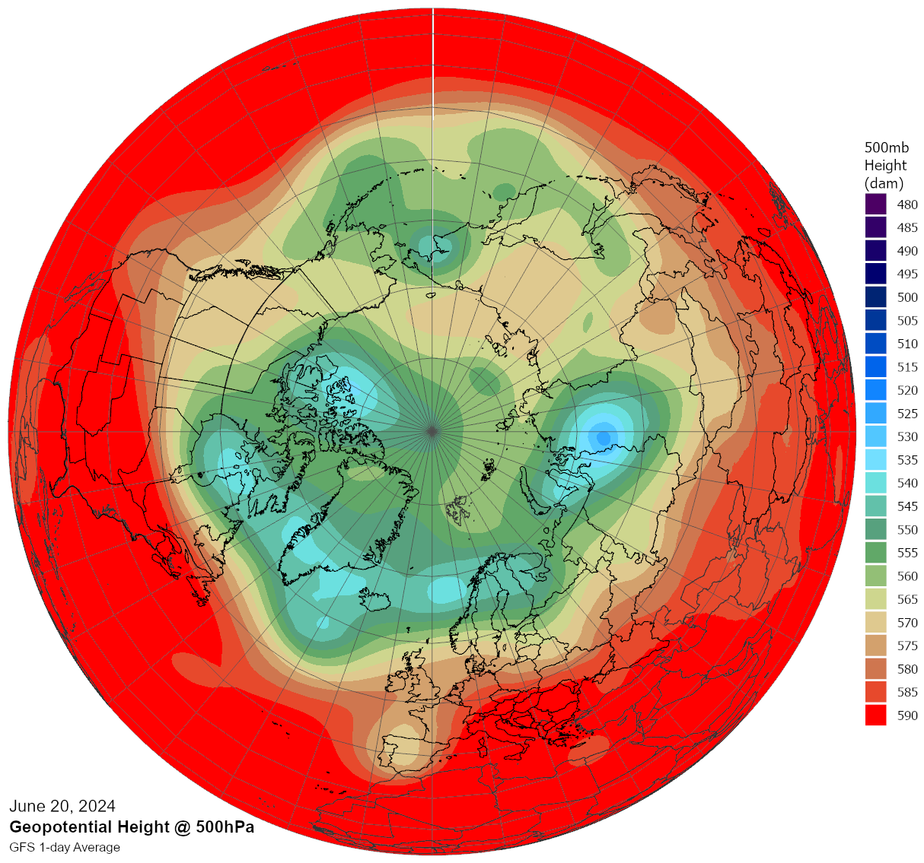

Slide 18
Conclusion
A brief explanation of how to access, process, and use weather data for map creation
Particularly beneficial for experts with no practical experience in weather or climate data, looking to incorporate it into their analysis
The importance of weather forecasting and reanalysis models in energy system modeling

