Slide 1
THE IMPACT OF LAND CONSOLIDATION ON THE CHANGE OF LAND COVER IN SELECTED CADASTRAL DISTRICTS
Monika Kopecká
Daniel Szatmári
Kateryna Polyvach
Tomáš Goga

Slide 2
PRESENTATION OVERVIEW
Introduction – background information about land consolidation
Research objective
Data and methodology
Study areas
Results
Conclusion
GeoKARTO 2024, Stará Lesná, September 5 – 6, 2024

Slide 3
INTRODUCTION
Slovakia – country with extremely scattered ownership
9.6 million plots
average area 0,45 ha
often 12 – 15 owners
98 million ownership relations
Compared to much larger Czech Republic – 10 millions ownership relations
Land consolidation – fundamental way to improve land efficiency, restructure rural space and revitalize rural economic
Process associated with a series of investment operations to improve functioning farms and the quality of live of the local community
GeoKARTO 2024, Stará Lesná, September 5 – 6, 2024

Slide 4
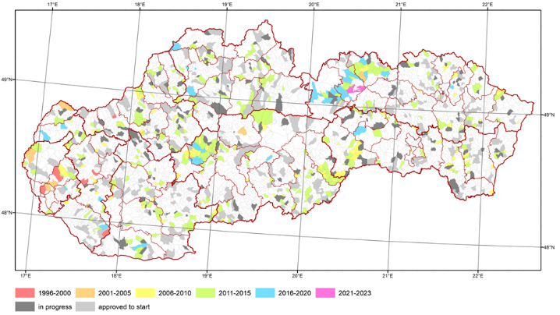
INTRODUCTION
Consolidation projects completed in 417 cadastral territories [2023] (11,7% of total of 3559)
Consolidated land 41 077 ha – 8,37 % country's area
More than 137 million EUR invested
114,5 million - EU resources
22,8 million EUR - budget of SR
How has this process contributed to optimizing land utilization ?
GeoKARTO 2024, Stará Lesná, September 5 – 6, 2024

Slide 5
INTRODUCTION
Act no. 330/1991 - land consolidation is understood as consolidation, division, dislocation, and arrangement of lots based on ownership
Act on Land Consolidation no. 487/2022 - at least 40% of the total amount of funds for the preparation of project documentation, the implementation and maintenance of common facilities and measures (roads to the newly created parcels, non-forest vegetation - windbreaks, tree rows, hedges)
GeoKARTO 2024, Stará Lesná, September 5 – 6, 2024

Slide 6
RESEARCH OBJECTIVE
Evaluate the benefit of land consolidation in terms of accessibility and increasing the diversity of non-forest woody vegetation
Municipalities in which more than 20 years have passed since the approval of land consolidation projects have been designated as study areas
The selected cadastral districts represented lowland agricultural land, sub-montane agricultural land, and urbanized land.
GeoKARTO 2024, Stará Lesná, September 5 – 6, 2024

Slide 7
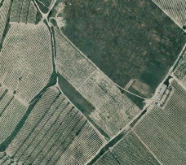
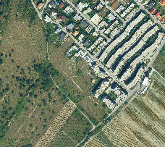
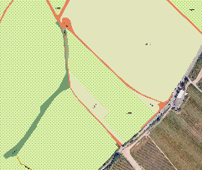
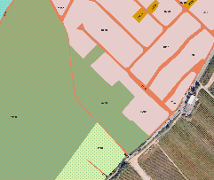
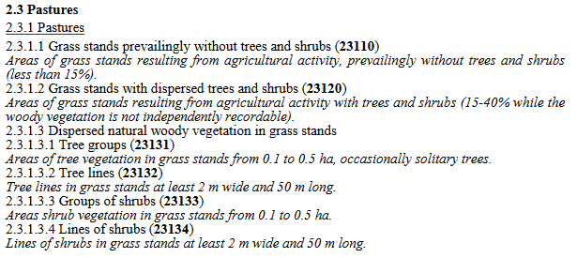
DATA AND METHODOLOGY
Land cover classes
five-digit codes, minimum mapping unit 0.1 ha, minimum change polygon 0,02 ha
Orthophotos from 2003 and 2020
Modified and extended version of CLC nomenclature
(Oťaheľ et al. 2017)
Landscape structure indices
extent of fragmentation, accessibility of agricultural plots:
Number of agricultural plots (N_{ap})
Average agricultural plot size (APS)
Accessibility (A_{cc})
abandonment rate and development rate:
Abandonment rate (AR)
Development rate (DR)
presence of small woody features in the agricultural landscape:
Share of non-forest woody features (S_{wf})
Number of non-forest woody features (N_{wf})
GeoKARTO 2024, Stará Lesná, September 5 – 6, 2024

Slide 8
DATA AND METHODOLOGY
Index | Definition of landscape
Number of agricultural plots (N_{ap}) | Number of polygons represented by agricultural land (CLC classes 2XXXX except for dispersed natural woody vegetation on arable land and grasslands (2115X and 2313X)
Average agricultural plot size (APS) | Average size of polygons represented by agricultural areas
Accessibility (A_{cc}) | Share of the number of polygons represented by agricultural land adjacent to the polygons representing roads (12212 and 12213) from the total number of number of polygons represented by agricultural areas
Abandonment rate (AR) | Share of abandoned agricultural land (CLC classes 22151, 22152, 22212, 22222, 22232) of the total agricultural land
Development rate (DR) | Share of artificial surfaces (CLC classes 1XXXX) of the total study area
Share of non-forest woody features (S_{wf}) | Share of small woody features polygons (classes 2115X, 2313X, 1223X) of the agricultural land (except for accompanying vegetation adjacent to roads with a paved surface, motorways, and railways)
Number of non-forest woody features (N_{wf}) | Number of polygons represented by CLC classes 2115X, 2313X, 1223X) of the agricultural land (except for accompanying vegetation adjacent to roads with a paved surface, motorways, and railways)
GeoKARTO 2024, Stará Lesná, September 5 – 6, 2024

Slide 9
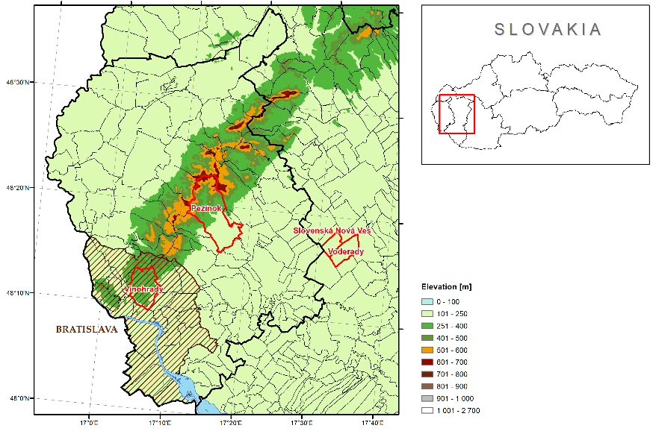
STUDY AREAS
Lowland agricultural land
Voderady (1 258 ha)
Slovenská Nová Ves (750 ha)
Submontane agricultural land
Pezinok (1 700 ha / 2 500 ha)
800 ha of arable land, 180 ha of permanent grassland, and 720 ha of vineyards
Urbanized land
Bratislava – Vinohrady (245 ha / 2 763,6 ha)
GeoKARTO 2024, Stará Lesná, September 5 – 6, 2024

Slide 10
RESULTS
significant differences in individual types of landscape
urbanized landscape:
increase in the abandonment of agricultural land, especially vineyards, by up to 65%
share of built-up surfaces increased significantly
a significant decrease in agricultural land and areas of non-forest woody vegetation
no positive effect of land consolidation on biodiversity or agricultural utilization
 | Bratislava - Vinohrady |  |  | Pezinok |  |  | Voderady |  |  | Slovenská Nová Ves
Index | 2003 | 2020 | 2020-2003 | 2003 | 2020 | 2020-2003 | 2003 | 2020 | 2020-2003 | 2003 | 2020 | 2020-2003
N_{ap} | 61 | 43 | -18 | 285 | 330 | 45 | 26 | 39 | 13 | 16 | 19 | 3
APS [ha] | 3.4 | 3.4 | 0 | 5.9 | 4.7 | -1.2 | 47.0 | 29.2 | -17.8 | 45.4 | 37.1 | -8.3
A_{cc} [%] | 91.8 | 97.7 | 5.9 | 95.4 | 98.5 | 3.1 | 96.2 | 97.4 | 1.2 | 100.0 | 100.0 | 0
AR [%] | 0.5 | 65.9 | 65.4 | 4.7 | 7.1 | 2.4 | 0 | 0 | 0 | 0 | 0 | 0
DR [%] | 8.6 | 31.5 | 22.9 | 53.8 | 61.7 | 7.9 | 1.0 | 8.2 | 7.2 | 1.7 | 4.2 | 2.5
S_{wf} [%] | 2.7 | 1.2 | -1.5 | 5.2 | 5.9 | 0.7 | 1.8 | 1.4 | -0.4 | 0.7 | 1.5 | 0.8
N_{wf} | 17 | 3 | -14 | 245 | 269 | 24 | 25 | 18 | -7 | 8 | 14 | 6
GeoKARTO 2024, Stará Lesná, September 5 – 6, 2024

Slide 11
RESULTS
submontane landscape:
increased number of agricultural plots by almost 16% at the end of the monitored period
increased accessibility of parcels
extensive abandonment of vineyards and arable land - abandonment index increased by 51%
increase in the development rate of almost 15%
increase in woody vegetation(S_{wf} and N_{wf}) - a consequence of the increased overgrowth of unused areas; NOT a targeted planting of woody plants as a result of land consolidation
 | Bratislava - Vinohrady |  |  | Pezinok |  |  | Voderady |  |  | Slovenská Nová Ves
Index | 2003 | 2020 | 2020-2003 | 2003 | 2020 | 2020-2003 | 2003 | 2020 | 2020-2003 | 2003 | 2020 | 2020-2003
N_{ap} | 61 | 43 | -18 | 285 | 330 | 45 | 26 | 39 | 13 | 16 | 19 | 3
APS [ha] | 3.4 | 3.4 | 0 | 5.9 | 4.7 | -1.2 | 47.0 | 29.2 | -17.8 | 45.4 | 37.1 | -8.3
A_{cc} [%] | 91.8 | 97.7 | 5.9 | 95.4 | 98.5 | 3.1 | 96.2 | 97.4 | 1.2 | 100.0 | 100.0 | 0
AR [%] | 0.5 | 65.9 | 65.4 | 4.7 | 7.1 | 2.4 | 0 | 0 | 0 | 0 | 0 | 0
DR [%] | 8.6 | 31.5 | 22.9 | 53.8 | 61.7 | 7.9 | 1.0 | 8.2 | 7.2 | 1.7 | 4.2 | 2.5
S_{wf} [%] | 2.7 | 1.2 | -1.5 | 5.2 | 5.9 | 0.7 | 1.8 | 1.4 | -0.4 | 0.7 | 1.5 | 0.8
N_{wf} | 17 | 3 | -14 | 245 | 269 | 24 | 25 | 18 | -7 | 8 | 14 | 6
GeoKARTO 2024, Stará Lesná, September 5 – 6, 2024

Slide 12
RESULTS
lowland agricultural landscape :
no case of abandonment of agricultural land
accessibility improved only to a minimal extent
slight increase in the fragmentation of agricultural land
several newly designed windbreaks were planted
urban development in both municipalities
 | Bratislava - Vinohrady |  |  | Pezinok |  |  | Voderady |  |  | Slovenská Nová Ves
Index | 2003 | 2020 | 2020-2003 | 2003 | 2020 | 2020-2003 | 2003 | 2020 | 2020-2003 | 2003 | 2020 | 2020-2003
N_{ap} | 61 | 43 | -18 | 285 | 330 | 45 | 26 | 39 | 13 | 16 | 19 | 3
APS [ha] | 3.4 | 3.4 | 0 | 5.9 | 4.7 | -1.2 | 47.0 | 29.2 | -17.8 | 45.4 | 37.1 | -8.3
A_{cc} [%] | 91.8 | 97.7 | 5.9 | 95.4 | 98.5 | 3.1 | 96.2 | 97.4 | 1.2 | 100.0 | 100.0 | 0
AR [%] | 0.5 | 65.9 | 65.4 | 4.7 | 7.1 | 2.4 | 0 | 0 | 0 | 0 | 0 | 0
DR [%] | 8.6 | 31.5 | 22.9 | 53.8 | 61.7 | 7.9 | 1.0 | 8.2 | 7.2 | 1.7 | 4.2 | 2.5
S_{wf} [%] | 2.7 | 1.2 | -1.5 | 5.2 | 5.9 | 0.7 | 1.8 | 1.4 | -0.4 | 0.7 | 1.5 | 0.8
N_{wf} | 17 | 3 | -14 | 245 | 269 | 24 | 25 | 18 | -7 | 8 | 14 | 6
GeoKARTO 2024, Stará Lesná, September 5 – 6, 2024

Slide 13
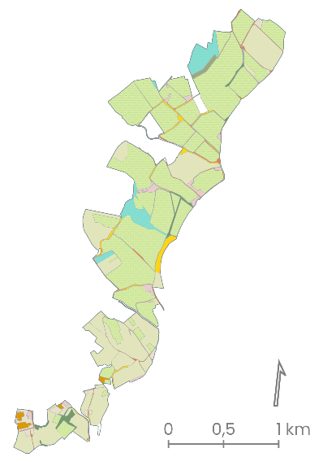
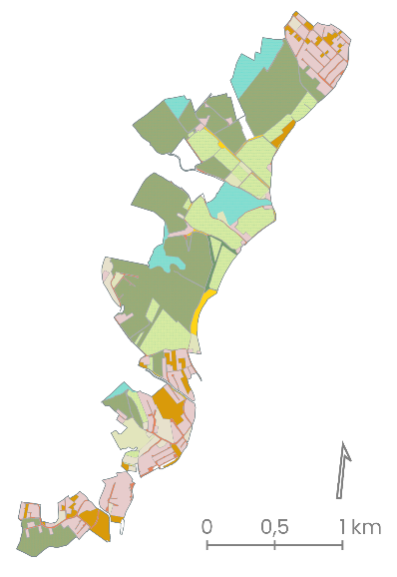
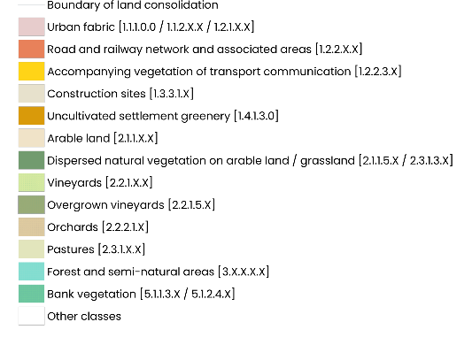
RESULTS
BRATISLAVA-VINOHRADY
significant increase in the development
the development rate increased
from 8.6% in 2003 up to 31.5% in 2020
newly built road network
located almost exclusively in new development areas
disappearance of areas of non-forest
woody vegetation
several areas of woody
vegetation became abandoned
extensive abandonment of vineyards
dominant change in terms of the agricultural landscape
the abandonment rate increased
from 0.5% in 2003 up to 65.9% in 2020
GeoKARTO 2024, Stará Lesná, September 5 – 6, 2024

Slide 14
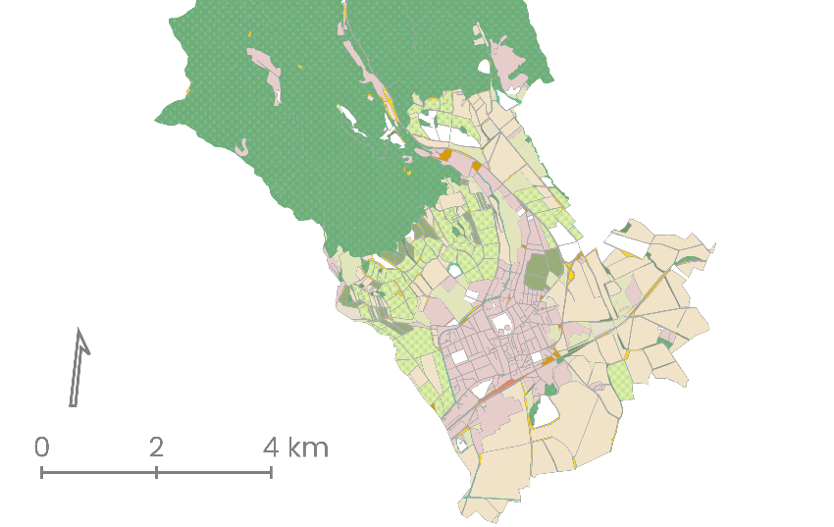
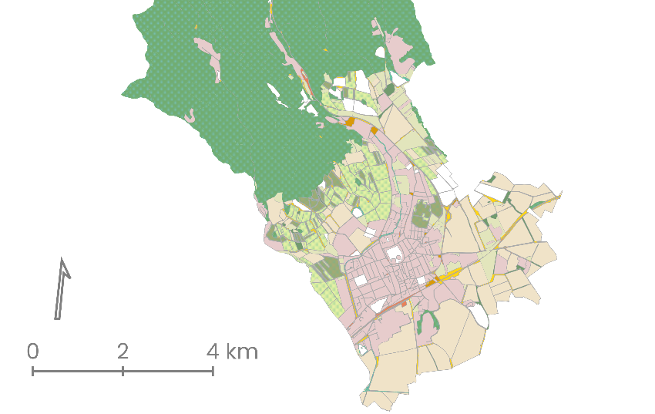
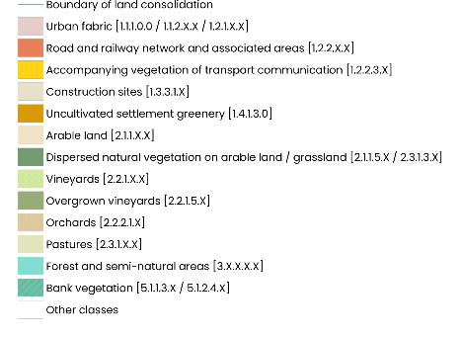
RESULTS
PEZINOK
increased number of agricultural plots
increased accessibility of parcels
extensive abandonment of vineyards and arable land
increase in the development rate
increase in woody vegetation
GeoKARTO 2024, Stará Lesná, September 5 – 6, 2024

Slide 15
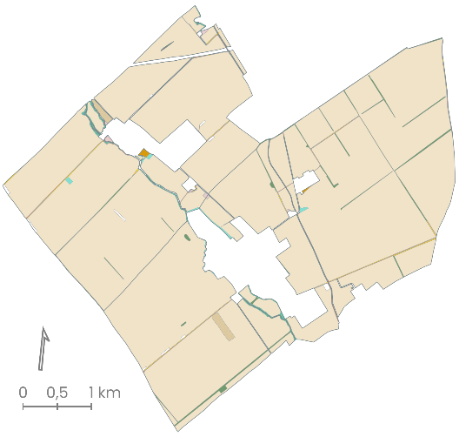
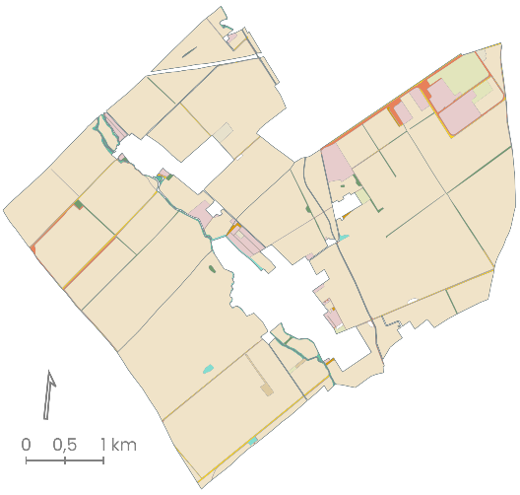
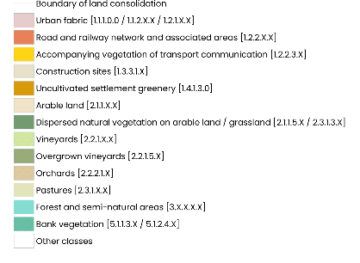
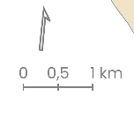
RESULTS
SLOVENSKÁ NOVÁ VES + VODERADY
no case of abandonment of agricultural land
several newly designed windbreaks were planted
urban development in both municipalities
GeoKARTO 2024, Stará Lesná, September 5 – 6, 2024

Slide 16
CONCLUSION
The presented procedure makes it possible to identify the benefit of land consolidations using indices relevant in terms of their main goals
Very high-resolution data - the high accuracy of the results, disadvantage - relatively high level of labour/difficulty in obtaining data
In all monitored types of landscape land consolidation contributed to the increase of built-up areas
Despite the slight improvement in the availability of agricultural plots, their spatial arrangement and way of use have not changed much
A significant trend of vineyard abandonment was recorded in the urbanized and submontane country
Planting new elements of non-forest woody vegetation was very rare, although it is one of the priorities of land management
GeoKARTO 2024, Stará Lesná, September 5 – 6, 2024

Slide 17
Thank you for your attention!
monika.kopecka@savba.sk
geography.sav.sk/en/

