Slide 1
Complex Forest Layers Mapping Based on Terrestrial Laser Scanning in Point Clouds
Mosab Arbain¹⁾, Ján Tuček¹⁾, Milan Koreň¹⁾
¹⁾Faculty of Forestry, Technical University in Zvolen, Slovakia.
Reference: mosab.arbain@tuzvo.sk

Slide 2
Contents
Introduction
Study objective
Study questions
Material and methods
Results and discussion
Conclusion

Slide 3
Introduction
The importance
Forest mapping, Tree identification, and measurements play crucial roles for forest management practices, which are highly important for ecological and socio-economic resources.
Field-based method is the conventional methods used to manual estimation of forest resources. Recently, remote sensing techniques have been used as the alternative and the modern tools for collecting forest resources data.

Slide 4
Forest inventory
For the forest resource dynamic changes, forest inventory is initial and takes a prerequisite mission for accurately and efficiently forest monitoring and evaluation.
It is necessary to estimate individual tree parameters including trees height, diameter at breast height (DBH), trees crown, and volume estimation, to fulfil the forest investigation processes requirements and to achieve the outcomes for forest resources assessment.

Slide 5
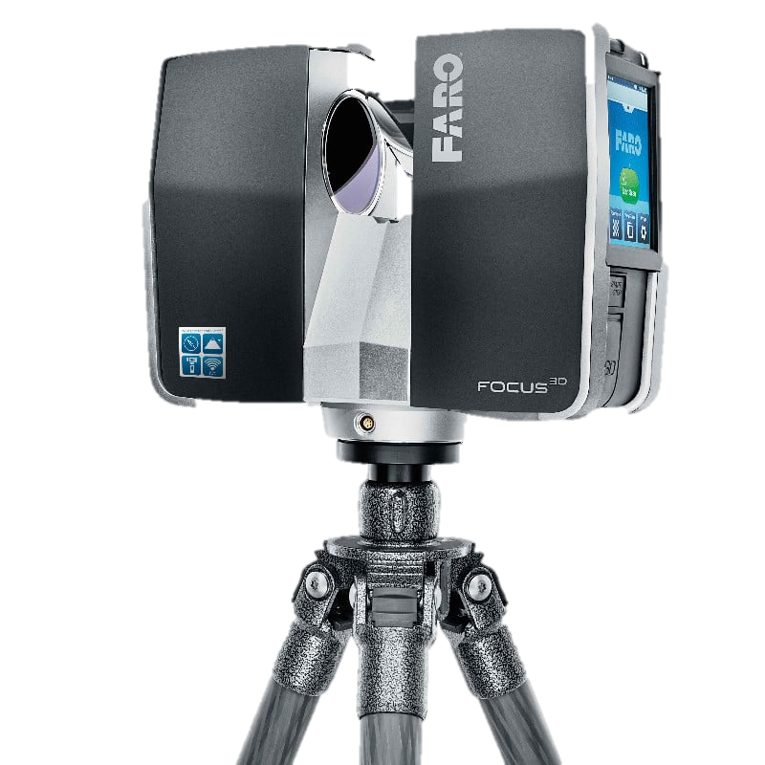
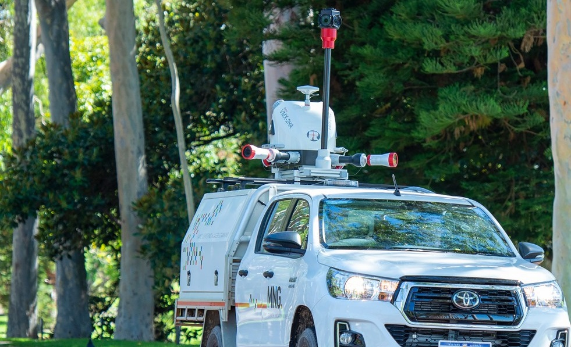
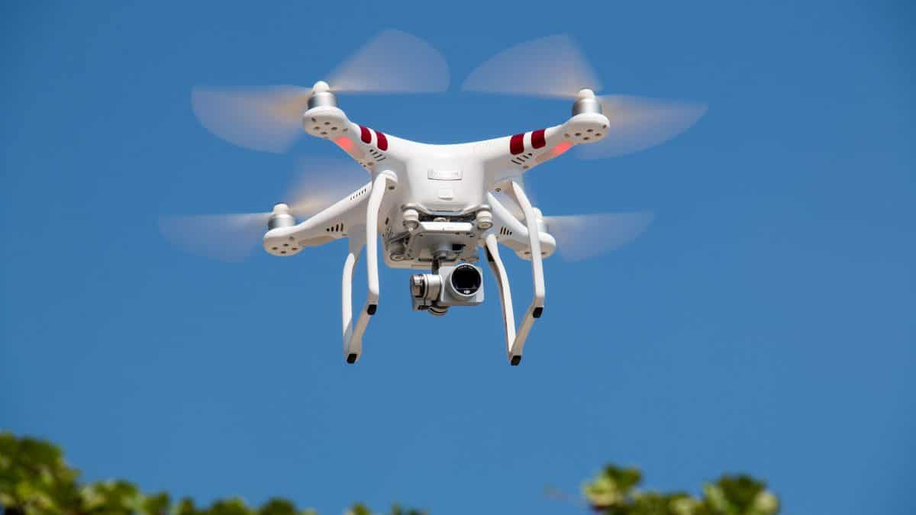
Modern methods
The light detection and ranging technology (LiDAR) is adapted to be the most recent tool for collecting forest resources information in 3D data. This advanced tool led to capture spatial, vertical and horizontal view of the scene, which introduces the data as point clouds for the processing procedures.
It leads to accurately estimate the tree parameters in a precise details structure which is necessary for tree layers classification, single tree segmentation, and growing stock estimation.
(Figures 3: “photos are from website”)
TLS
MLS
Drone

Slide 6
The limitation of previous tools
Conventional field-based methods are costly, labour-intensive, time-consuming, and their limit to be applied in wider areas as well as the low accuracy.
Remote sensing data based on the raster images’ limit is the capabilities view of trees parameters and structure.
Although ALS collect detailed 3D data in point clouds from wider areas, however it’s less accuracy when we targeted the tree trunks and understory compared to TLS.

Slide 7
The motivation of the study
The accurate tree detection and delineation is necessary to fitful the requirements of optimal evaluation of forests.
TLS is the most accurate tool used for collecting 3D data in point clouds from forest, especially in term of forest layers classification, and estimation of tree's trunk.
We are using TLS technology for the need of high segmentation accuracy and to avoid the shortages of the conventional methods, and the deficiency of ALS and MLS.

Slide 8
Study Objective
.
The objective of our study is to delineate forest layers, to estimate the standing trees and to partition the individual tree based on TLS from 3D data in point clouds.

Slide 9
The Study Questions
.
How the TLS tool can accurately capture forest layers in 3D data view.
How can the trees could be delineated and partitioned based on point clouds.
?
What is the suitable process to be used for precise trees classification and measurement.

Slide 10
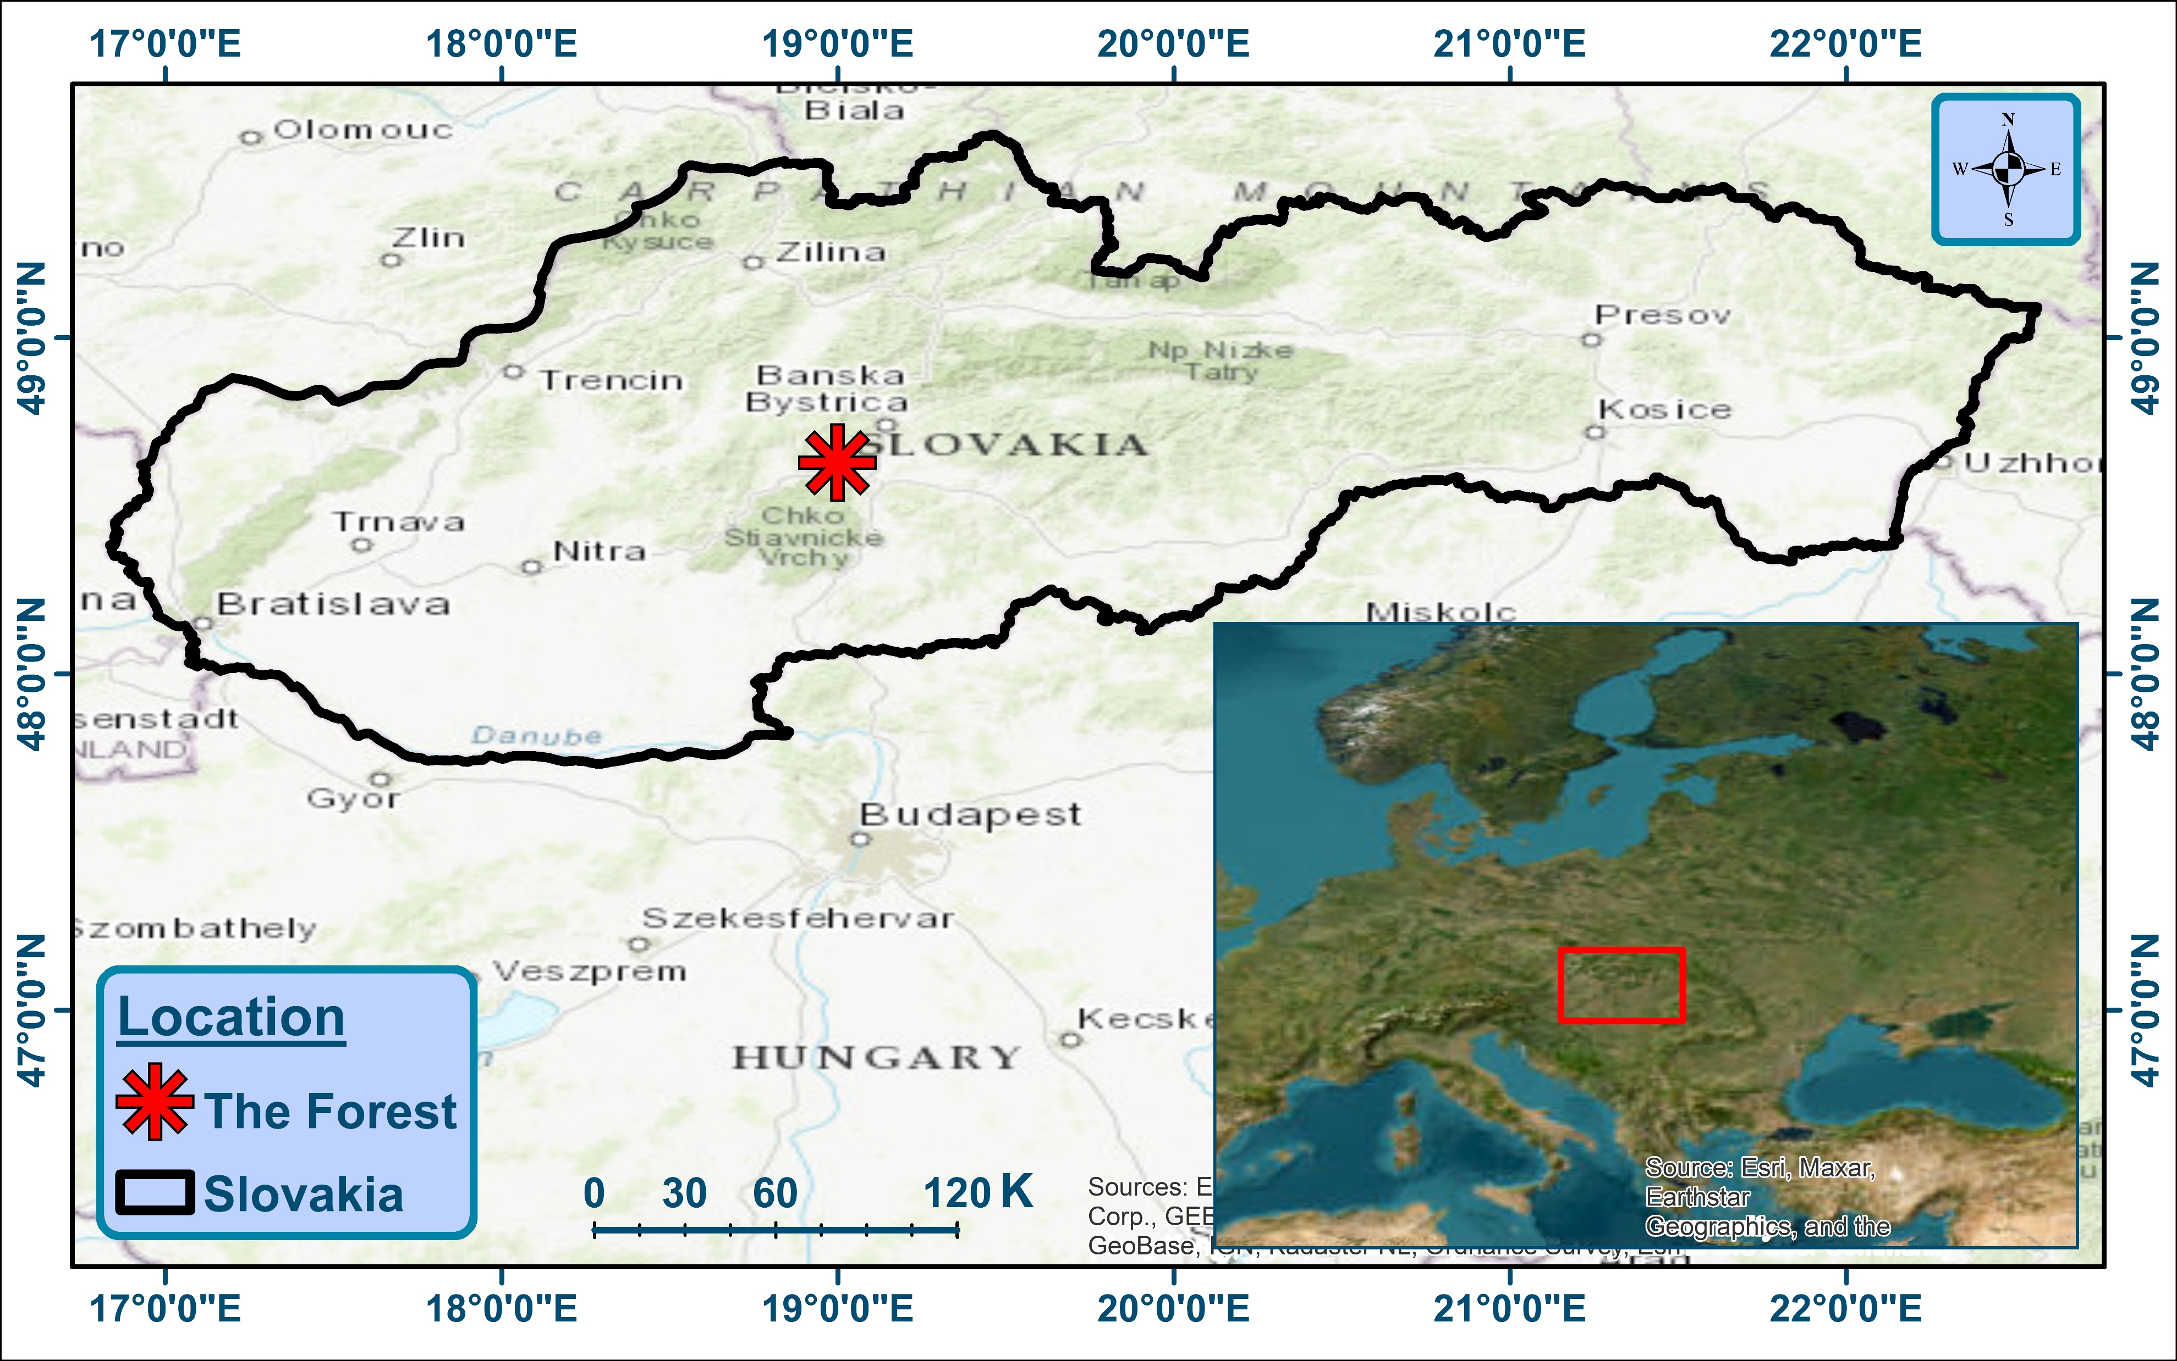
Material and method
Study site
The figure shows the study site which is lies within Banska Bistrica region, in the middle of Slovakia. It consists of large and ahigh dense trees.
Figure (3): Study area. Sources: ArcMap-10.8.2 processed by the author.

Slide 11
Scanning design
The scan design set of seven scan points in equal distances, the reference point is in the middle, and six scans are surround it, to covers the targeted trees and for the need of complete tree shapes in point clouds.

Slide 12
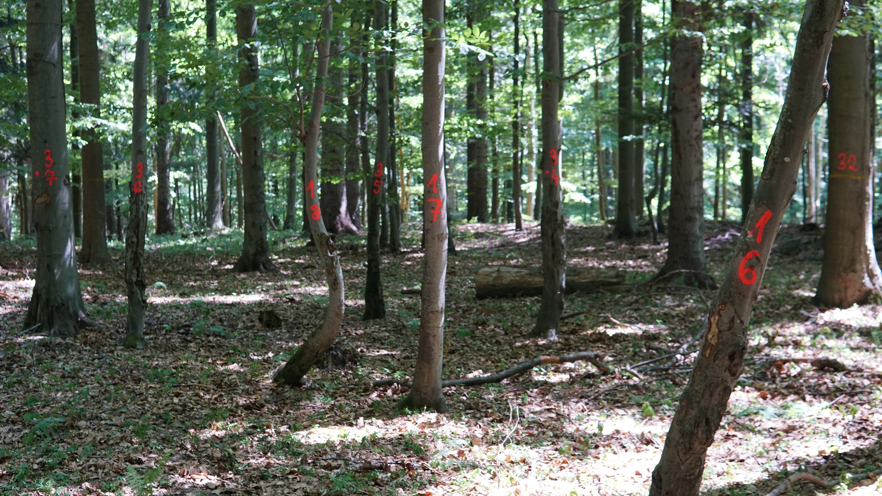
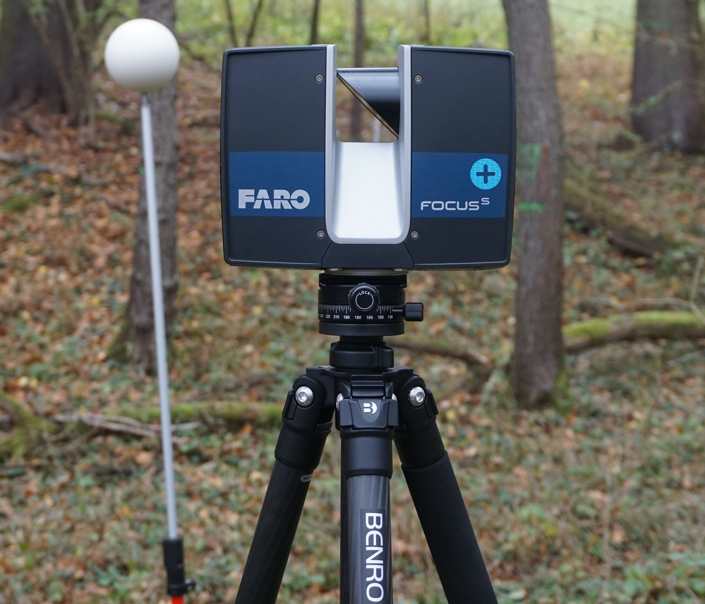
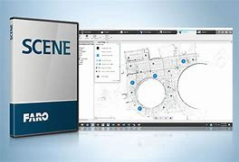
The tools used
Forest plot FARO Focus FARO SCENE

Slide 13
The study method
The proposed study workflow consists of TLS 3D data processing and outputs based on SCENE software.

Slide 14
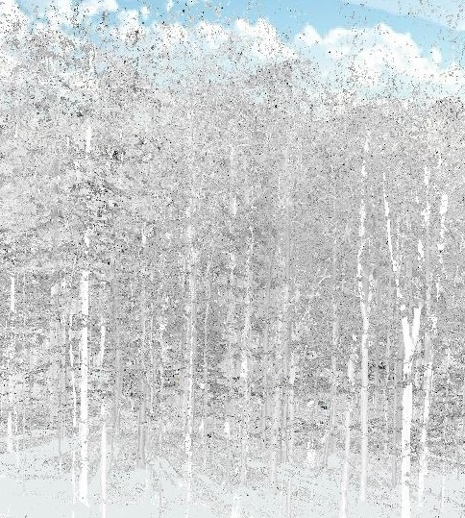
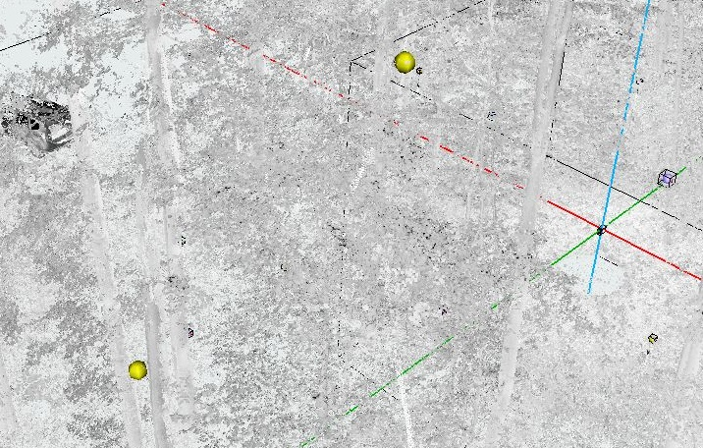
Data processing
Building point clouds
Scanned raw data
Manual filtering
Colorized scan in Z-Axis

Slide 15
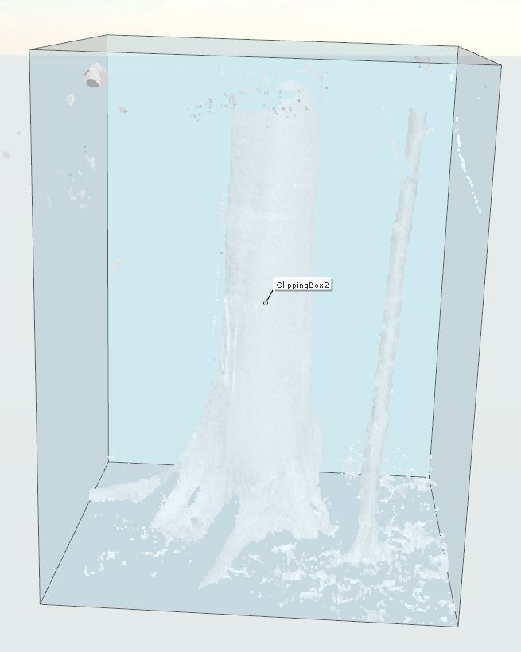
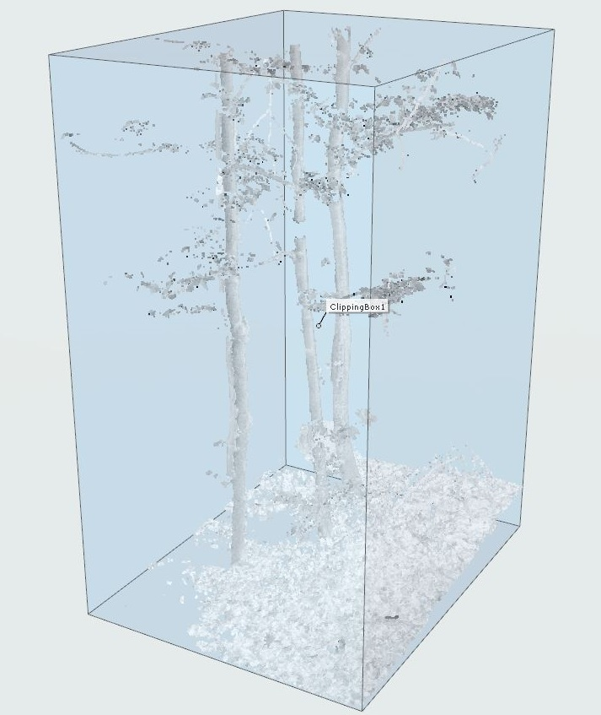
Identification of trees
The required trees for the measurements is the tree with diameter larger than 5 cm. Because the study focuses on the tree trunks, the classification is depending on the shapes and stems of the trees. Meanwhile, we investigate the capability of TLS to capture understory trees in point clouds.
Large tree
Understory/small trees
Trees and understory and trees with diameters less than 5 cm.

Slide 16
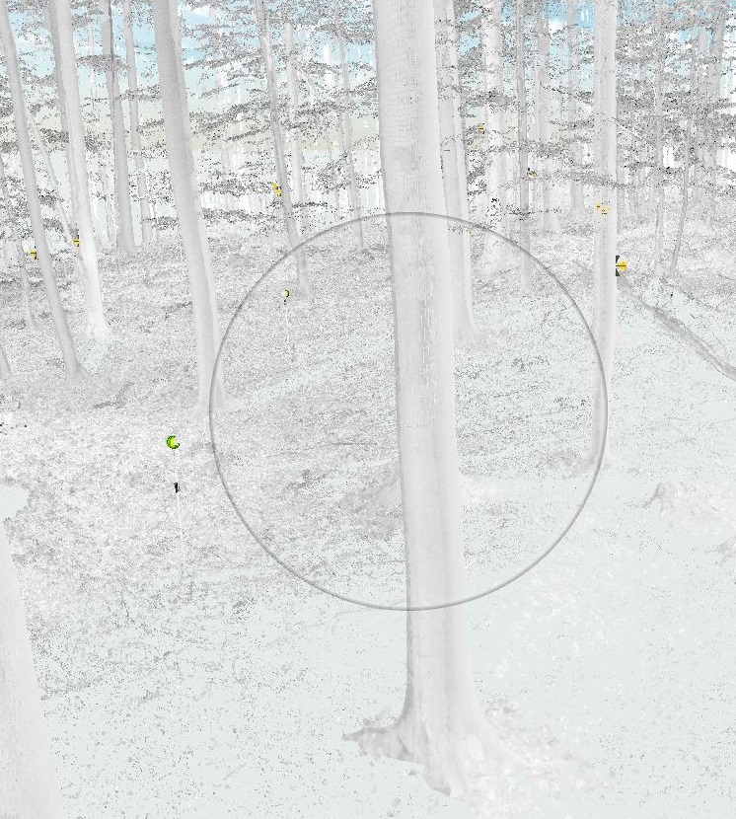
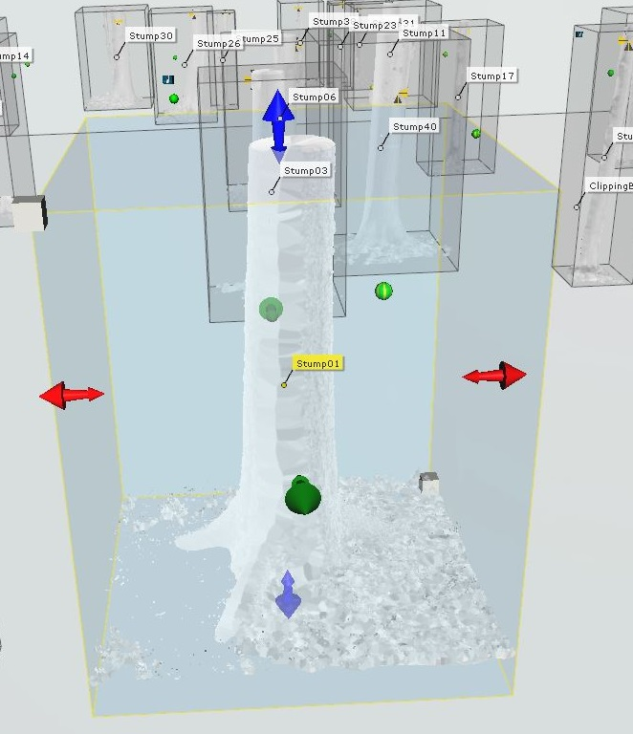
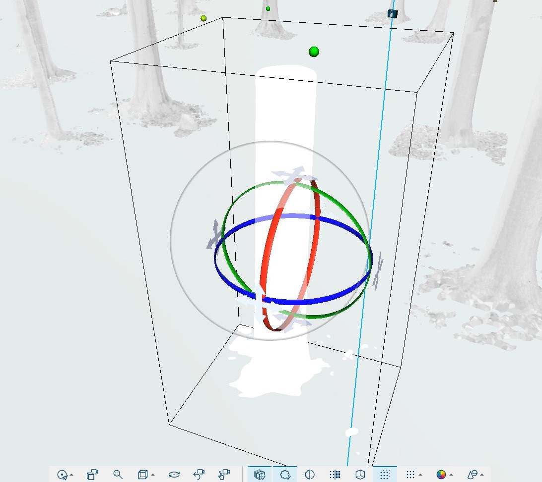
Trees enhancement
.
Selection of a single tree
Applying clipping-box
Mesh creation

Slide 17
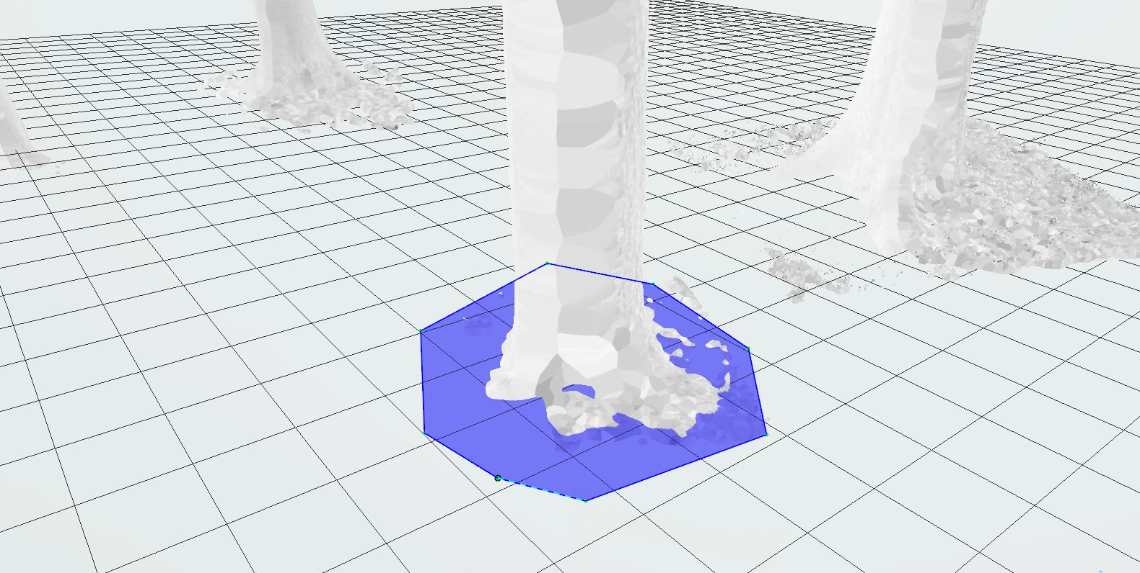
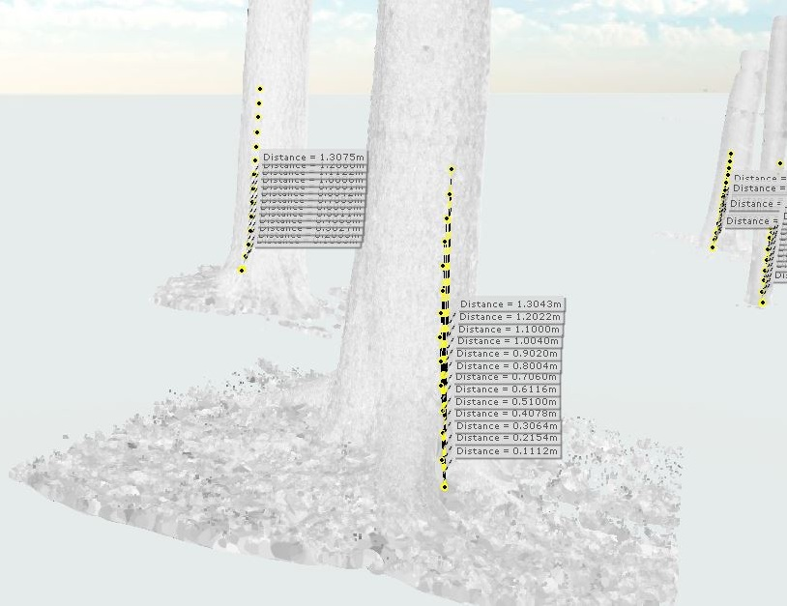
Tree measurements
Measuring tree heights
Identify tree basis
Height's measurement

Slide 18
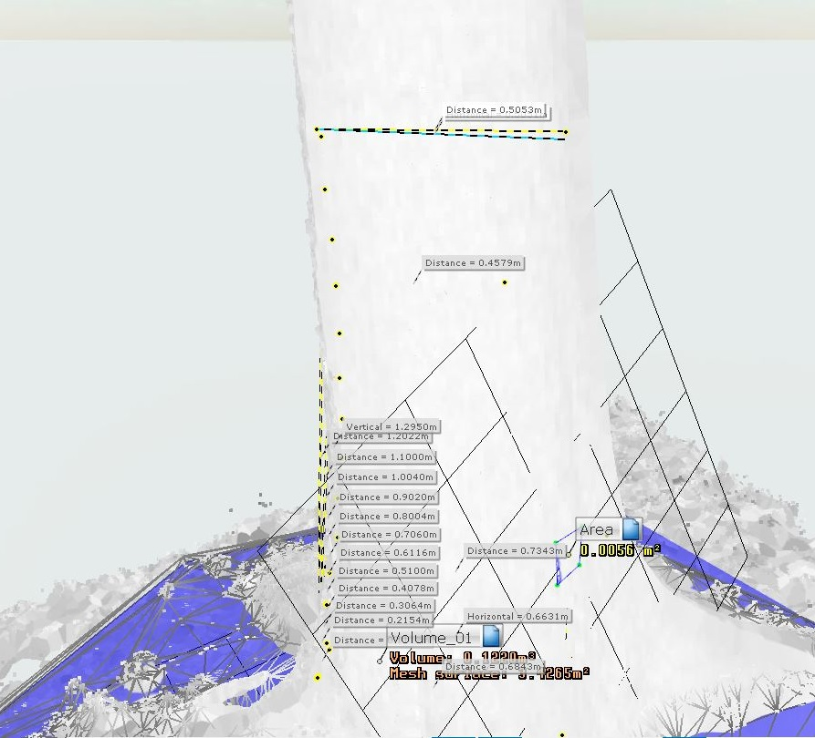
Measuring diameters and calculate volumes
Diameters measurement
Volume calculations

Slide 19
Results and discussion
The successful captured trees in the plot were 43 with almost complete point clouds. The average DBH (1.30 m) of the trees in the plot is 33.39 cm with the average volume of about 0.251 m³ depends on the automagical statistics of the parameters.
The understory and trees with the diameters less than 5 cm are either eliminated from the scan point clouds or avoided to be measured because of their unmatched shapes and misrepresentative of the optimal tree trunks.

Slide 20
Conclusion
.
The study attempted to map forest stands, to classify tree layers, and to estimate trees parameters based on 3D TLS data in point clouds from data that collected by FARO Focus laser scanning and processed by FARO Scene software.
It comes out by sufficient estimation of trees and understory, by using manual segmentation, identification and measurements.
The future suggestion is to apply quantitative structure model (QSM) for tree segmentation to compare the accuracy assessment.

Slide 21
Thank you

