Slide 1
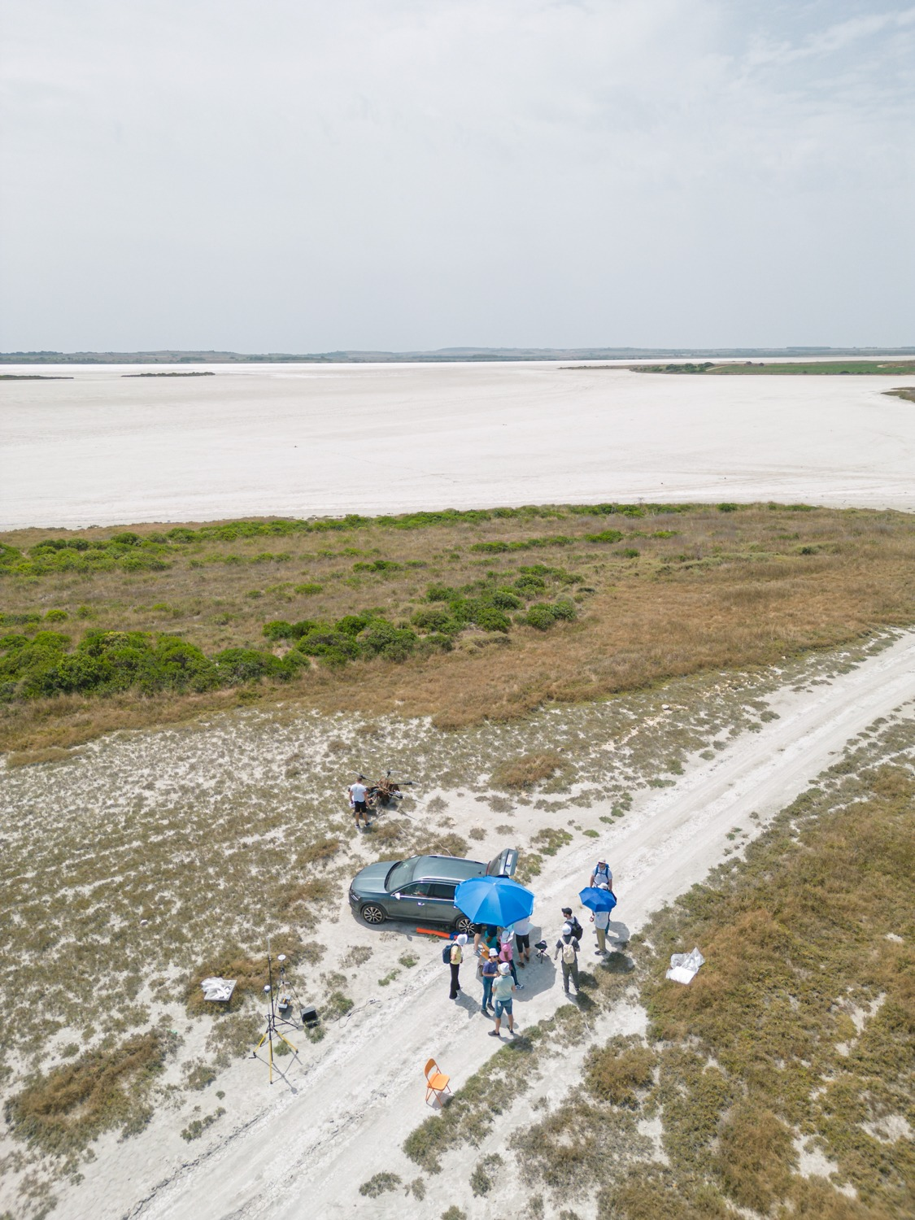
Airborne laser and hyperspectral scanning of a salt lake in Sardinia
for calibration of satellite hyperspectral sensors
GALLAY, KAŇUK, ŠAŠAK, ONAČILLOVÁ, NOVÁKOVÁ¹, MUSACCHIO², MELIS³
1 - Ústav geografie, Prírodovedecká fakulta UPJŠ v Košiciach, Jesenná 5, 04001 Košice
2 - Istituto Nazionale di Geofisica e Vulcanologia, Osservatorio Nazionale Terremoti, Roma, Italy
3 - Department of Chemical and Geological Sciences, Università di Cagliari, Cagliari, Sardinia, Italy,

Slide 2
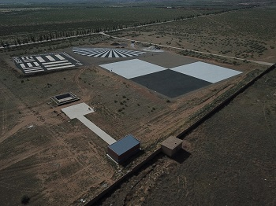
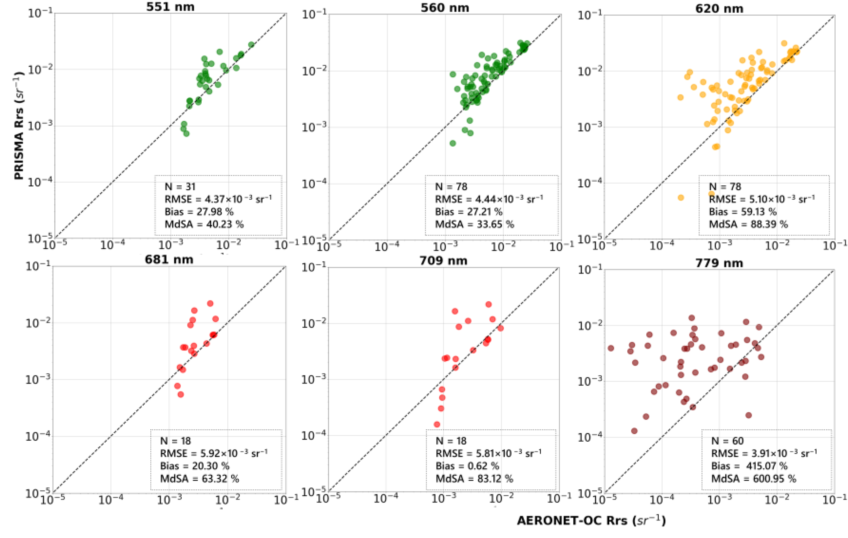
Introduction
Importance of terrestrial calibration sites for hyperspectral sensors.
Sal 'e Porcus Salt Lake potentially suitable for CAL/VAL of HS sensors
Calibration for satellite missions like ASI-PRISMA and DLR-EnMAP.
Image quality targets at Baotou calibration site © ESA
in situ and PRISMA L2d, Pellegrino et al. 2023. Remote Sens. 15(8), 2163.
Notes:
The Need for Calibration:
"Hyperspectral sensors can provide us with highly detailed data, but the accuracy of this data depends on how well we calibrate the sensors. Ground-based calibration is essential because it allows us to correct any errors or deviations that occur in satellite measurements."
Why Sal 'e Porcus?:
"Sal 'e Porcus offers a unique combination of characteristics that make it an ideal calibration site. Its flat surface and consistent spectral properties help ensure that satellite data remains reliable over time. The site’s dry evaporite crust forms naturally each summer, making it perfect for calibration during this period."
Importance for Satellite Missions:
"This site has already been selected by major hyperspectral satellite missions like ASI-PRISMA and DLR-EnMAP. These satellites need high-quality, ground-truth data to ensure the accuracy of their hyperspectral imaging, which is used for a wide range of environmental and scientific applications."

Slide 3
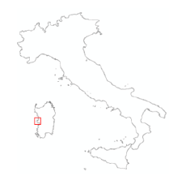
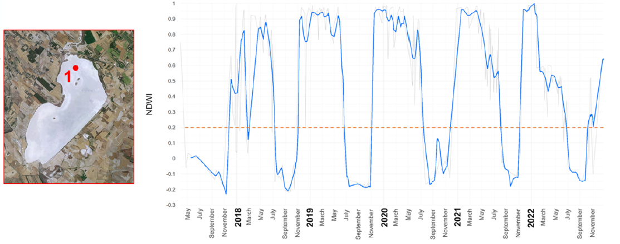
Introduction
Sal 'e Porcus Salt Lake
Seasonally dry, „white“ - spectrally stable salty surface
Calibration for satellite missions like ASI-PRISMA and DLR-EnMAP.
NDWI time series values derived from Sentinel-2 imagery for the point 1
Notes:
The Need for Calibration:
"Hyperspectral sensors can provide us with highly detailed data, but the accuracy of this data depends on how well we calibrate the sensors. Ground-based calibration is essential because it allows us to correct any errors or deviations that occur in satellite measurements."
Why Sal 'e Porcus?:
"Sal 'e Porcus offers a unique combination of characteristics that make it an ideal calibration site. Its flat surface and consistent spectral properties help ensure that satellite data remains reliable over time. The site’s dry evaporite crust forms naturally each summer, making it perfect for calibration during this period."
Importance for Satellite Missions:
"This site has already been selected by major hyperspectral satellite missions like ASI-PRISMA and DLR-EnMAP. These satellites need high-quality, ground-truth data to ensure the accuracy of their hyperspectral imaging, which is used for a wide range of environmental and scientific applications."

Slide 4
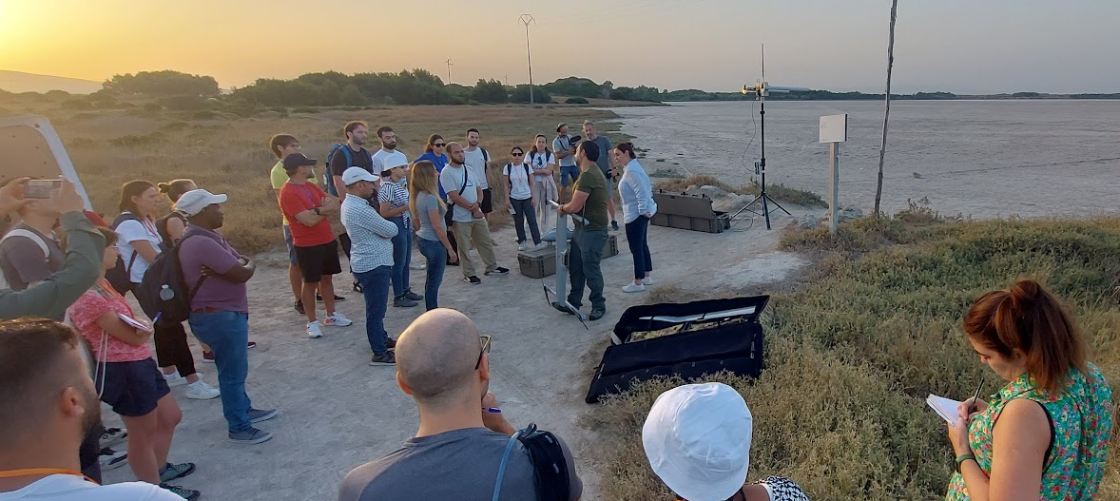
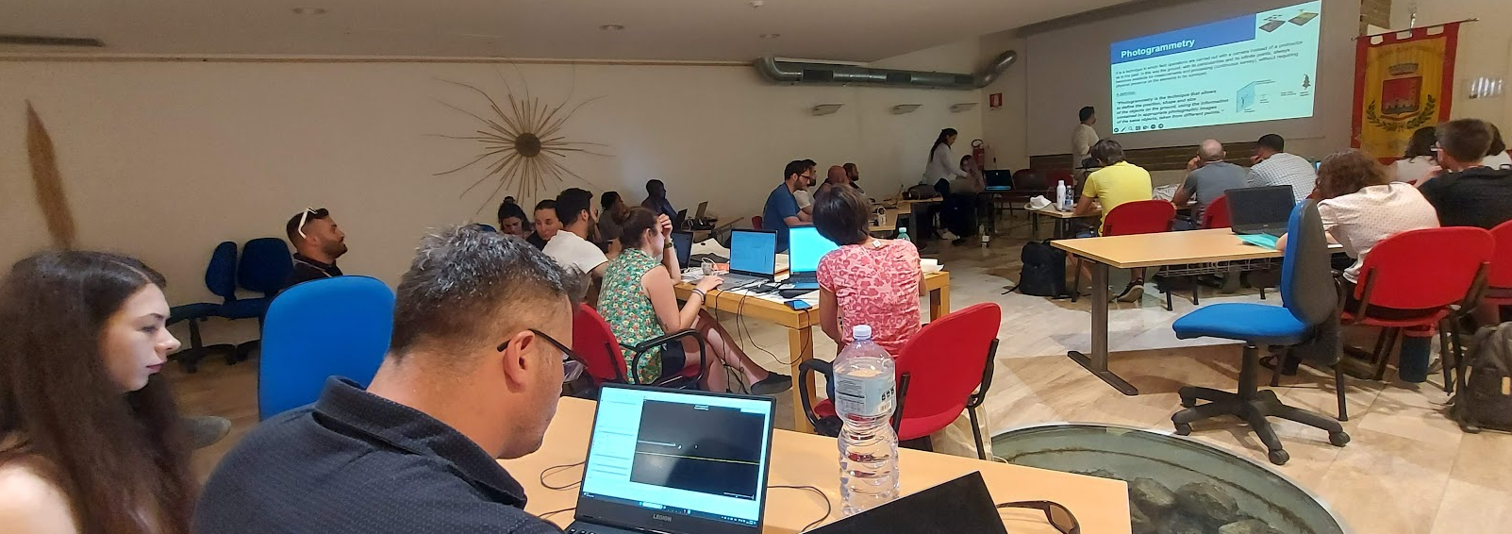
Objectives
Assess site suitability for CAL/VAL: Determine if the lake meets the requirements for hyperspectral satellite calibration.
High-resolution terrain mapping: Generate detailed digital terrain models using LiDAR technology and assess the terrain flatness.
Verify spectral homogeneity: Ensure consistent spectral properties across the lake's surface.
Evaluate long-term viability: Assess the site’s stability for future calibration and validation efforts.
IRSS 2023, Sardinia
Notes:
Site Suitability for CAL/VAL:
"The primary focus of our study is to evaluate whether Sal 'e Porcus can serve as an effective calibration site. Calibration/validation (CAL/VAL) requires locations with stable and consistent surface properties that can be used as a reference for hyperspectral satellites. This is key for ensuring the accuracy of satellite data."
High-Resolution Terrain Mapping:
"We used LiDAR technology to create detailed maps of the lakebed’s surface. Even slight variations in elevation can impact how a surface reflects light, which can cause inaccuracies during calibration. We need to ensure that the terrain is flat and stable enough for this purpose."
Spectral Homogeneity:
"One of the major goals of the study is to confirm that the lake's surface exhibits spectral homogeneity—meaning the surface has consistent spectral properties across its area. This is important because the satellite sensors need a uniform surface to ensure accurate calibration."
Long-Term Viability:
"Finally, we are assessing the long-term potential of the site. If we want to use Sal 'e Porcus for future calibration campaigns, it needs to remain stable throughout seasonal changes and across years. The study will help us determine whether this site can be reliably used for upcoming missions, such as ESA’s CHIME hyperspectral satellite."

Slide 5
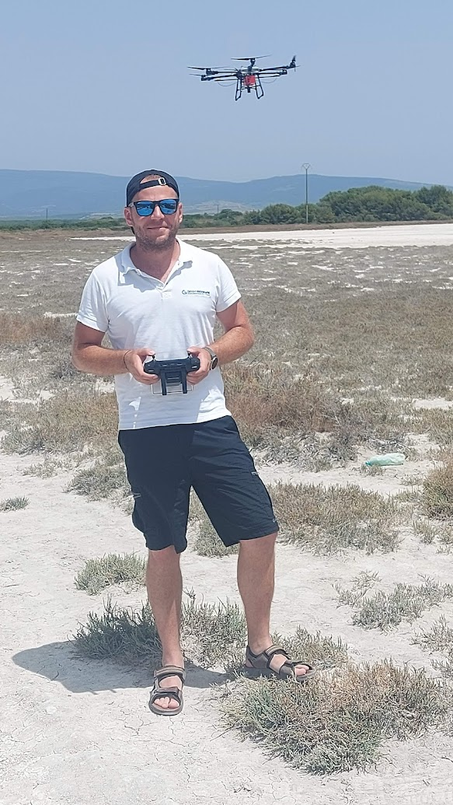
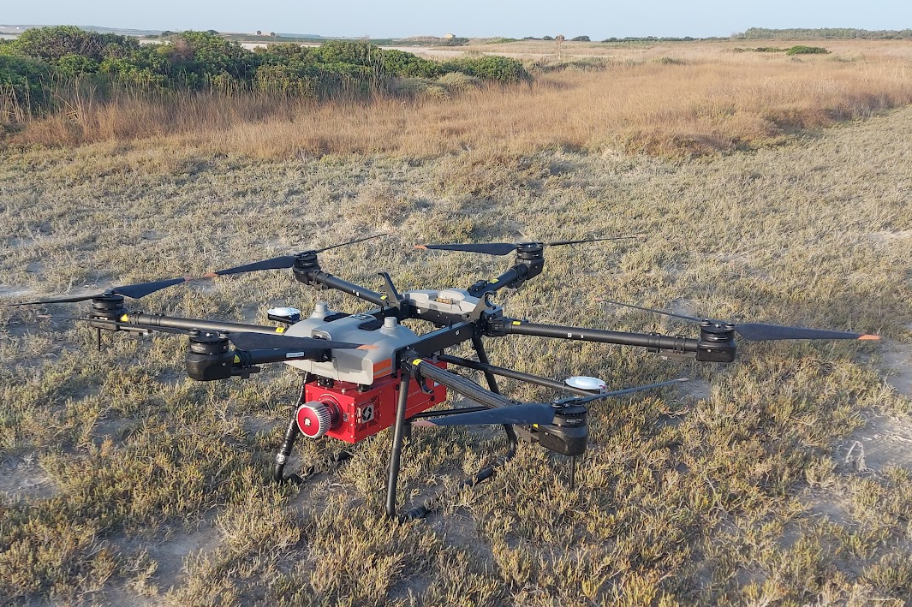
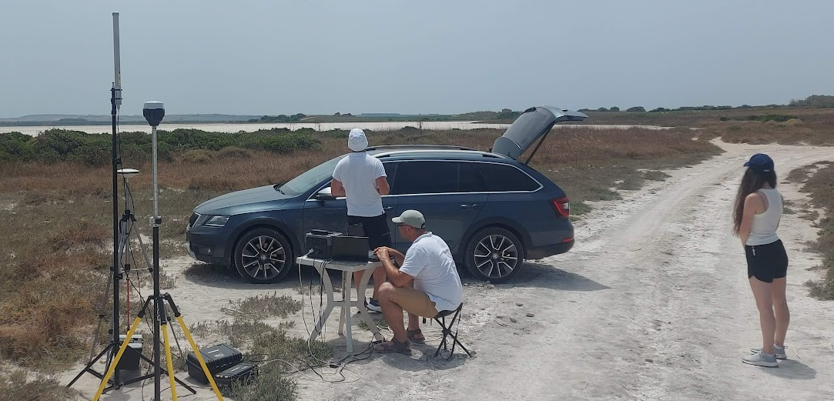
Data Collection Methodology
UAV laser scanning (lidar) mounted on DJI AGRAS T30 UAV.
UAV hyperspectral imaging
Ground-based spectroradiometry, GNSS ground control

Slide 6
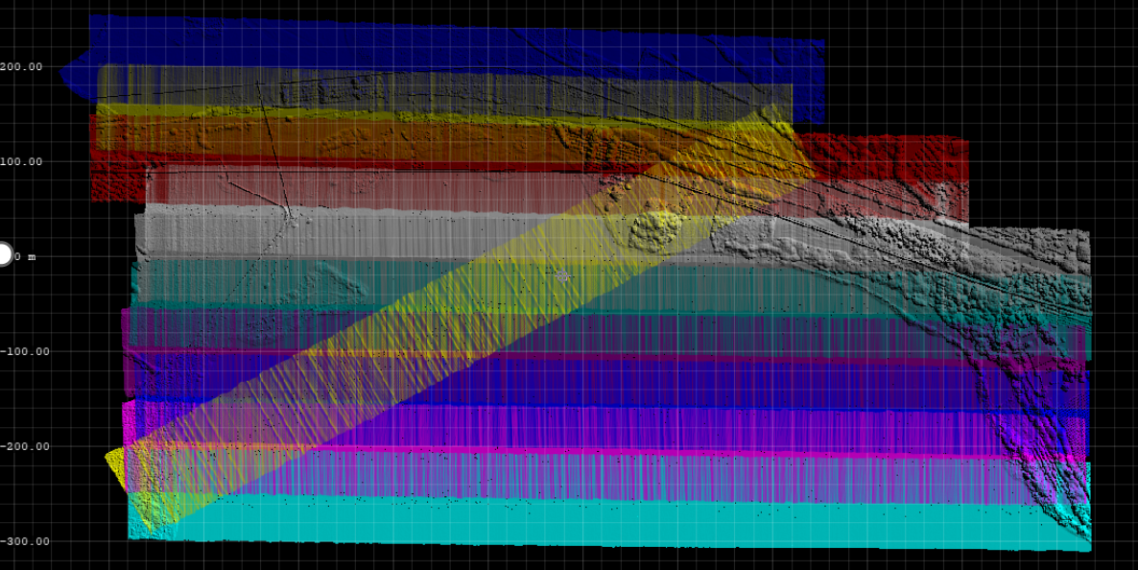
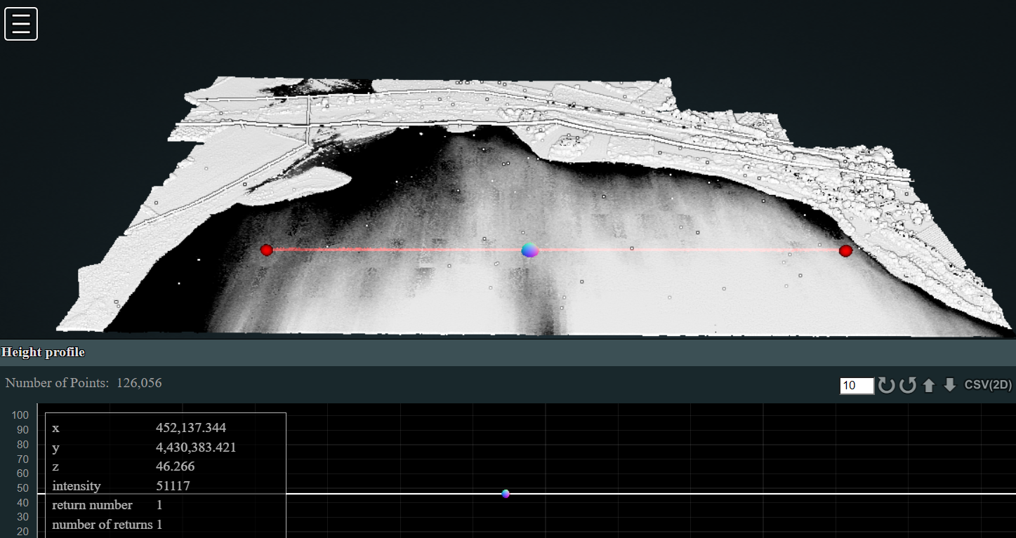
Data Collection
UAV LiDAR scanning for mapping topography
RIEGL VUX-1 scanner with OXTS GPS/INS
Digital Terrain Models (DTMs) of 0.2 m cell size for flatness assessment.
High-precision processing ensures minimal errors (standard deviation of 0.004 m).
Lidar flight lines and final point cloud in a perspective view towards north with a profile line. The grey tones represent elevation between 46.18 and 46.40 meters above sea level of the lake salt pan/bottom. The lidar data help to characterise the surface inclination which is were mild within the range of 0.2 m.
Notes:
We used LiDAR technology to map the terrain of Sal 'e Porcus in high resolution. The RIEGL VUX-1 scanner, mounted on a UAV, provided precise elevation data. By generating digital terrain models (DTMs), we confirmed that the lakebed is almost perfectly flat, with elevation variations of only 30 cm. Such flatness is crucial because it ensures consistent reflectance for satellite calibration.
Additionally, using advanced processing techniques, we were able to achieve a very high level of precision in the LiDAR data, with a standard deviation of just 0.004 meters. This level of accuracy minimizes errors and confirms the site's suitability for calibration.

Slide 7
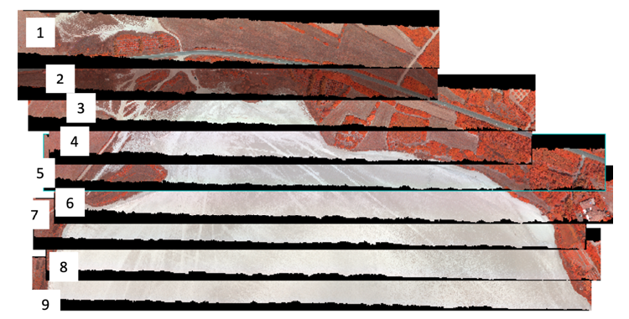
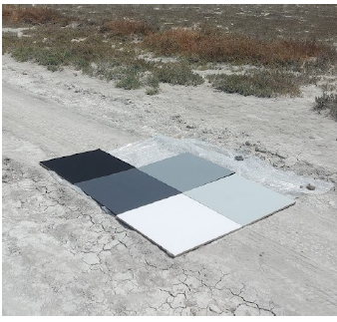
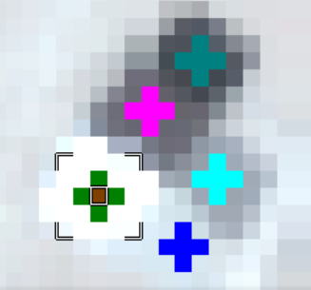
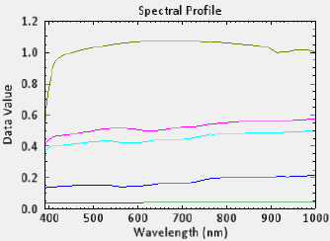
Data Collection
Hyperspectral data collection
Hyperspectral imaging with a linear (push-broom) AISA Kestrel 10 camera by SPECIM in 380-1000 nm range.
UAV flights 120 minutes with 8 cm pixel resolution from 80 meters.
Radiometric calibration using ASD FieldSpec and Empirical Line Correction.
Post-processed georectified atmospherically corrected HS data. Radiance (mW.cm⁻² . sr ⁻¹ .µm ⁻¹)*1000.00
Notes:
In parallel, we captured hyperspectral data to assess the spectral properties of the lakebed. Using the SPECIM AISA Kestrel 10 camera, we gathered spectral data across the 380-1000 nm range. This data allows us to analyze the surface's spectral characteristics in high detail, essential for validating satellite sensor calibration.
To ensure the hyperspectral data was accurate, we performed radiometric calibration using field targets and ground truth data. This confirmed that the spectral data was reliable and consistent. Importantly, we verified the spectral homogeneity across the lake, a key factor for determining its suitability for hyperspectral calibration.

Slide 8
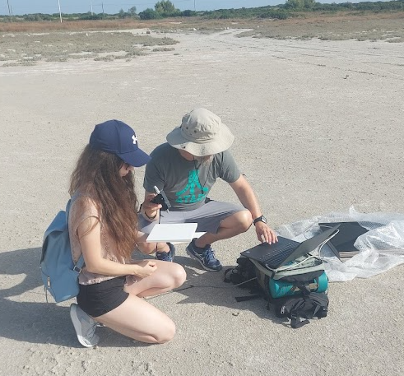
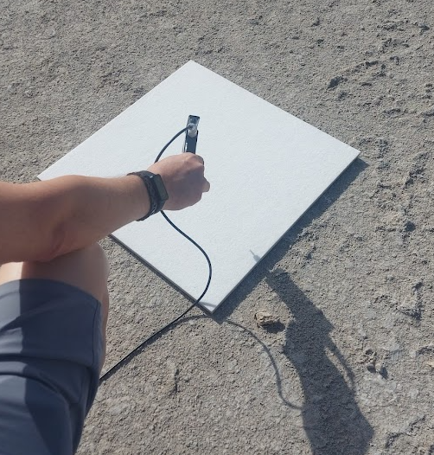
Data Collection
Ground-based measurements using ASD FieldSpec spectroradiometer

Slide 9
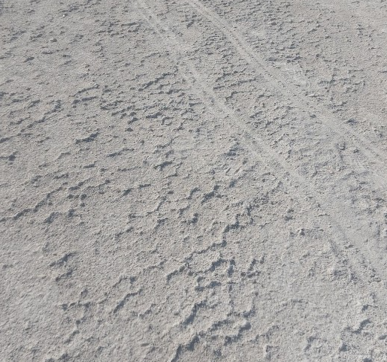
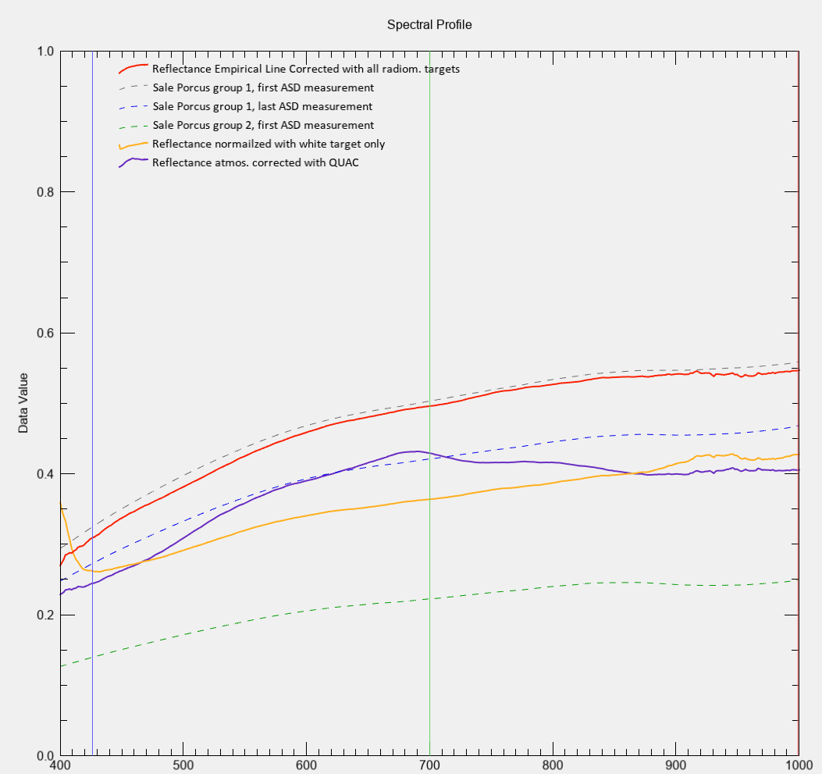
Key Findings
Flat terrain with elevation variation of less than 30 cm.
Spectral homogeneity confirmed in the 400-1000 nm range.
Mineralogical composition dominated by halite and gypsum.
Seasonal stability for calibration during the dry summer period.
Notes:
Flat Terrain and Minimal Elevation Variation:
The LiDAR data we collected showed that the lakebed is remarkably flat, with less than 30 cm of elevation variation across the entire surface. This flatness is important because it minimizes any distortions in the satellite data caused by surface irregularities, ensuring that we get accurate, reliable readings.
Spectral Homogeneity:
Using the AISA Kestrel 10 hyperspectral camera, we were able to confirm that the surface of the lake is spectrally homogeneous. This means that the reflectance values we observed were consistent across the northern part of the lake, which is critical for satellite calibration.
Mineralogical Composition:
Our analysis showed that the lakebed is primarily made up of halite and gypsum, both of which have highly reflective surfaces. This makes Sal 'e Porcus an ideal location for calibrating hyperspectral sensors because it provides a stable, reflective surface that satellites can use to fine-tune their readings.
Stability and Seasonal Suitability:
The lakebed dries out every summer, forming a stable salt crust that lasts from May to September. This drying period is consistent from year to year, making it a reliable site for repeated calibration activities. The consistency of the site over time further validates its use for future satellite missions.

Slide 10
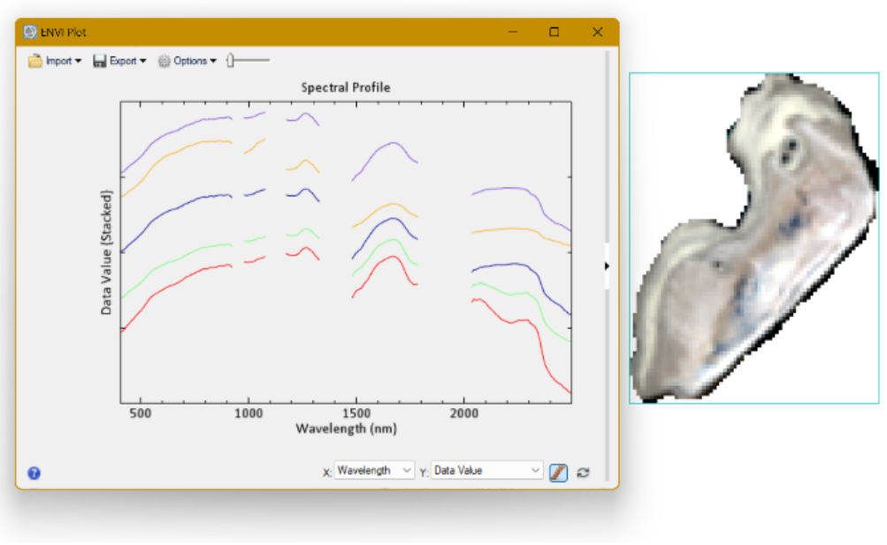
Conclusions
UAV HS data spectrum
Sal 'e Porcus is a reliable long-term calibration site.
Flat terrain and spectral stability make the site ideal for hyperspectral calibration.
Calibration potential confirmed for current and upcoming HS satellite missions (ASI-PRISMA, DLR-EnMAP, ESA CHIME).
Additional data collection, machine learning integration, and site expansion in the future.
+
PRISMA L2D pre-processed image of the salty pond,
showing different horizons
9
Notes:
Sal 'e Porcus as a Calibration Site:
Sal 'e Porcus offers a unique combination of characteristics that make it ideal for satellite sensor calibration. Its flat terrain, spectral homogeneity, and mineral composition provide a stable and predictable surface that satellites can use to calibrate their sensors over time.
Support for Hyperspectral Missions:
The site is already being used for missions like ASI-PRISMA and DLR-EnMAP, which rely on accurate ground-based data for calibration. Furthermore, its stability makes it suitable for future hyperspectral missions like ESA's CHIME, ensuring long-term viability as a calibration site.
Key Advantages:
One of the key advantages of Sal 'e Porcus is its large, homogeneous surface. This makes it an excellent target for satellite calibration, as there is a minimal risk of data distortions due to surface variability. Additionally, its high reflectivity ensures that the satellites receive a strong signal, even across multiple wavelengths.

Slide 11
Airborne laser and hyperspectral scanning of a salt lake in Sardinia
Grazie per attenzione :)
for calibration of satellite hyperspectral sensors
GALLAY, KAŇUK, ŠAŠAK, ONAČILLOVÁ, NOVÁKOVÁ¹, MUSACCHIO², MELIS³
1 - Ústav geografie, Prírodovedecká fakulta UPJŠ v Košiciach, Jesenná 5, 04001 Košice
2 - Istituto Nazionale di Geofisica e Vulcanologia, Osservatorio Nazionale Terremoti, Roma, Italy
3 - Department of Chemical and Geological Sciences, Università di Cagliari, Cagliari, Sardinia, Italy,
Resources:
Melis, Musacchio, Casu, Collu, Correa, Sedda, Silvestri, Buongiorno, Rabuffi, Andreucci, Kanuk, Gallay, Onacillova, Sasak, Naitza, Fantini, Dessì, Noli (2024). First results of the spectral characterisation of a salt flat in Europe: the Sal 'e Porcus salty pond. ISPRS Archives, Technical Commission III Mid-term Symposium on Remote Sensing
4-8 November 2024, Belém, Brazil.

